Slide 1
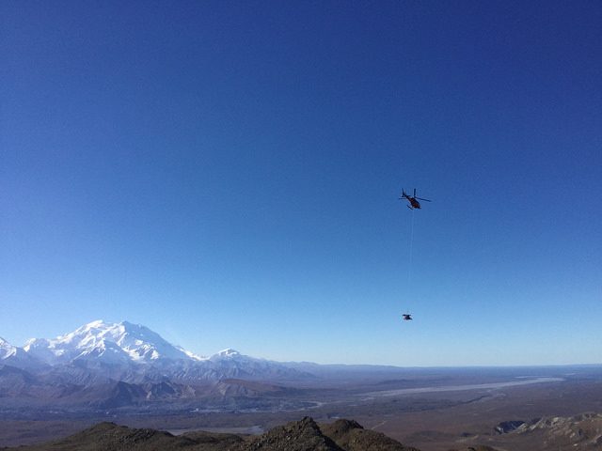
Alaska Regional Network (AK): Overview
Notes:
I am with the Alaska Earthquake Center and we are part of the University of Alaska Fairbanks. While I am the only listed author on this presentation, the data analyzed here is the product of efforts of the entire staff of the Earthquake Center, so I would like to acknowledge all of their contributions.
In The background image you see mount Denali in the Denali National park in Alaska and the view is from one of our seismic monitoring sites that became part of the USArray project. And here is the helicopter carrying away some equipment after the site upgrade.

Slide 2
Earthquake Center mission and historical perspective
Regional seismic network established in Alaska in late 60s- early 70s, in the wake of the 1964 M9.2 Great Alaska earthquake.
AEC formally established in 1987 to:
- Assess seismic hazards for Alaska;
- Monitor earthquake activity by collecting and analyzing seismic data;
- Provide information and assistance to State and local agencies, public and research community in planning to reduce risks to lives and property.
We have multiple state, federal and private industry partners.

Slide 3
Earthquake Center - Current state
We are members of ANSS – Advanced National Seismic System. One of our key responsibilities is real time earthquake reporting for Alaska region.
We collect, analyze and archive data from about 600 seismic sites in the State, and also from our neighbors Canada and Russia and Global Seismic Network.
In recent years we have been reporting over 40,000 local and regional earthquakes.
We are responsible for maintenance of 150 seismic sites.
We provide seismic monitoring of the Trans-Alaska Oil Pipeline, and hydro-electric dams.
We participate in the Tsunami Hazard program by producing tsunami inundation maps for coastal communities in the State.
We have staff of about 15.

Slide 4
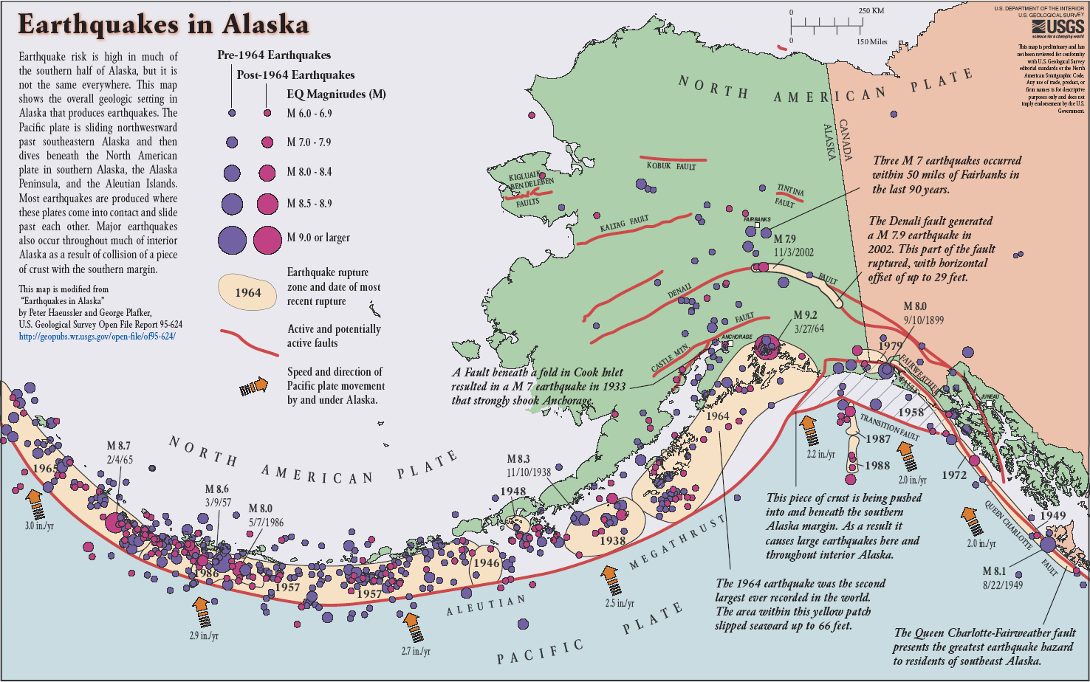
Tectonics of Alaska
Notes:
Just a quick introduction into tectonics of Alaska. It is dominated by the Pacific plate subduciton along the southern Alaska margin and the Aleutian arc. This plate boundary produced a number of major earthquakes within the past 100 years. The intermediate depth seismicity extends down to 300 km in some places. In southeast Alaska the plate boundary follows the strike-slip Queen Charlotte fault. Away from the plate boundary, there is a number of significant crustal faults, including the Denali fault. Crustal faulting extends hundreds of km away from the plate boundary into northern and western Alaska and western Canada. This map only contains magnitude 6 and greater earthquakes as of 10 years go, but In my later slides you will be able to see more detailed seismicity distribution.

Slide 5
Regional seismic network (2018)
About 585 sites total in Alaska and western Canada (not including urban strong motion networks)
Alaska Earthquake Center (AK)
USArray (TA)
Alaska Volcano Observatory (AV)
Other: GSN, US, AT, CN, FLATS
Notes:
Alaska has a regional seismic network that dates back to 1960s. This map illustrates current locations of seismic monitoring sites. It’s the most comprehensive coverage that ever existed in the state.
The network is composed of sites that are maintained by different agencies. The most significant contributors are the Alaska Earthquake Center, Alaska Volcano Observatory and the most recent addition of the USArray project.
In my presentation I’ll be comparing earthquakes reported with this station configuration before USArray project and with the presence of USArray project.

Slide 6
Network Summary
AEC operates 150 seismic monitoring sites:
  About 70 sites have co-located broadband and strong motion sensors
  32 sites are strong motion only, including Fairbanks and Anchorage urban networks
  1 structural array (Engineering building on UAF campus)
  1 short period site (last remaining in the network)
100% digital telemetry (radio, cell, satellite, microwave network, internet)
Digitizers: Kinemetrics Q330, Q330S, Basalt, Etna2
Sensors:
  Kinemetrics STS2, STA5a, Episensor
  Nanometrics T120, T240, Titan
  Guralp (very few) GMT5T, CMG5Tc, 3EST, 3T
Acquisition, processing and archival is via Antelope software (BRTT, Inc.)

Slide 7
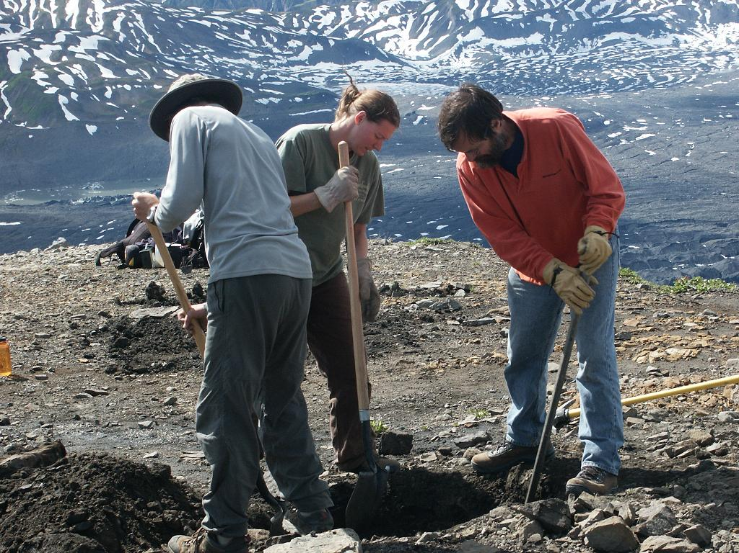
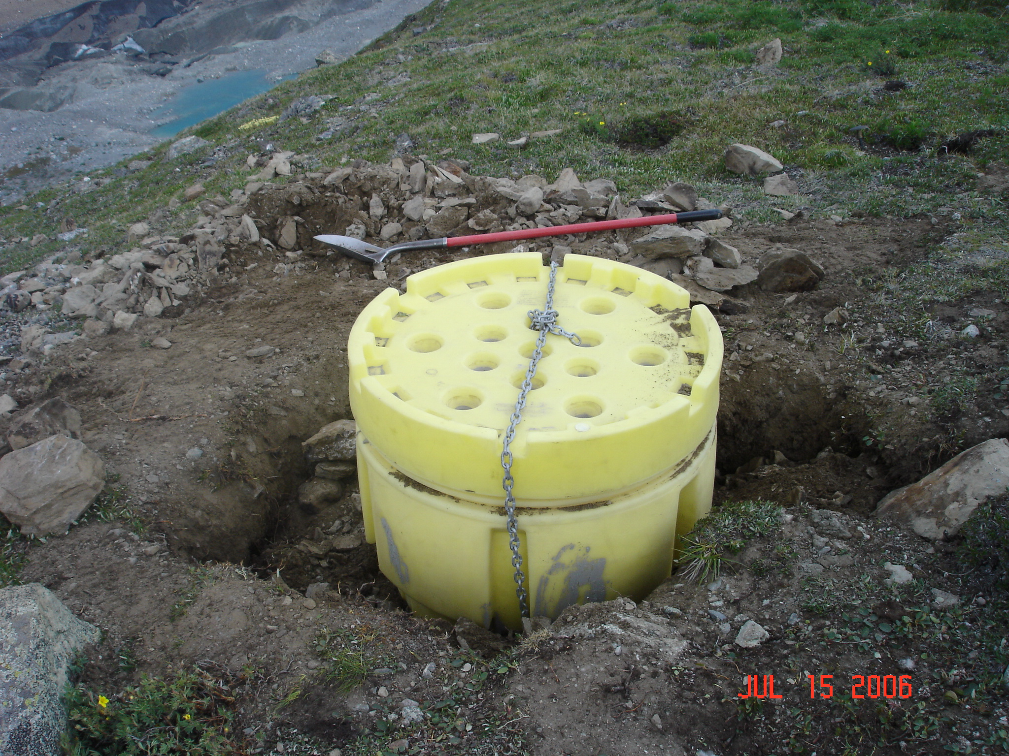
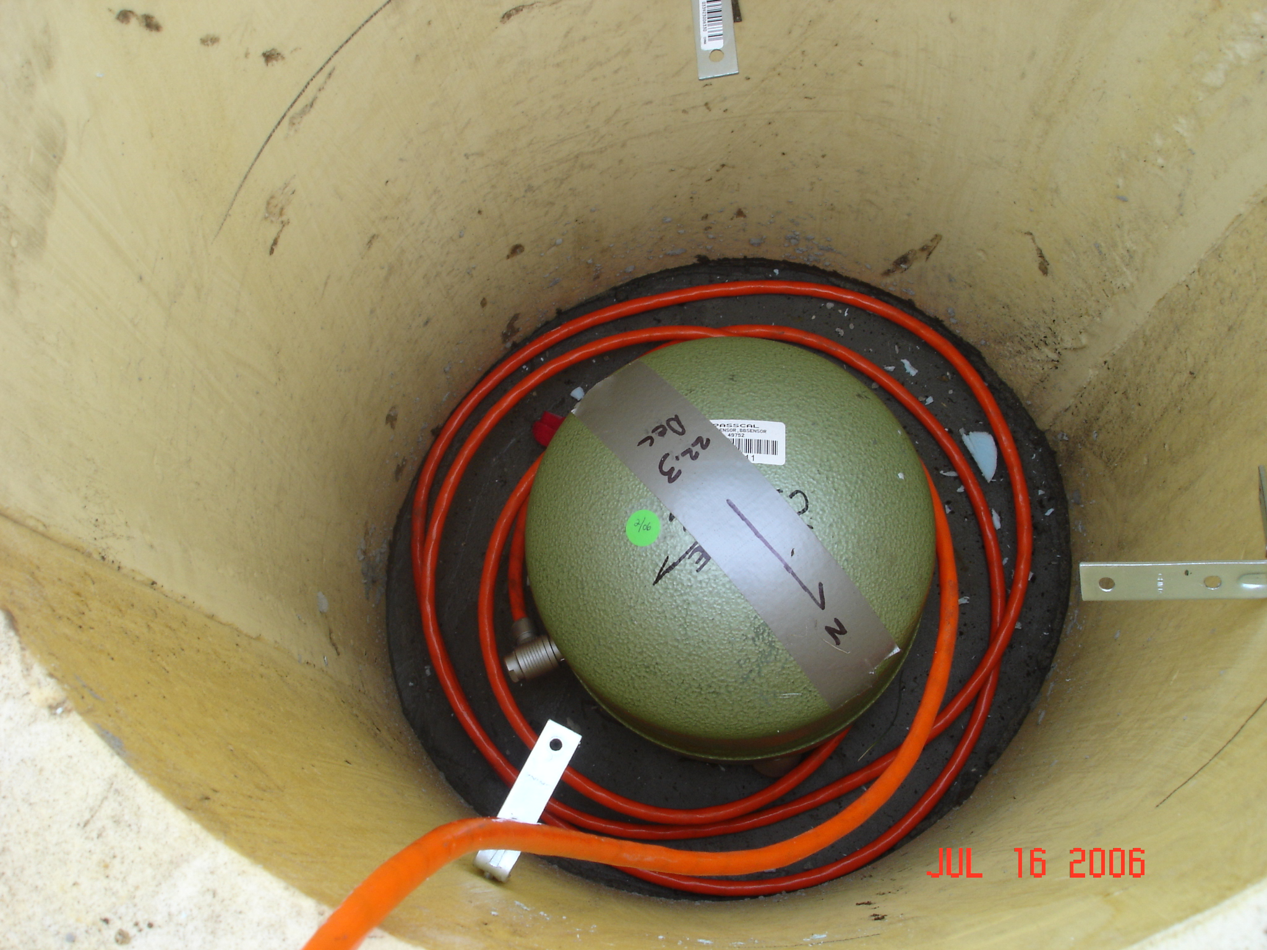
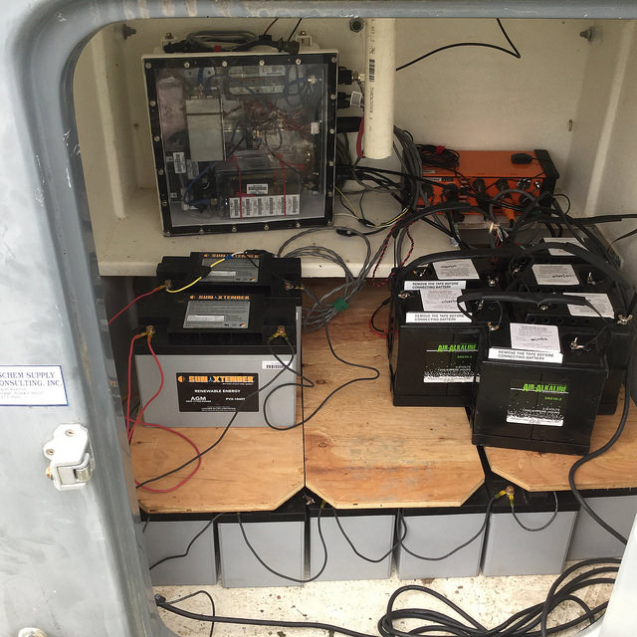
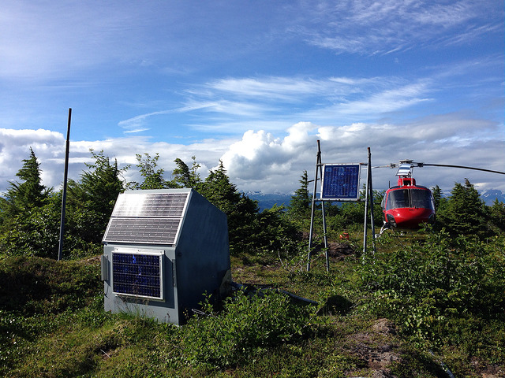
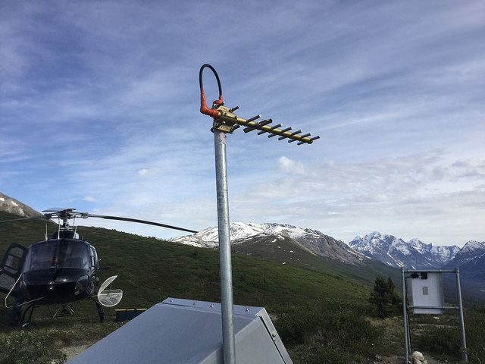
Components of AK seismic monitoring site

Slide 8
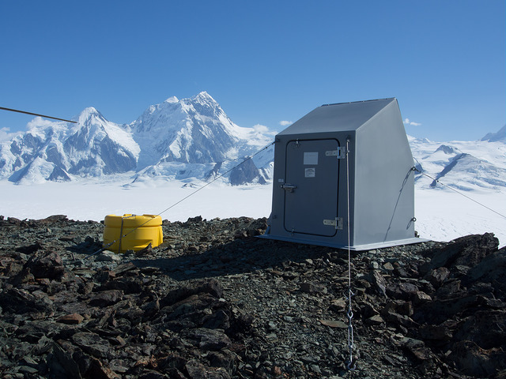
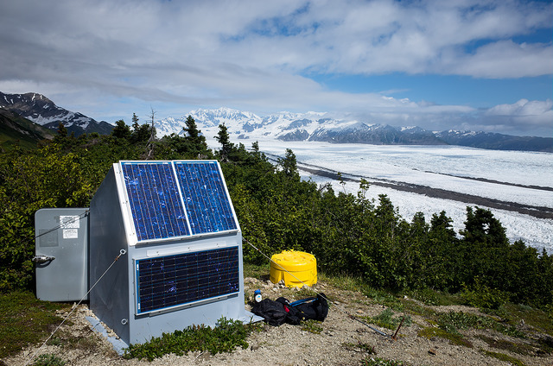
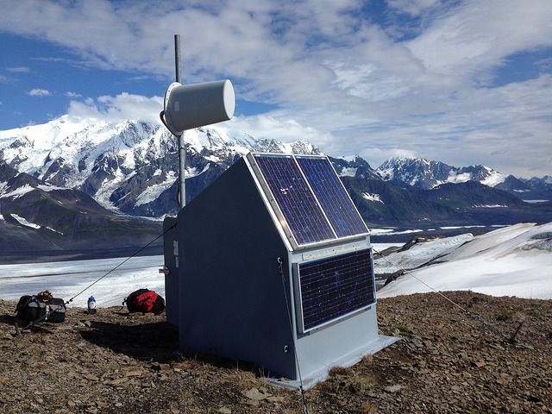
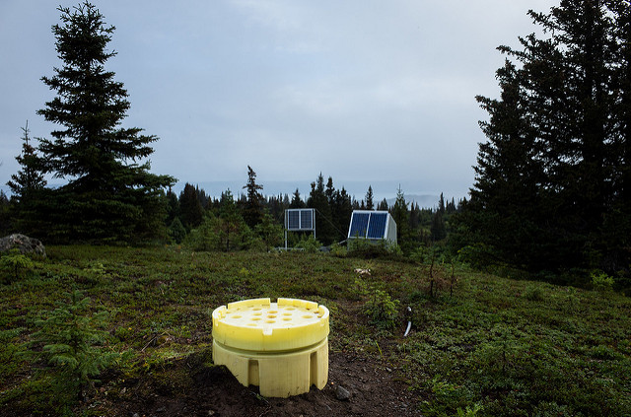
AK Seismic monitoring sites

Slide 9
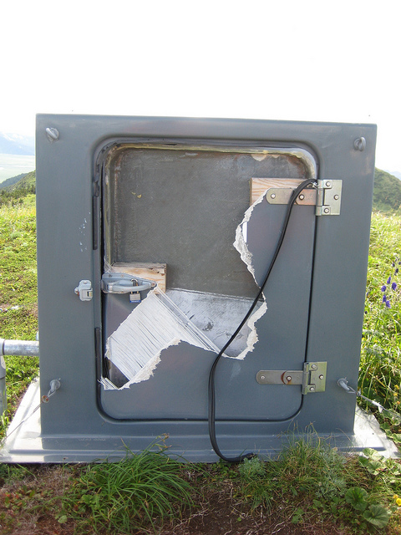
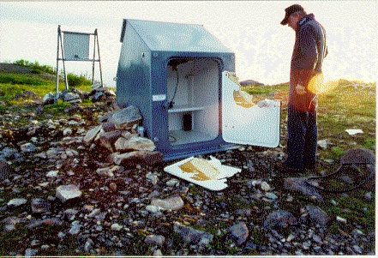
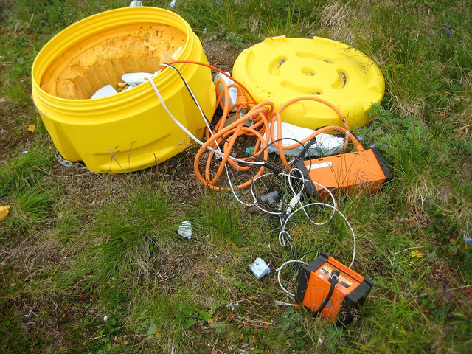
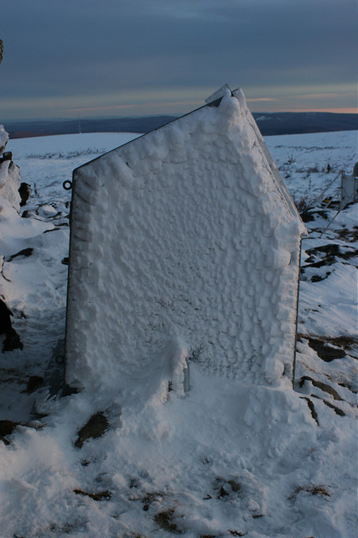
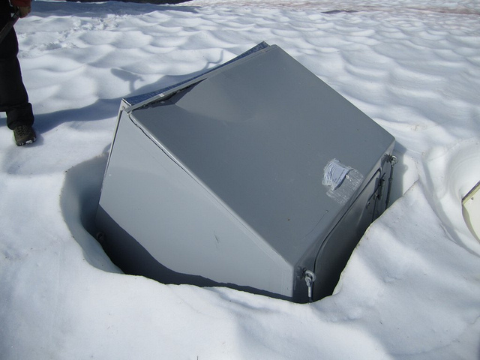
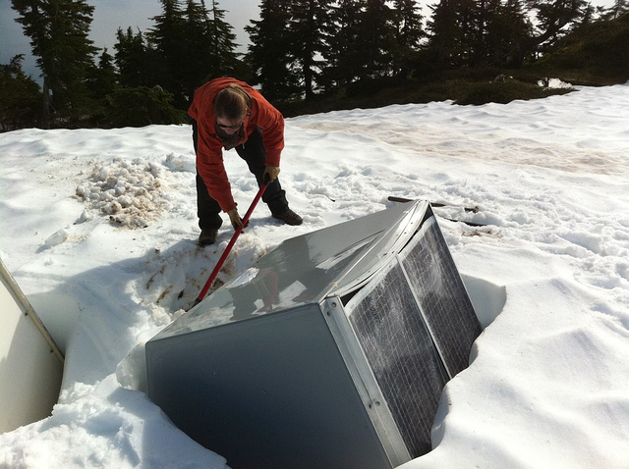
Station damage: bears and snow

Slide 10
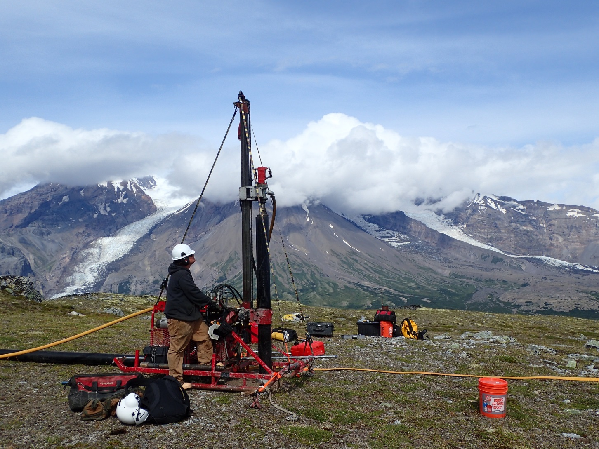
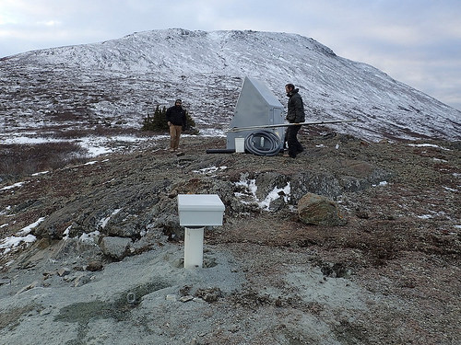
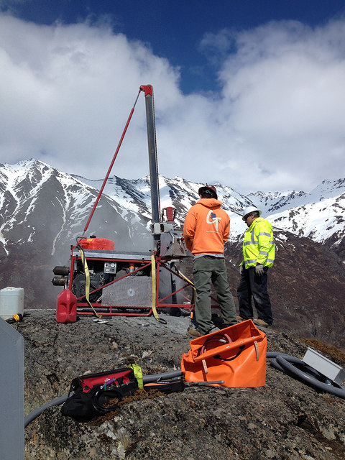
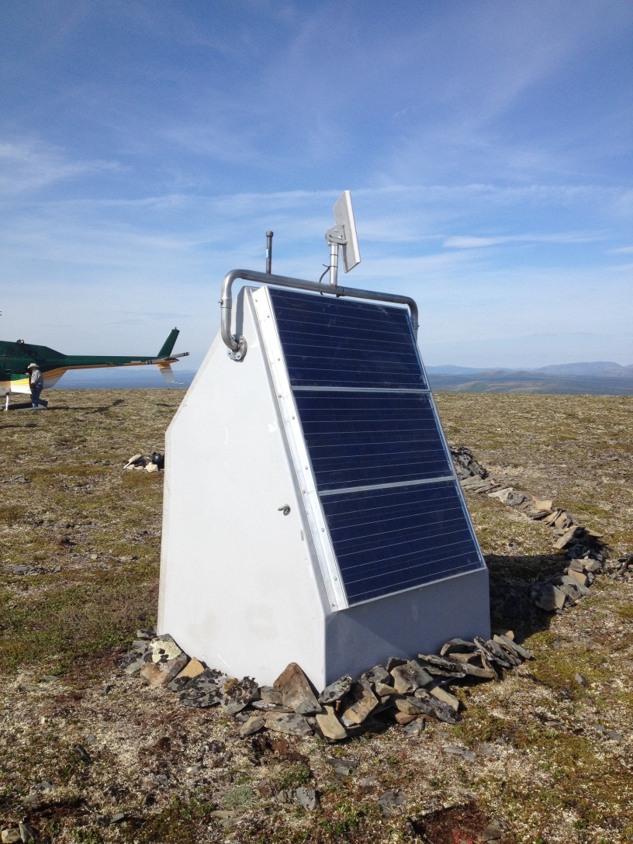
USArray upgraded AK seismic monitoring sites
Posthole seismic sensors are placed in shallow boreholes (8-20 ft) augured with portable drills
This protects sensors from surface noise thus providing high quality data
State of art communications and power systems have been designed specifically for Alaska region
TA seismic site in southern Alaska

