Slide 1
GT Event Relocations in the Caucasus
István Bondár
Research Centre for Astronomy and Earth Sciences, Hungarian Academy of Sciences
Training in Network Management Systems and Analytical Tools for Seismiology
Baku, Azerbaijan, 23-27 October 2017

Slide 2
Motivation
GT events are needed to develop to assess the performance of location algorithms and travel time predictions from various velocity models
There are 189 GT5 events in the Caucasus region
Reasonable statistical sample
Well recorded events with local stations
GT5 events were obtained from
Multiple event locations, HDC-RCA (Bondár et al, 2008)
GT5 selection from the ISC bulletin (Bondár and McLaughlin, 2009)
Demonstrate the effect of various factors on location accuracy

Slide 3
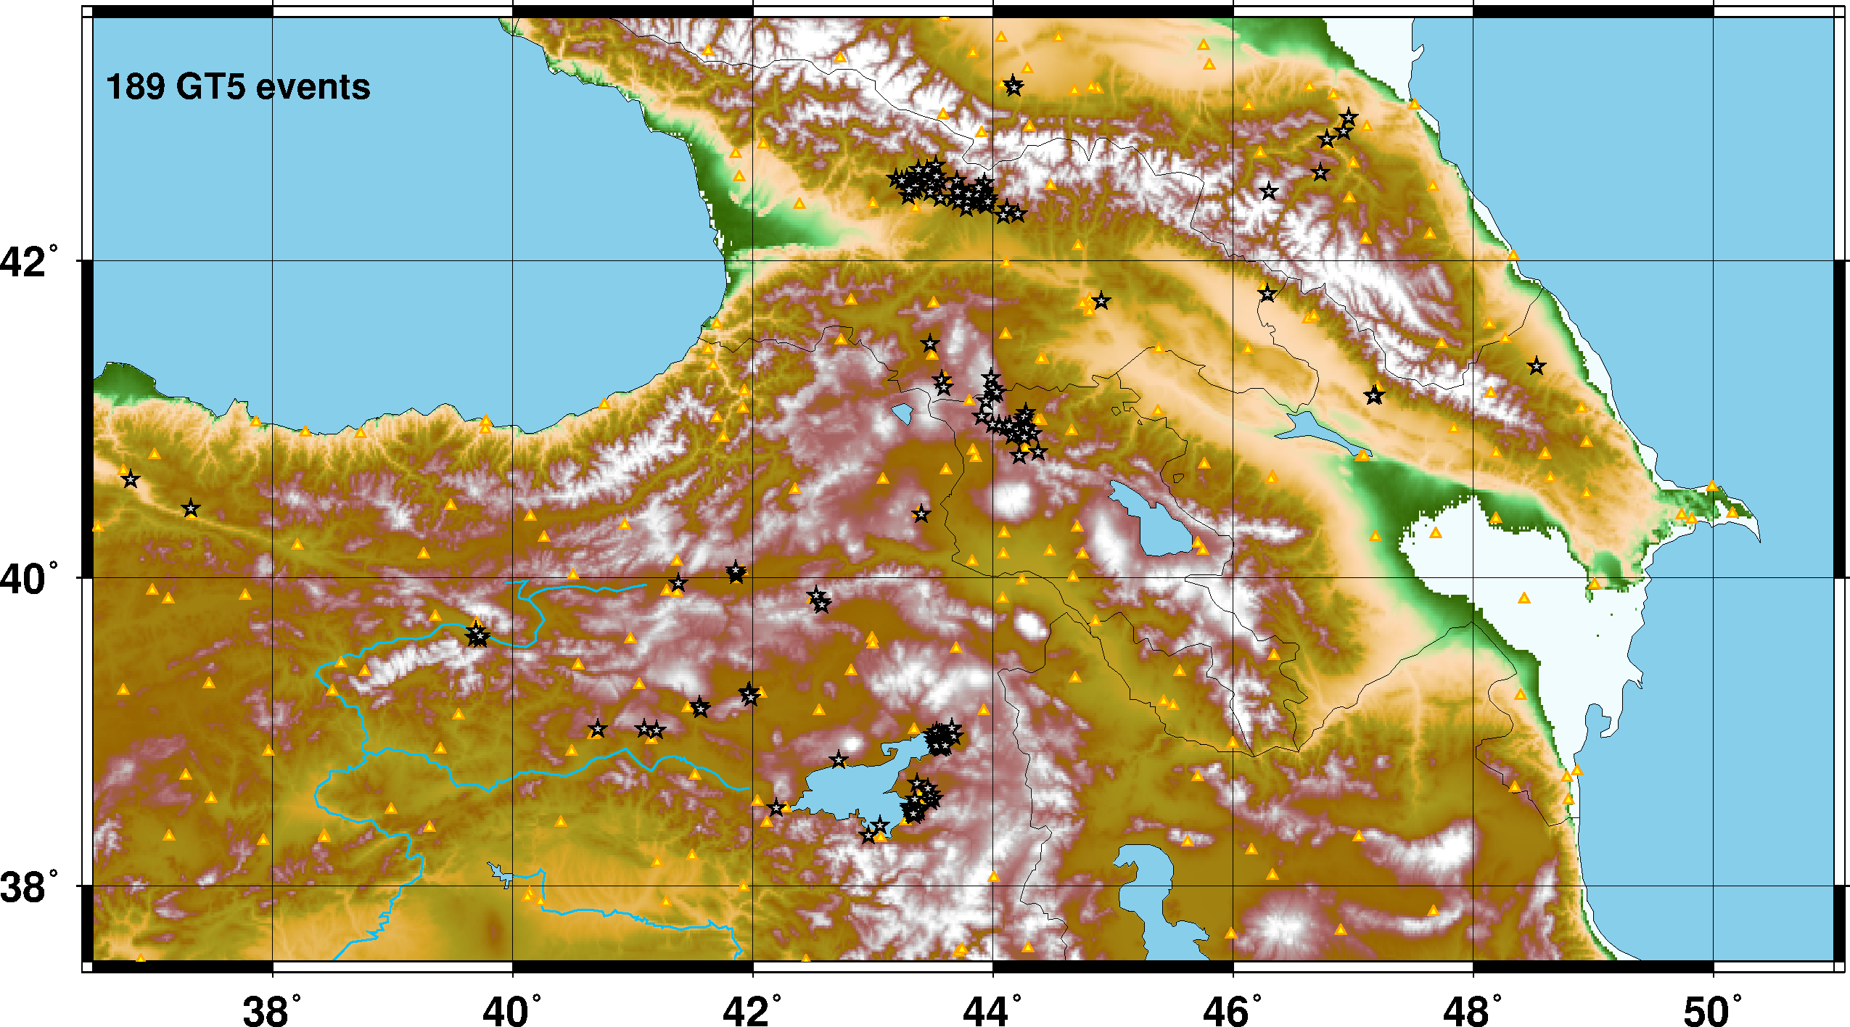
GT5 Events
Mixture of old aftershock sequences (Racha, Spitak, Erzincan) and relatively recent earthquakes

Slide 4
GT5 events
GT5 events were downloaded from the ISC website
ISC locations are not quite homegeneous
Before 2000: Jeffrey’s uniform reduction and JB tables
2000-2009: Jeffrey’s uniform reduction and ak135 tables
After 2009: ISC locator (Bondár and Storchak, 2011) and ak135 tables
Relocations
ak135 assuming independent errors
ak135 accounting for correlated errors
RSTT accounting for correlated errors
Because the GT5 events are all well-recorded with good azimuthal coverage, we expect larger improvements in the tails of the distributions

Slide 5
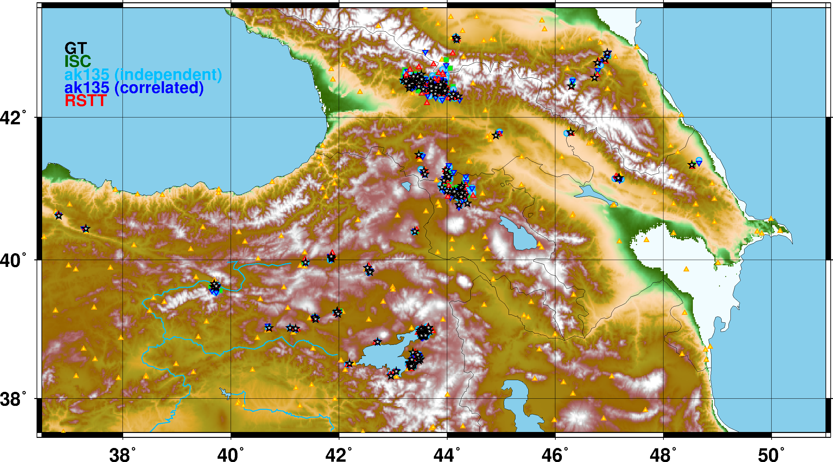
GT5 Event Relocations

Slide 6
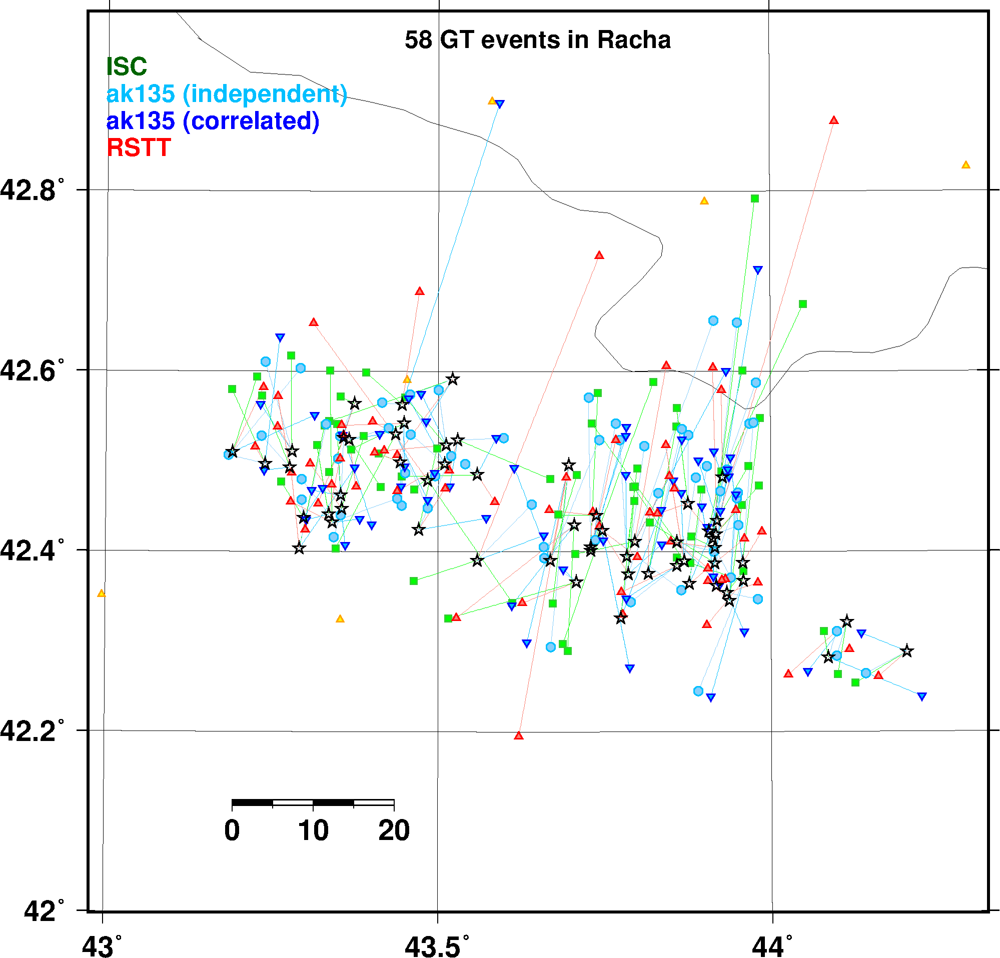
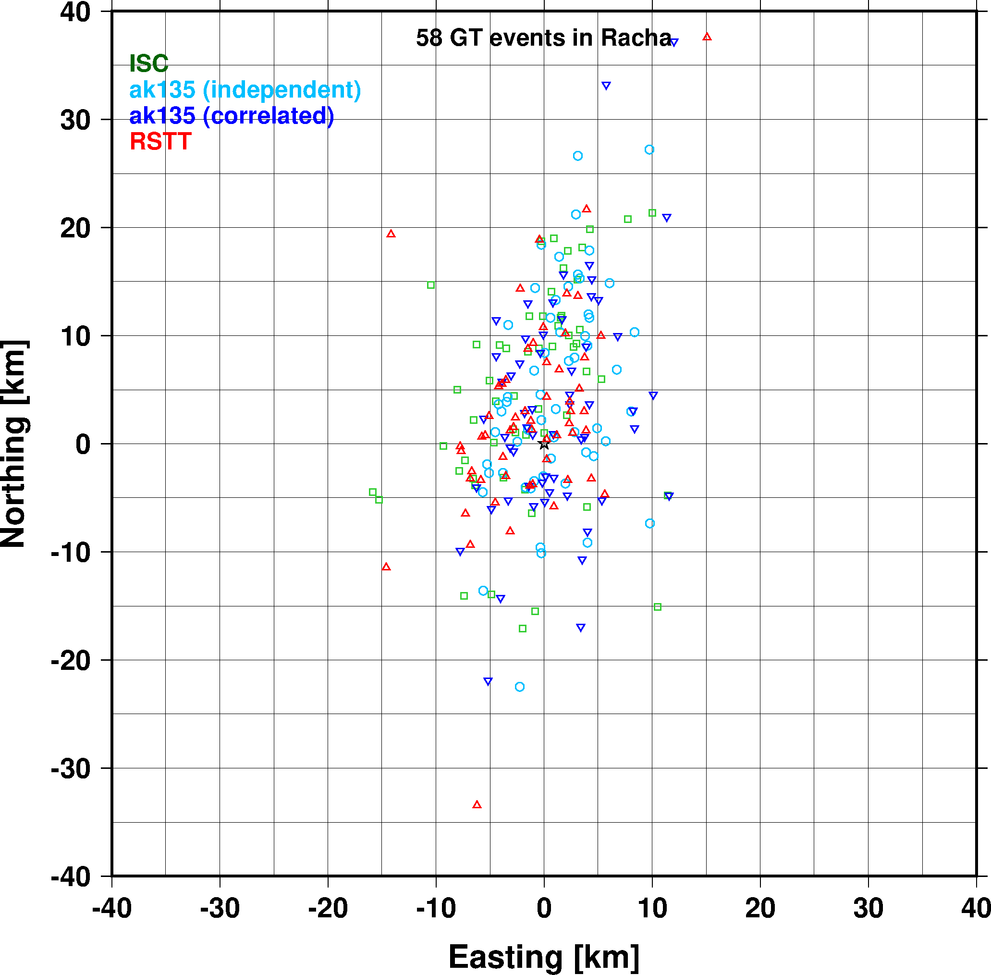
GT5 Event Relocations, Racha

Slide 7
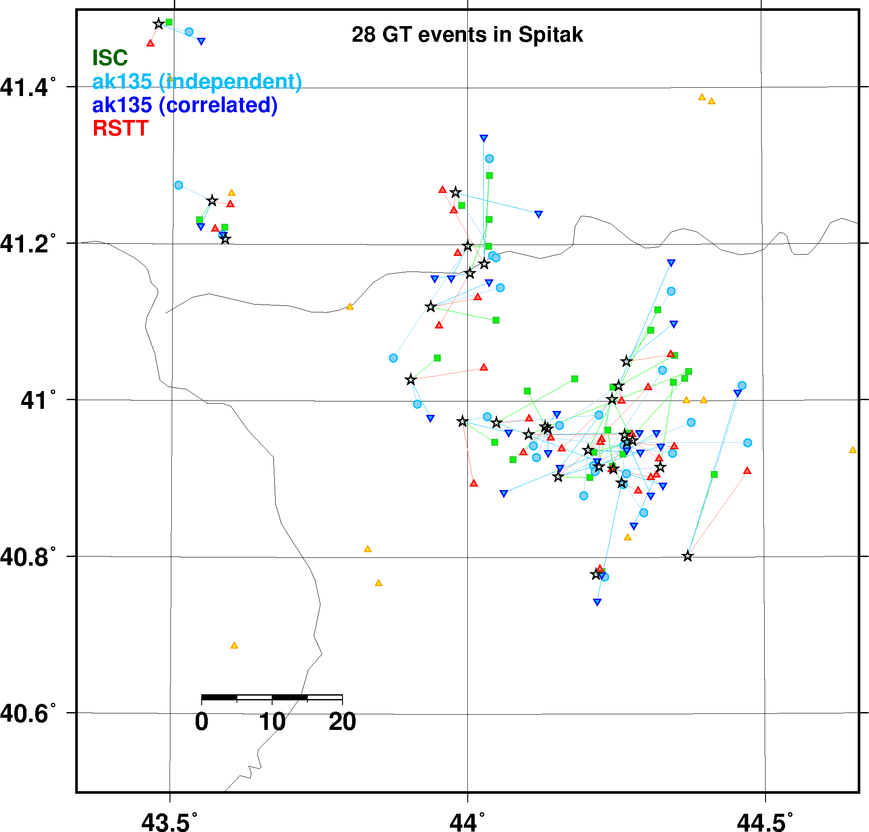
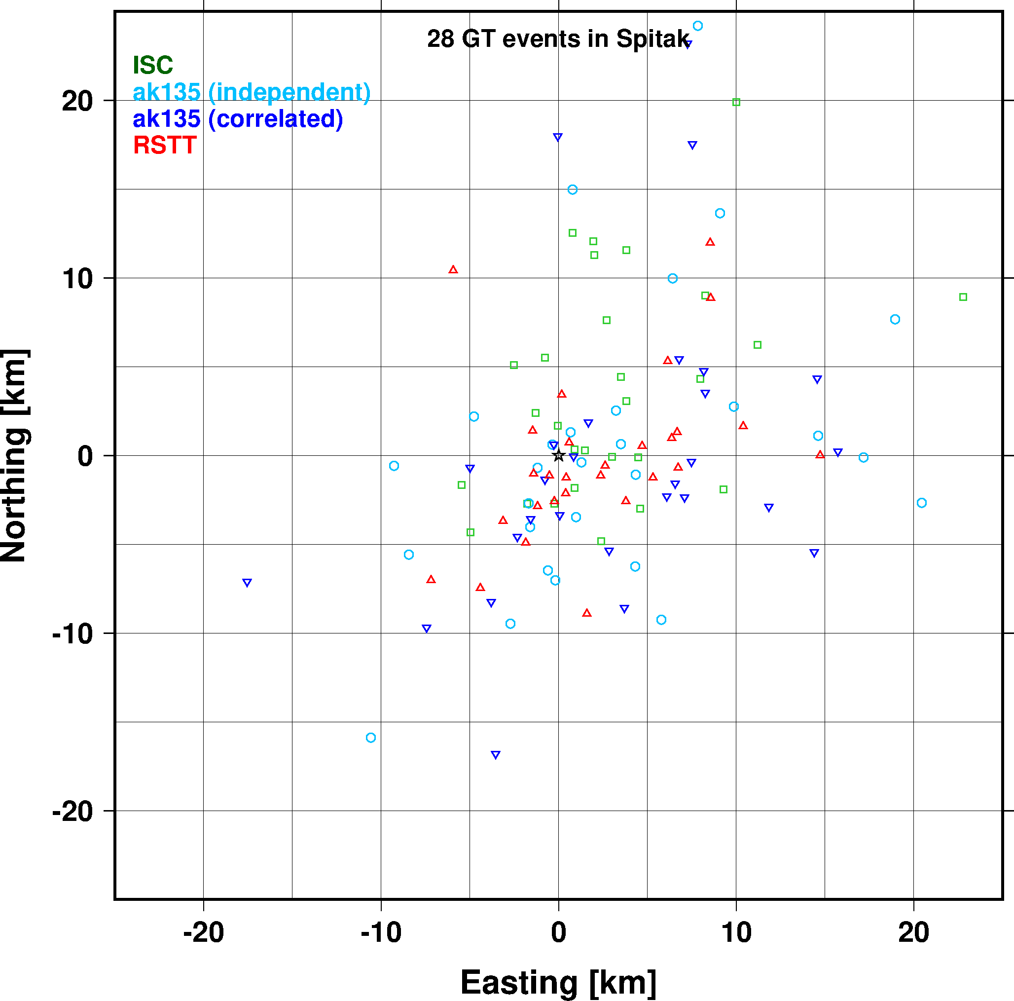
GT5 Event Relocations, Spitak

Slide 8
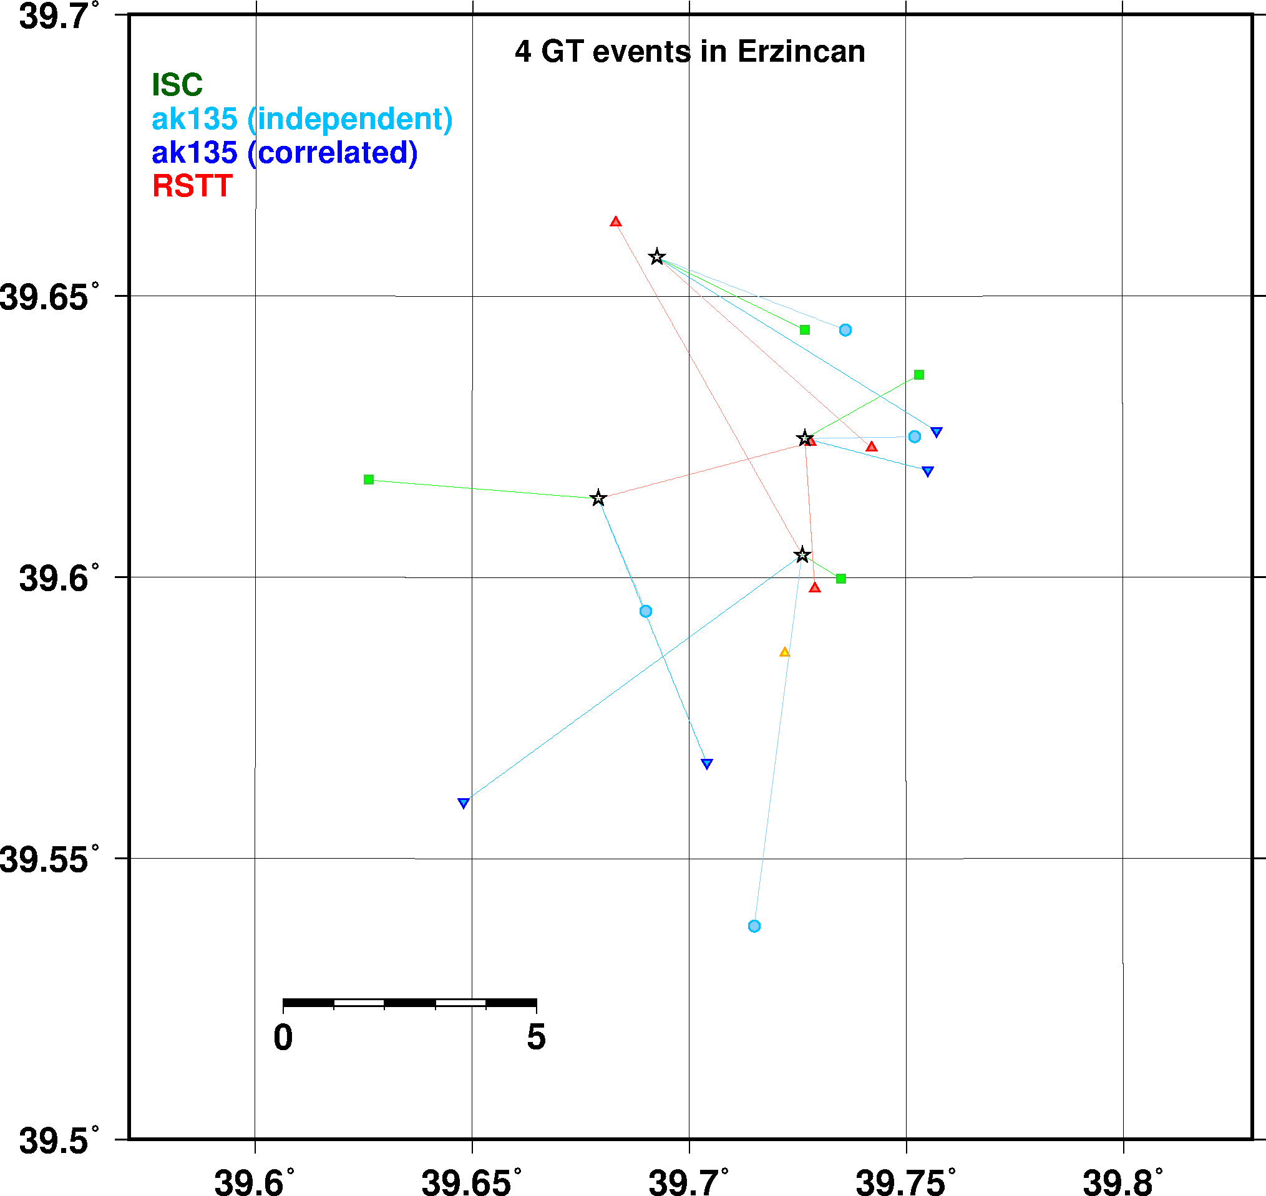
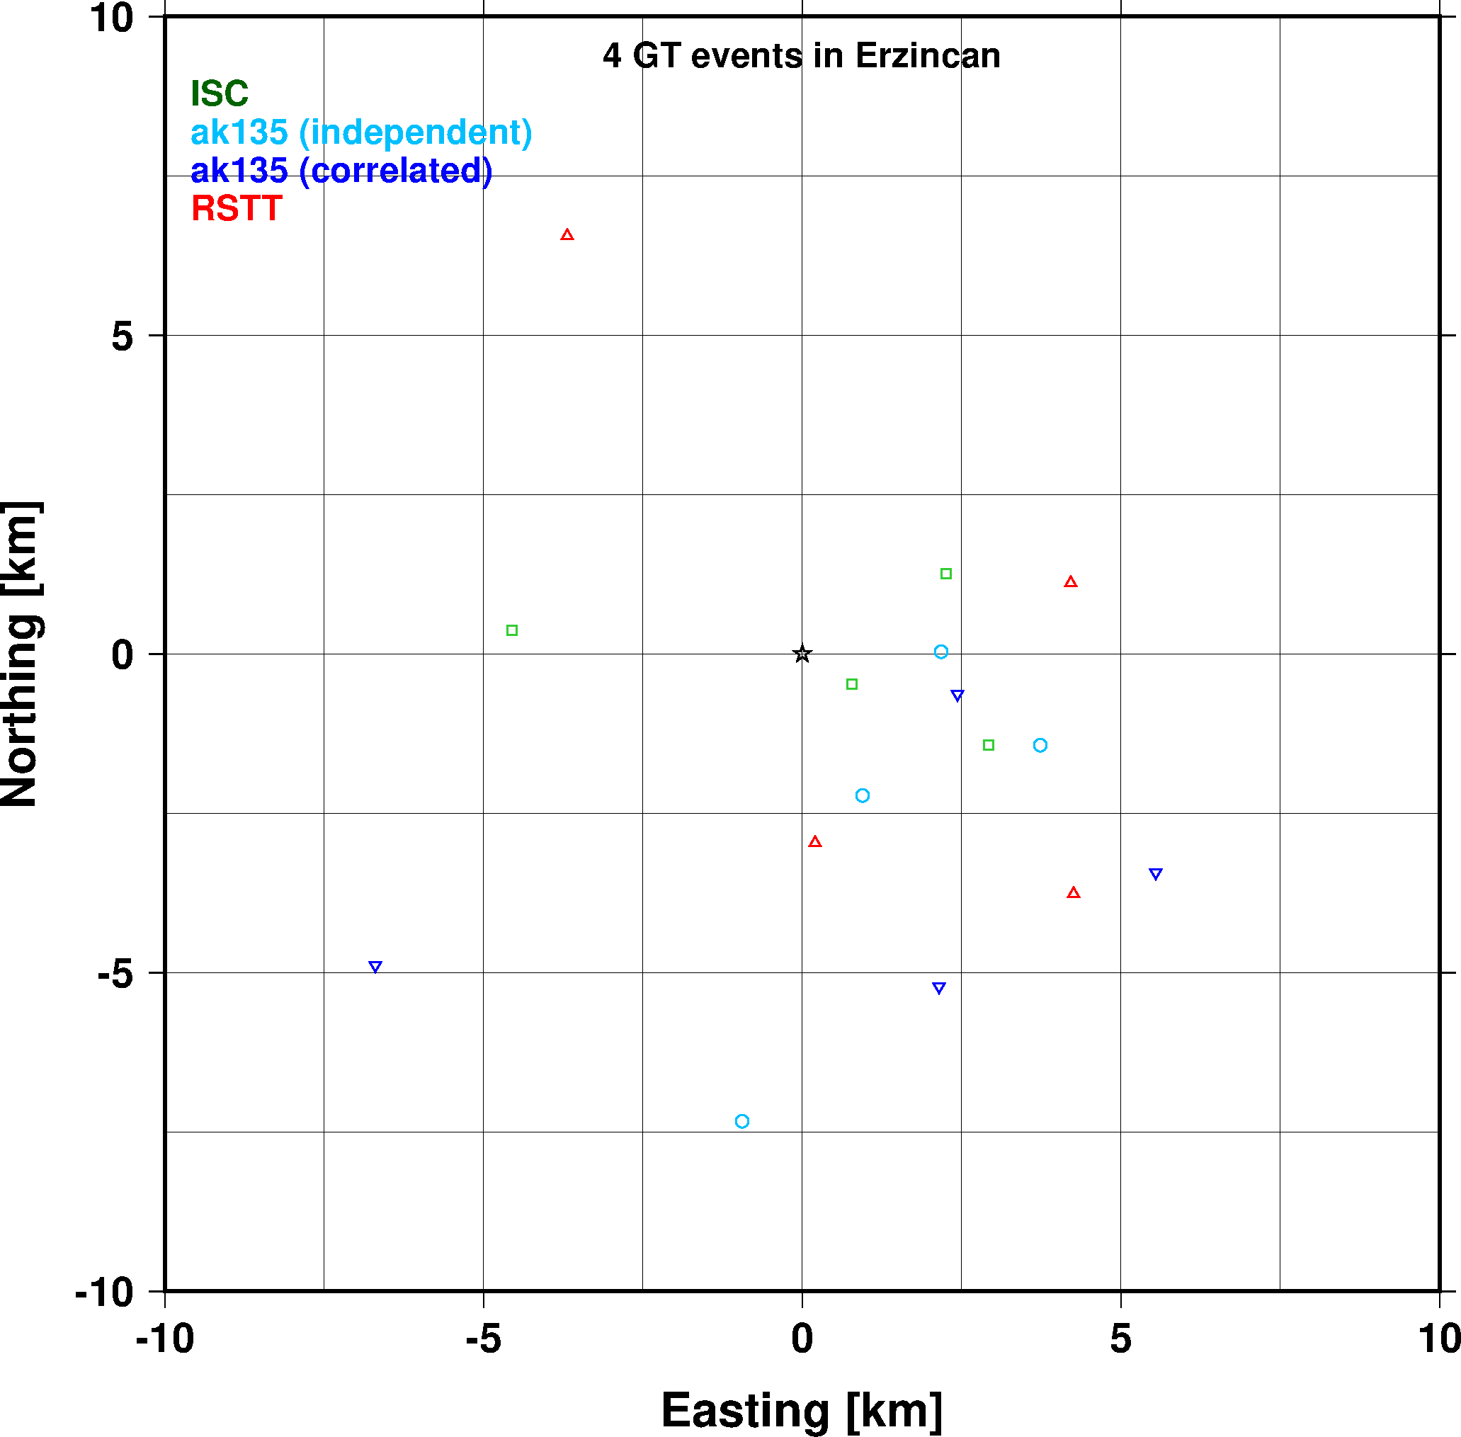
GT5 Event Relocations, Erzincan

Slide 9
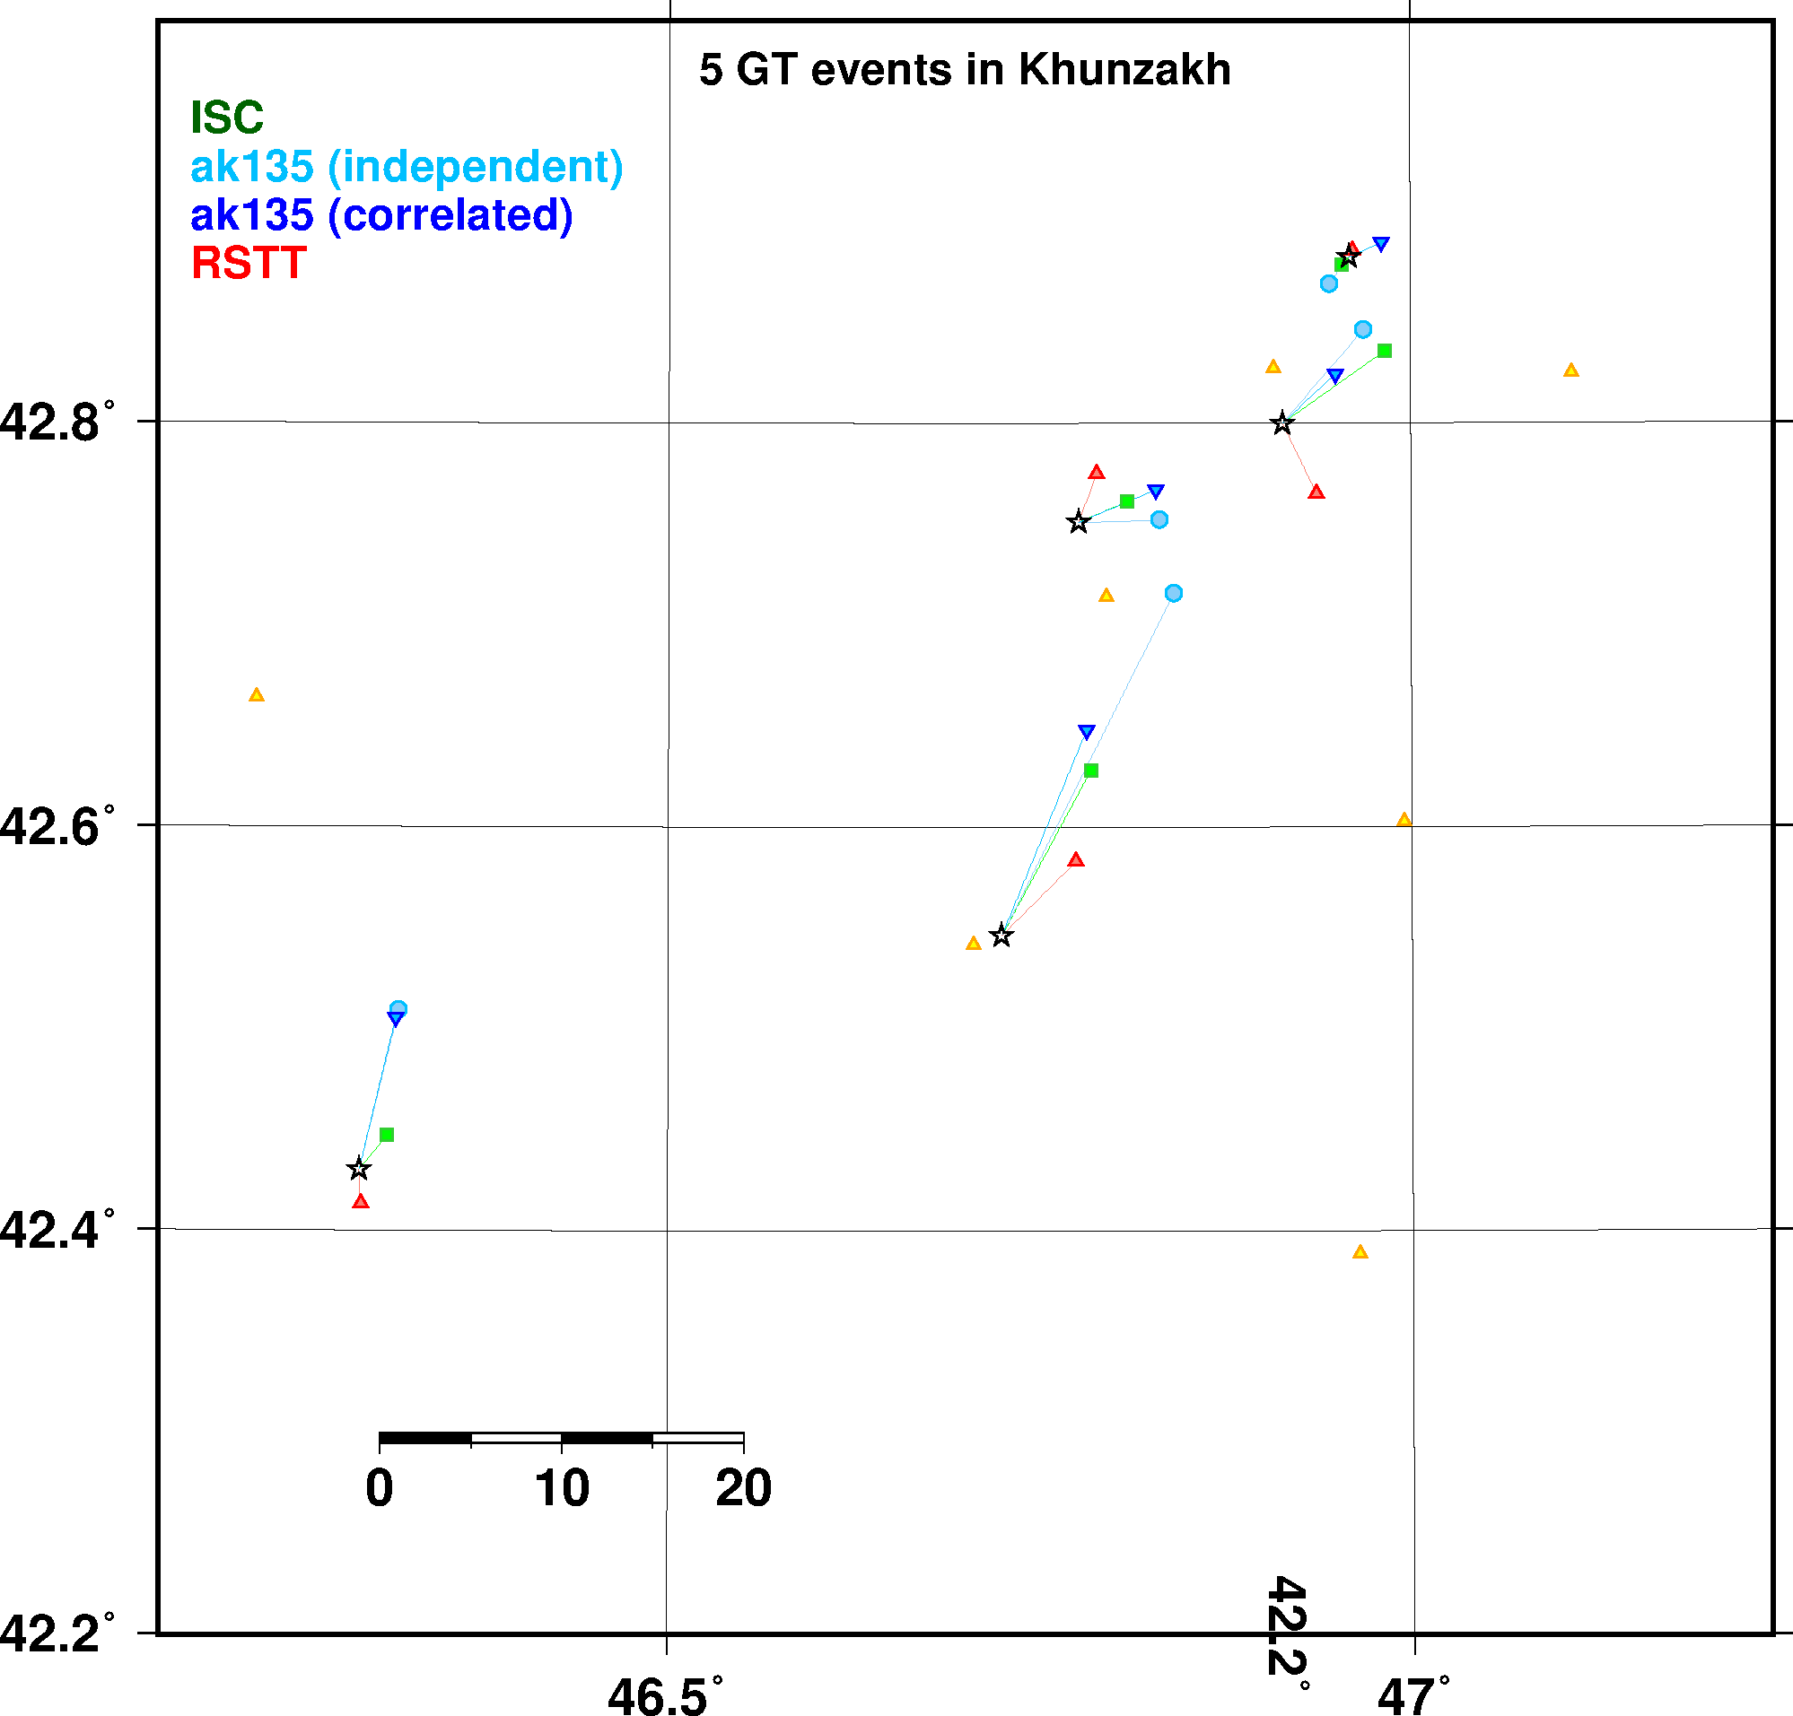
GT5 Event Relocations, Khunzhak

Slide 10
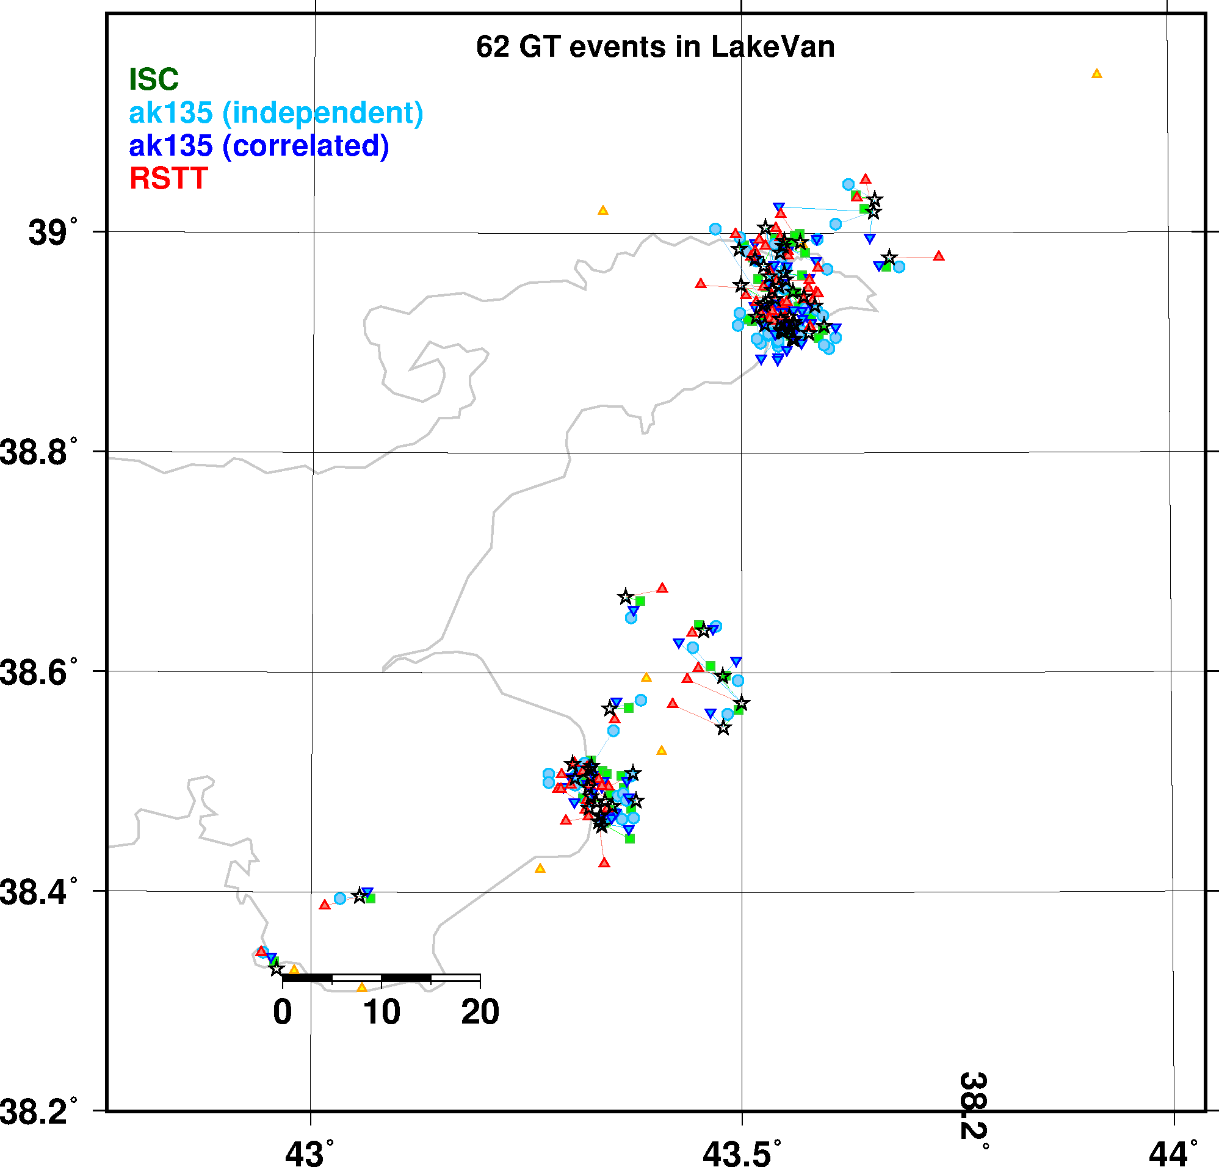
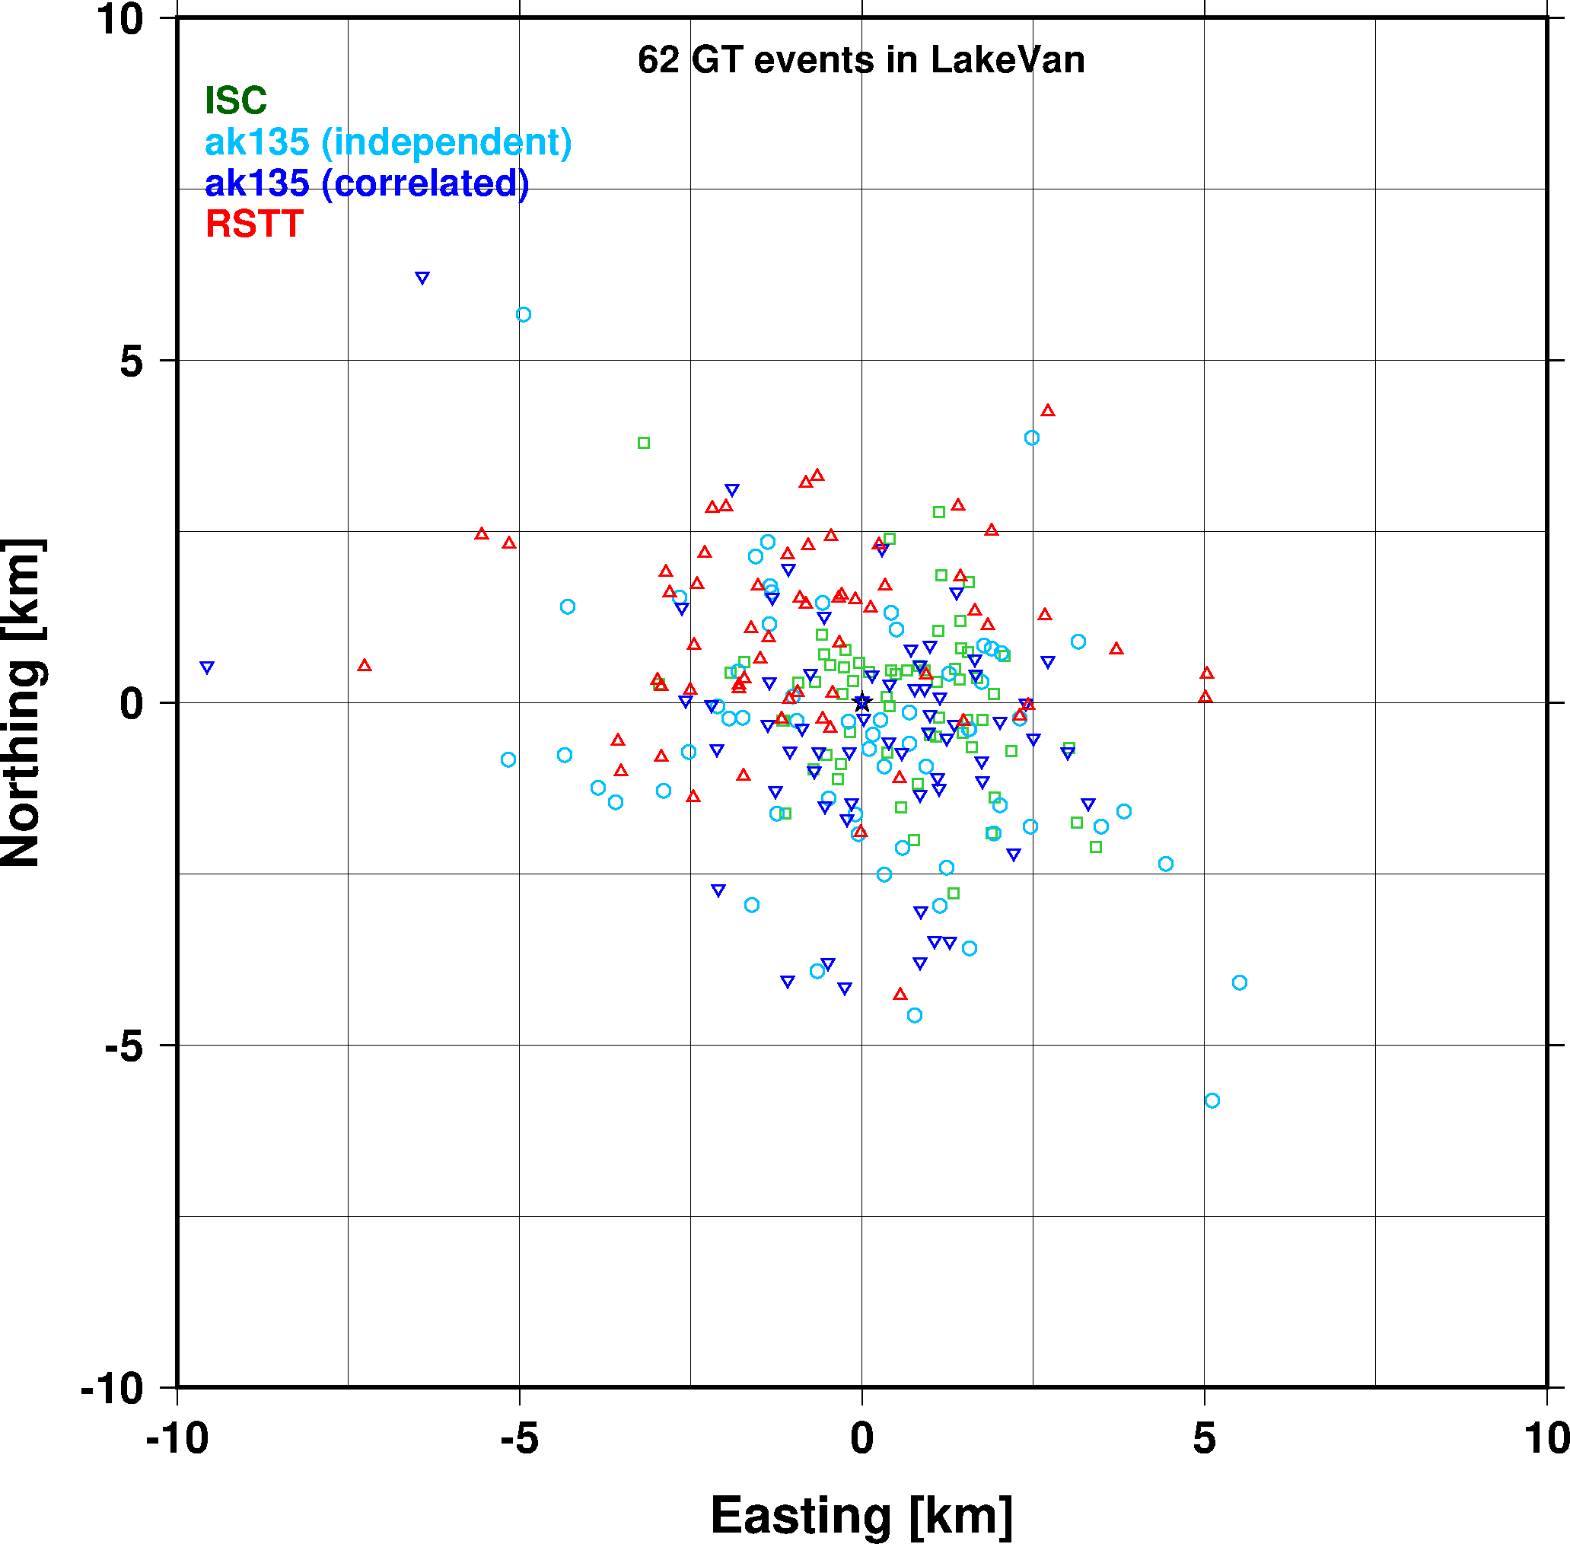
GT5 Event Relocations, Lake Van

Slide 11
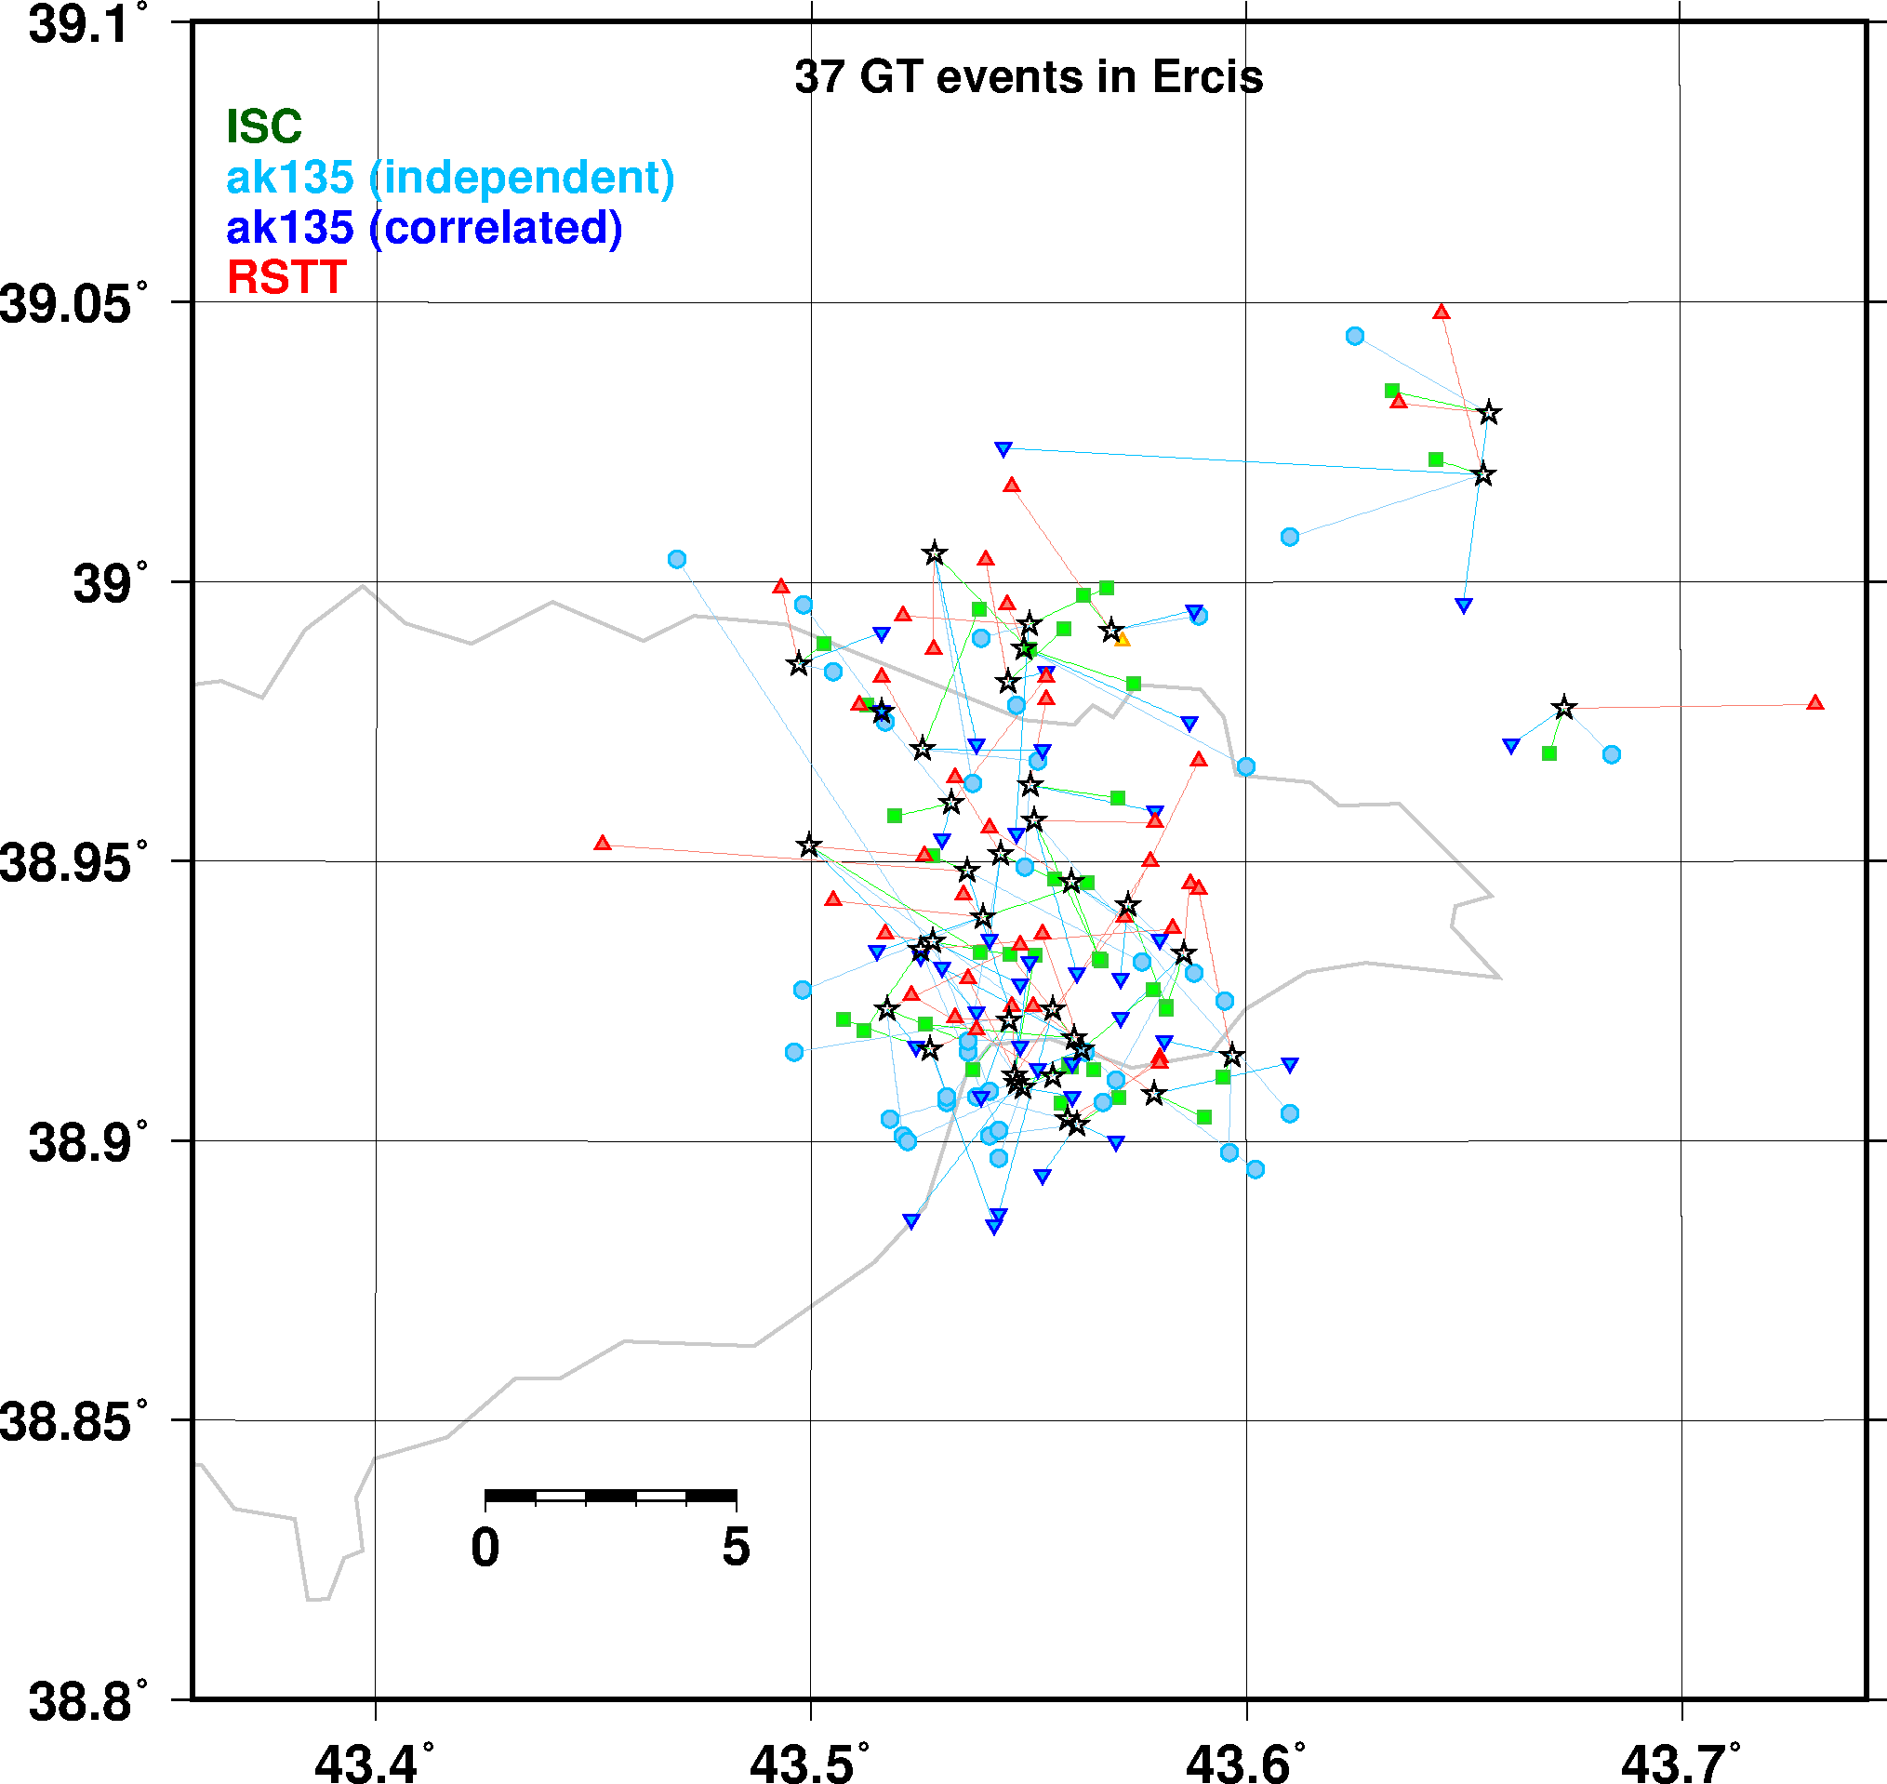
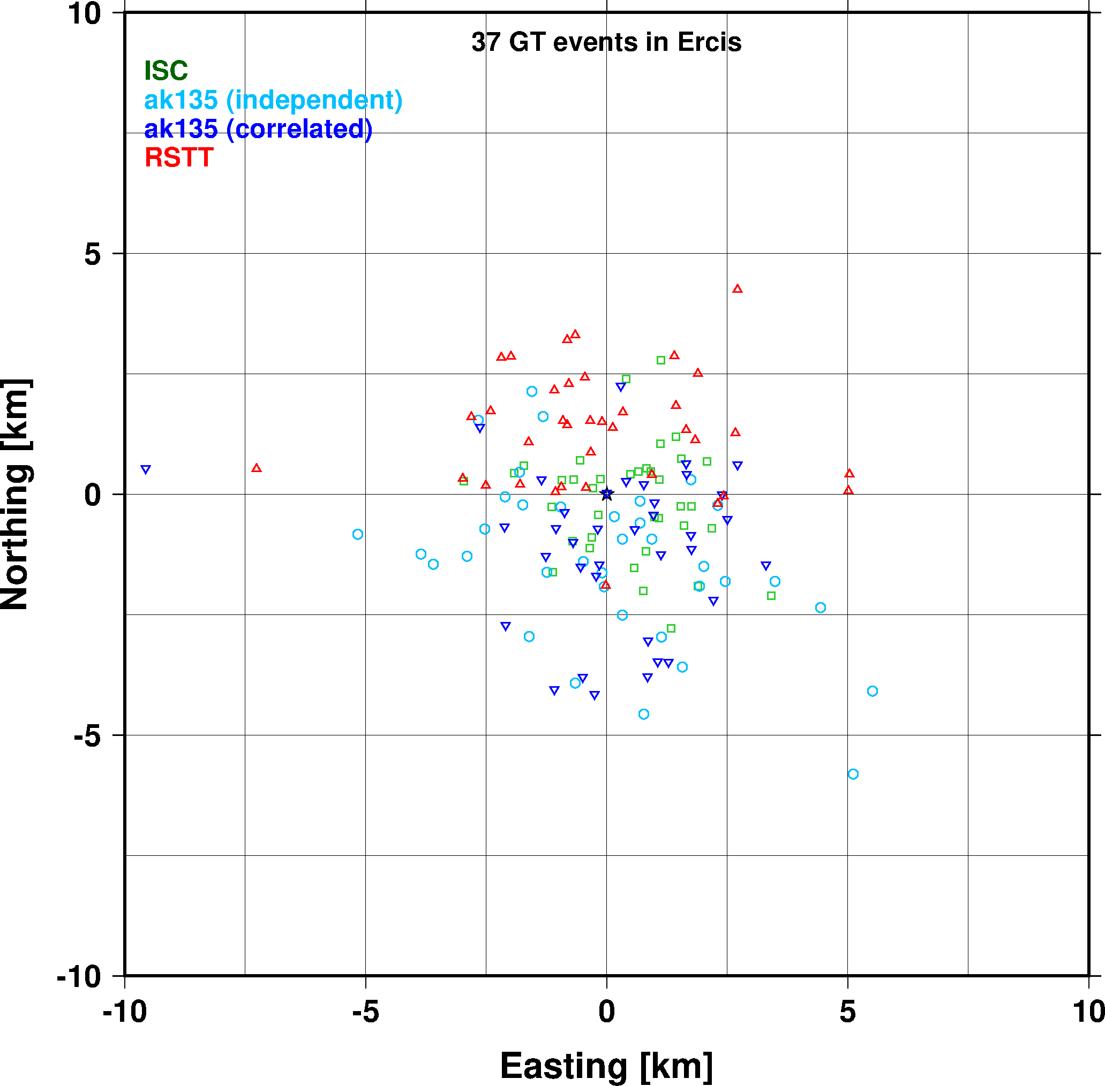
GT5 Event Relocations, Ercis

Slide 12
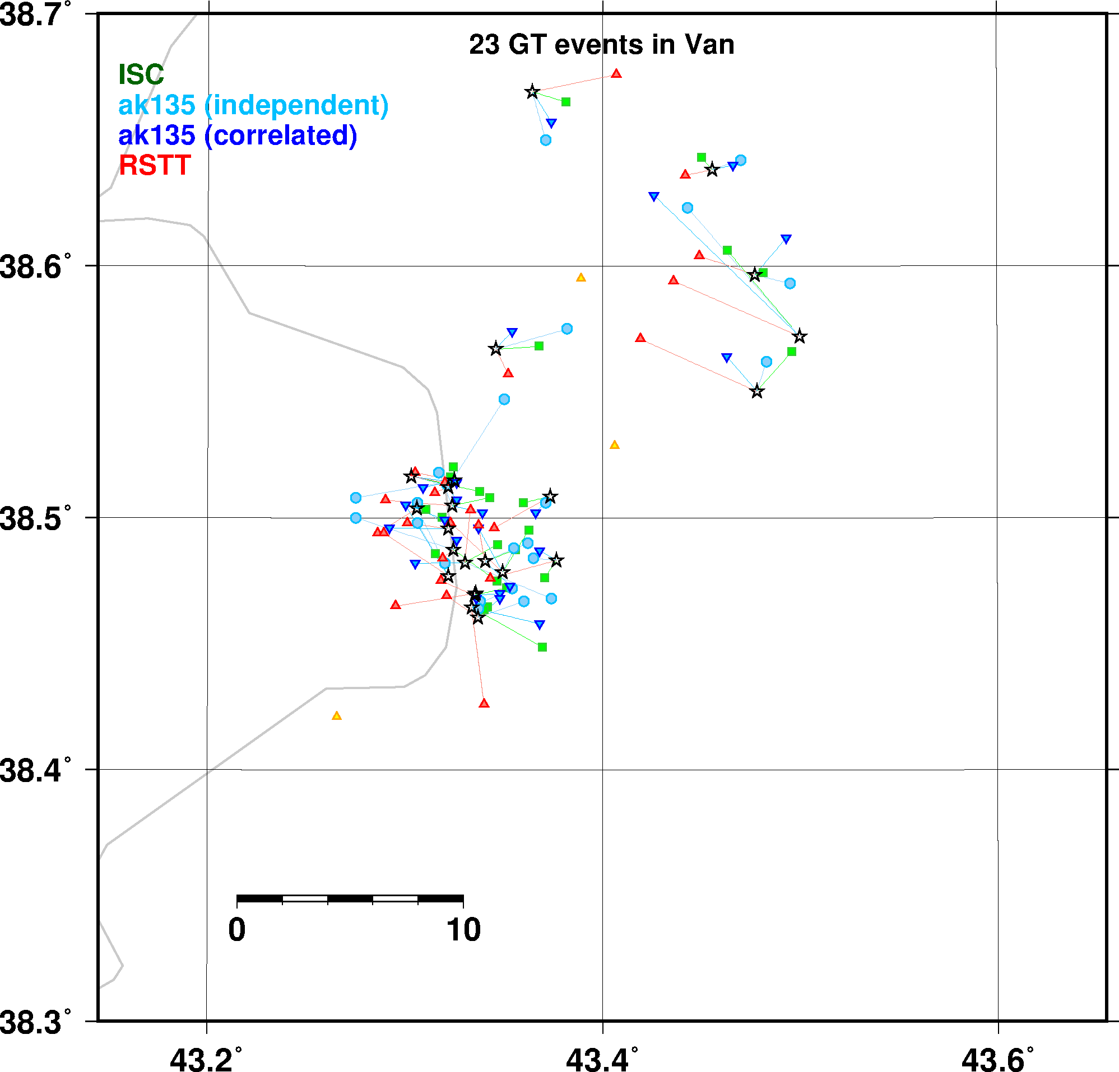
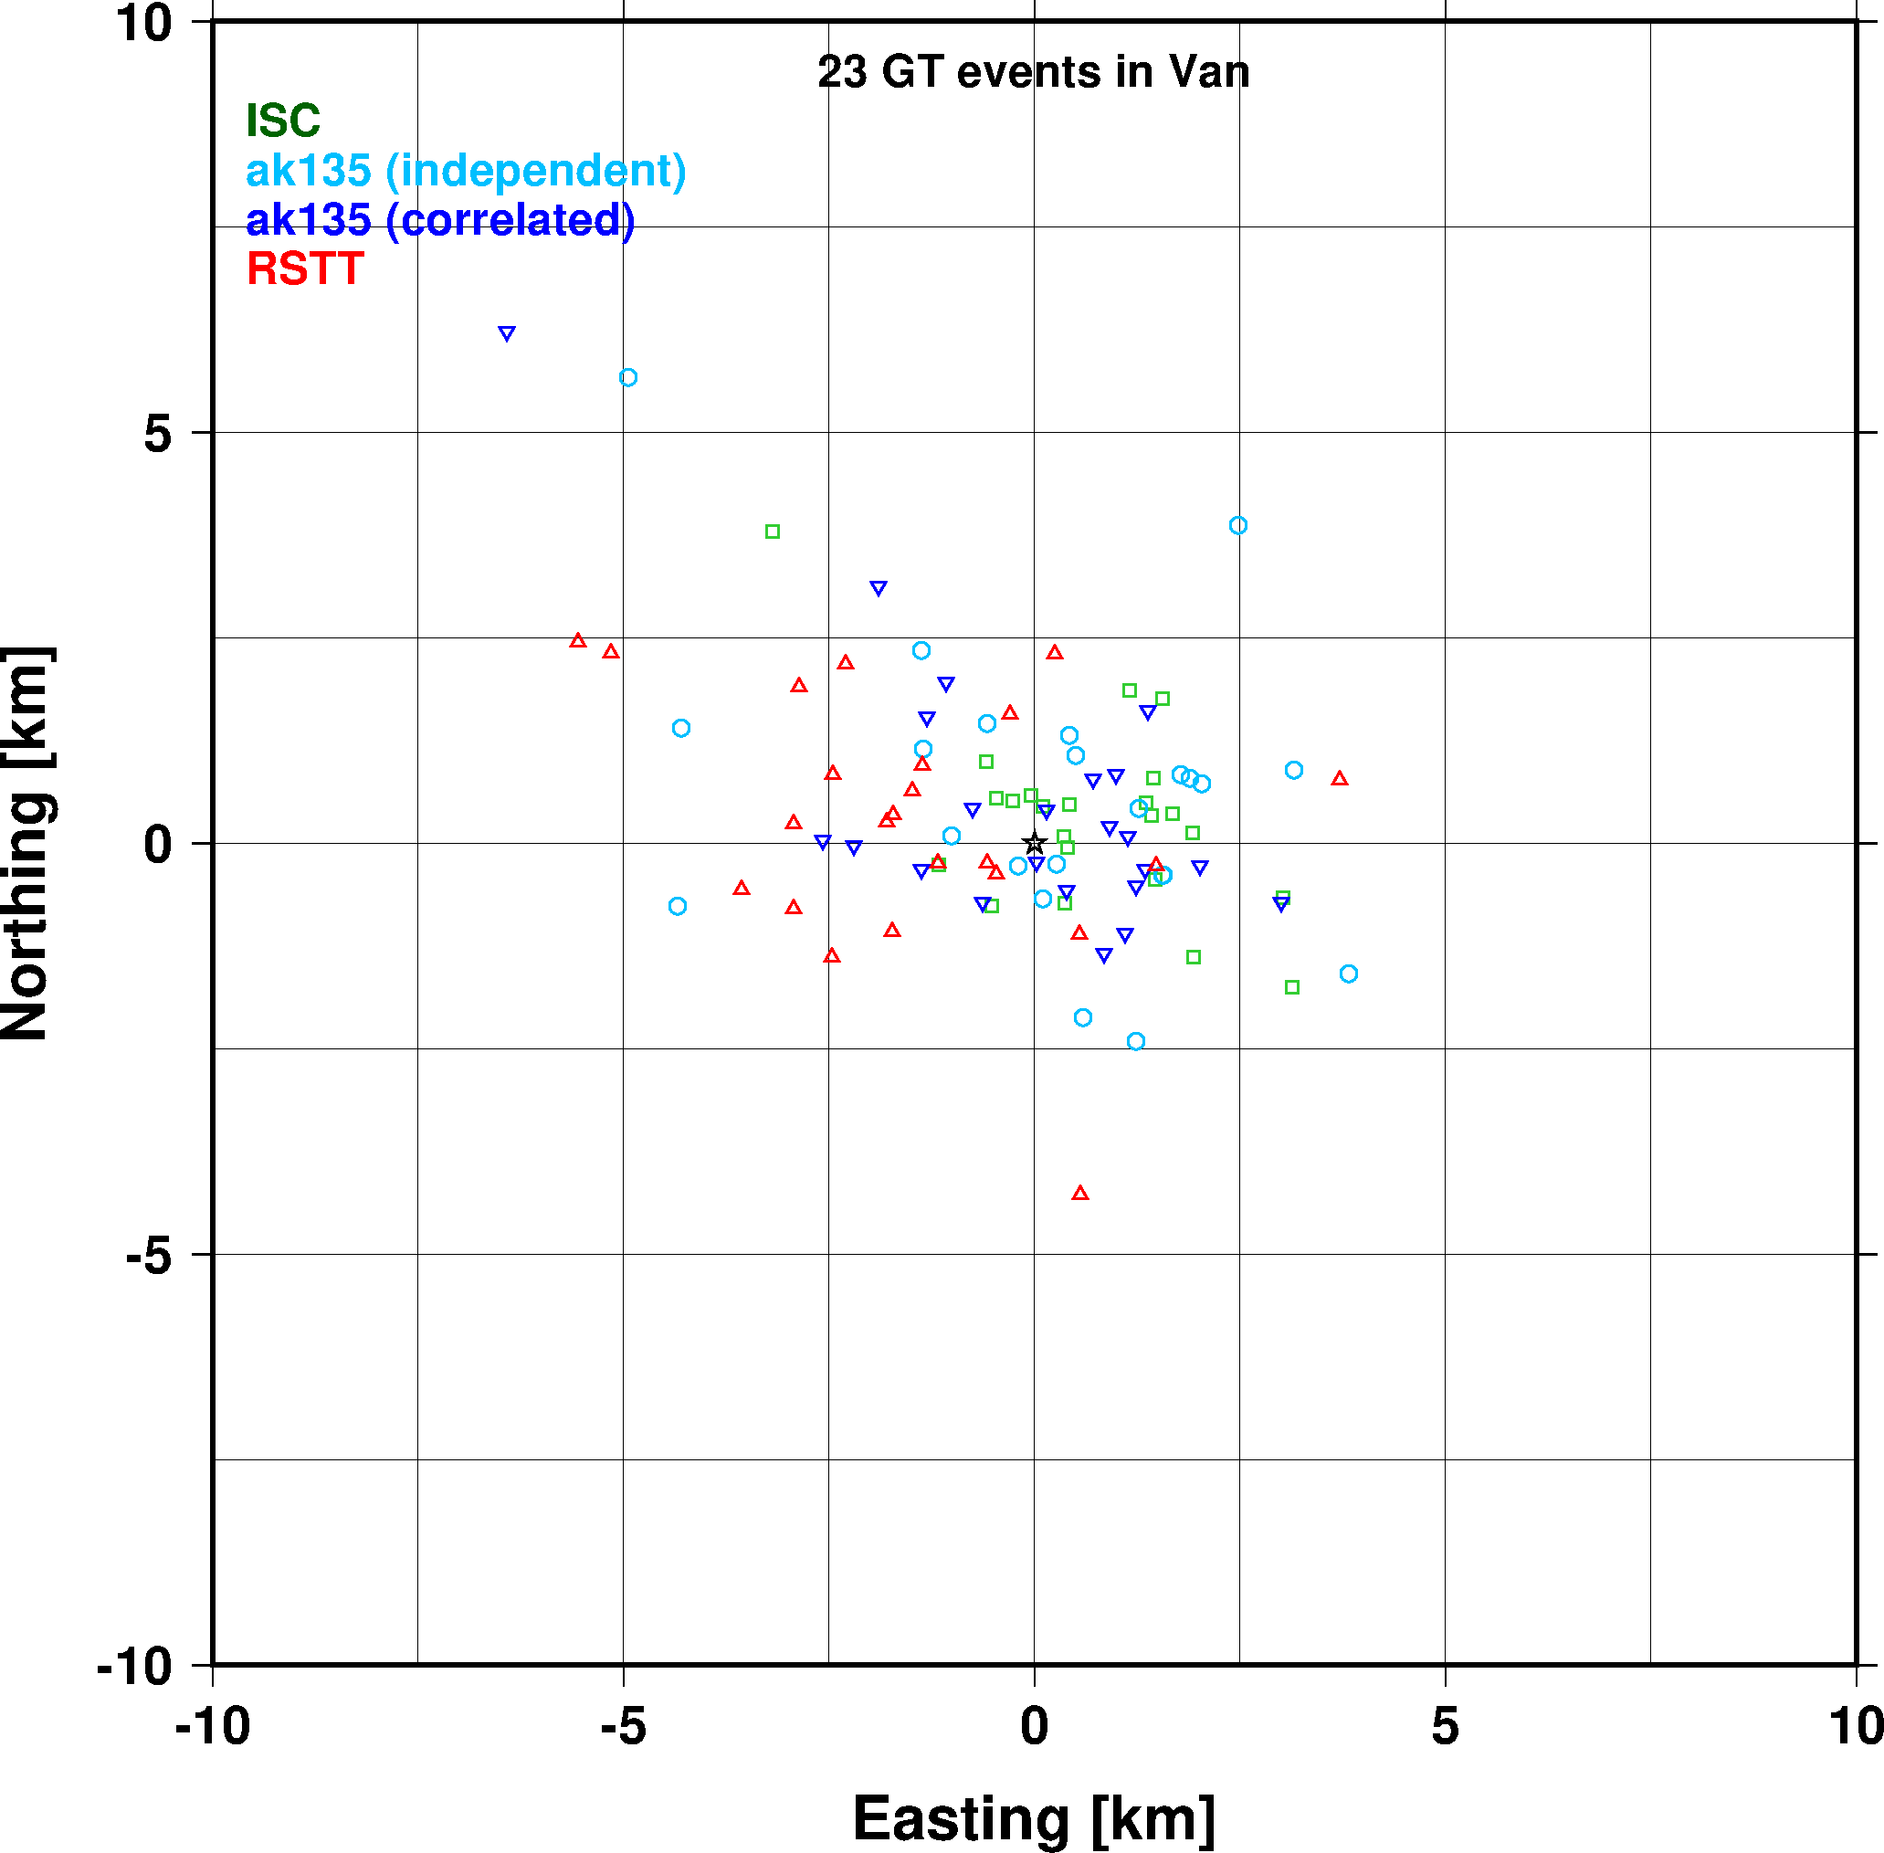
GT5 Event Relocations, Van

Slide 13
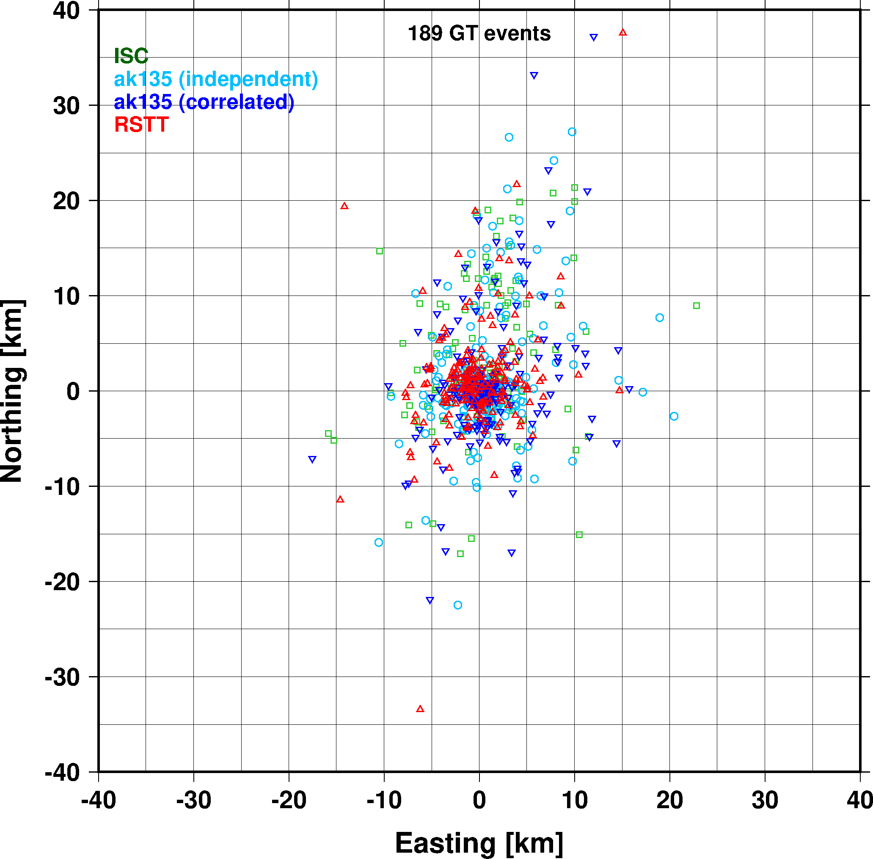
GT5 Event Relocations

Slide 14
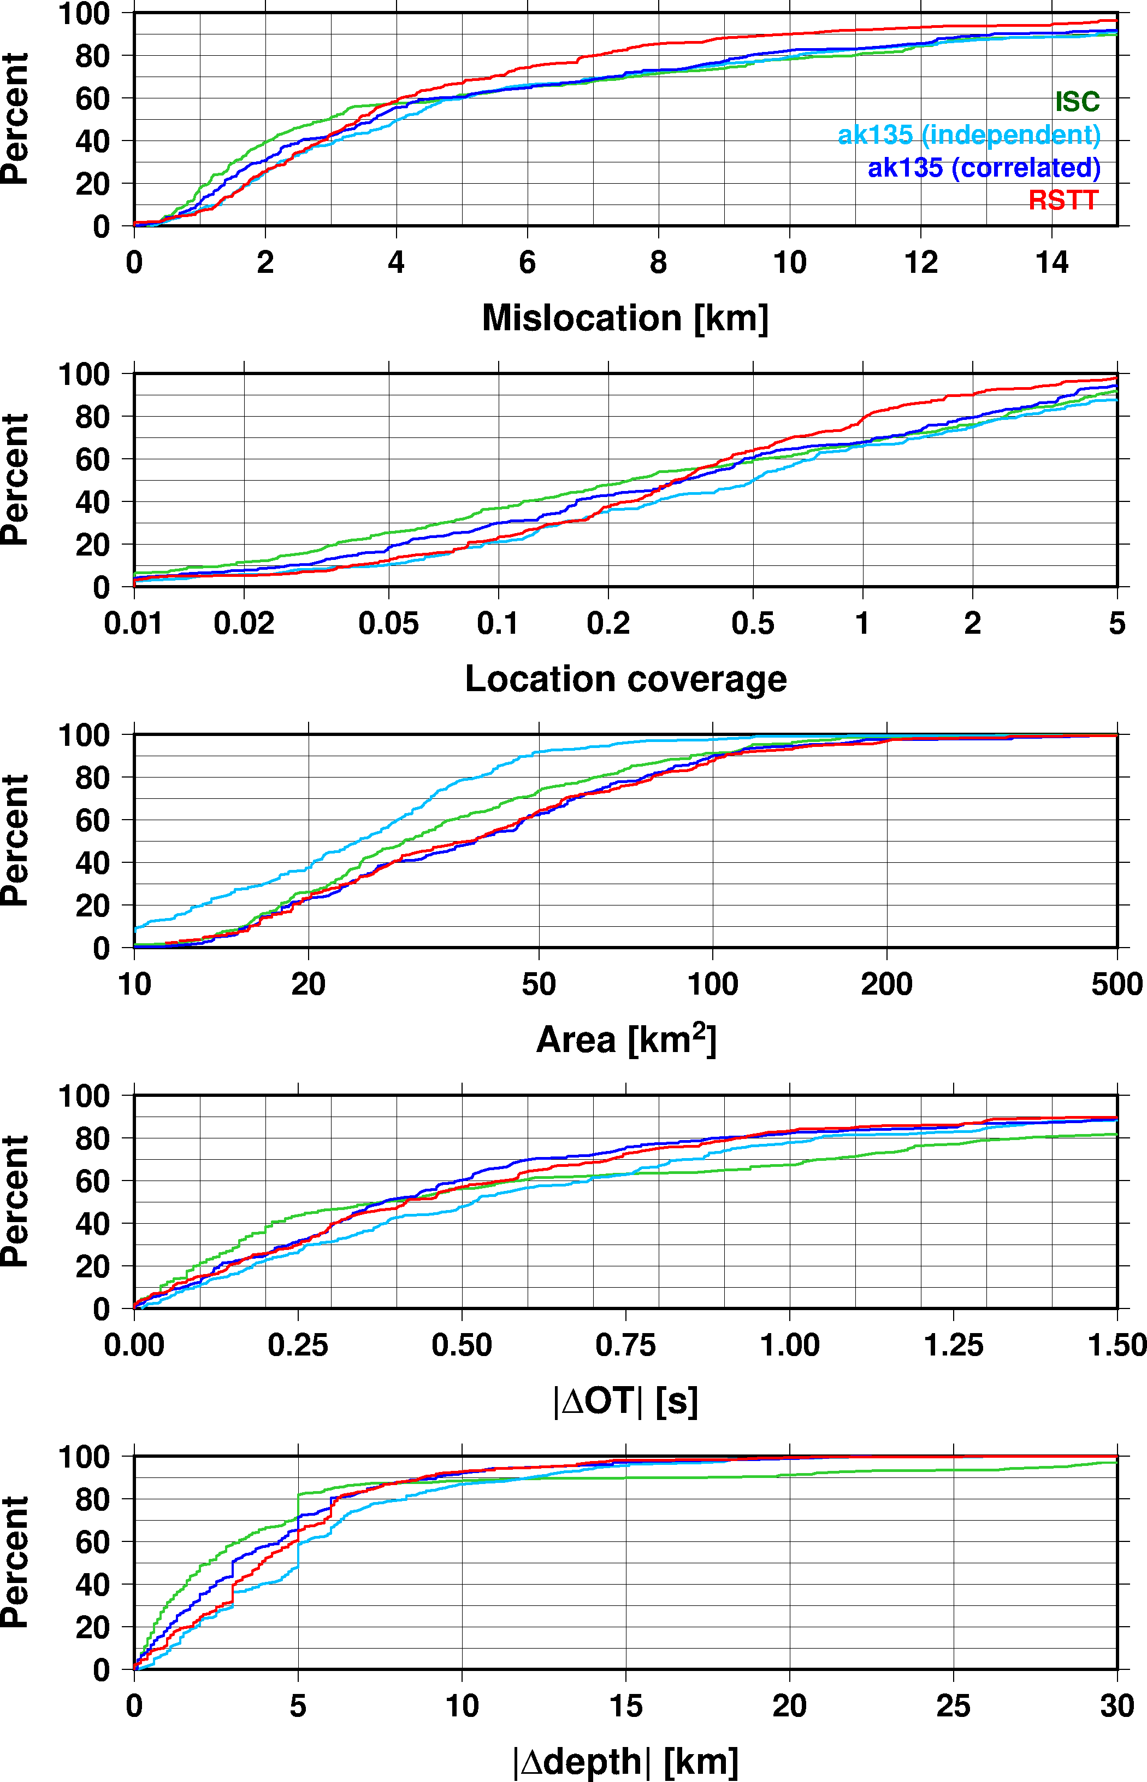
GT5 Event Relocations
No significant differences at the median level
90th percentile level
Mislocation: 9km for RSTT, larger than 14 km for the rest
Depth and OT: iLoc with correlated errors beats ISC
Error ellipse area: ISC and independent errors underestimate uncertainties
GT coverage: RSTT 80%, ak135 70%
RSTT outperforms ak135

Slide 15
Summary
The Caucasus region is a tectonically complex region
It is difficult to assess the performance of velocity models without GT information
Event with GT5, no significant difference on average
The improvements are in the tails
ak135 with the assumption of independent errors gives the worst results
ak135 with correlated errors is better than ISC
RSTT model outperforms ak135 on all counts.

