Slide 1
INTRODUCTION TO MUSTANG
Laura Hutchinson, Data Quality Analyst, IRIS DMC

Slide 2
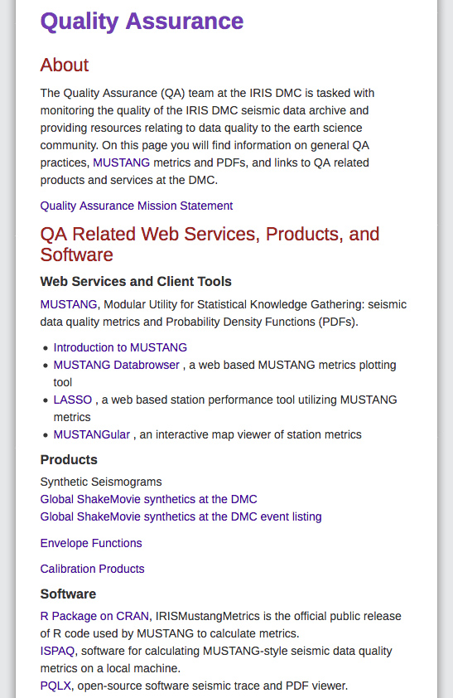
Quality Assurance
Is…
Important for high quality research
Useful for improving data – fixing stations, etc.
Subjective – bad for you might be good for me
Ex. Is noise good or bad?

Slide 3
Quality Assurance Using MUSTANG
What is MUSTANG
MUSTANG is an automated data quality assurance system that stores measurements of seismic data quality for the entire IRIS archive and makes them available to the community through standard web services.
Currently, 46 metrics are calculated.
The system is modular; new metrics can be added readily.
MUSTANG has the capability to automatically update metrics values when the data or metadata changes, and in the future, when metrics algorithm changes.

Slide 4
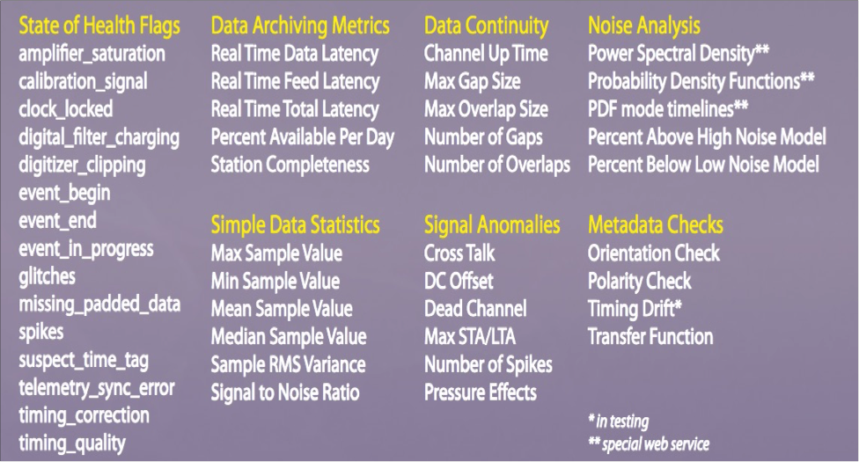
MUSTANG: Quality Assurance System

Slide 5
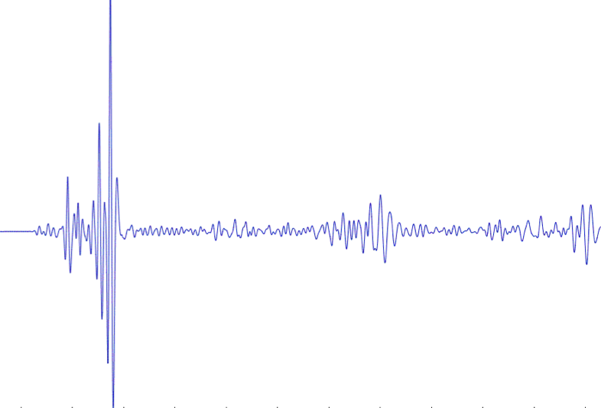
IRIS DMC: Enhanced Quality Assurance
MUSTANG
MUSTANG Measurements
gaps, overlaps, completeness, signal-to-noise, psd, pdf, etc (46 metrics)
Domestic & non-US Network Operators
PostgreSLQ
Database
Data Quality Analyst (me)
Public

Slide 6
Accessing MUSTANG Metrics
Now that you know what they are, how do you get to them?

Slide 7
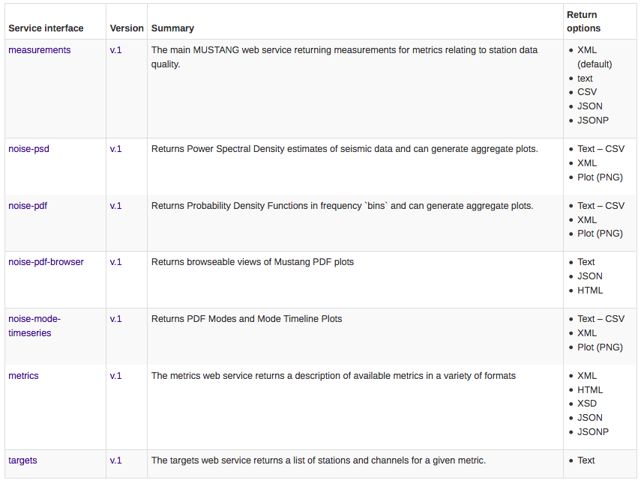
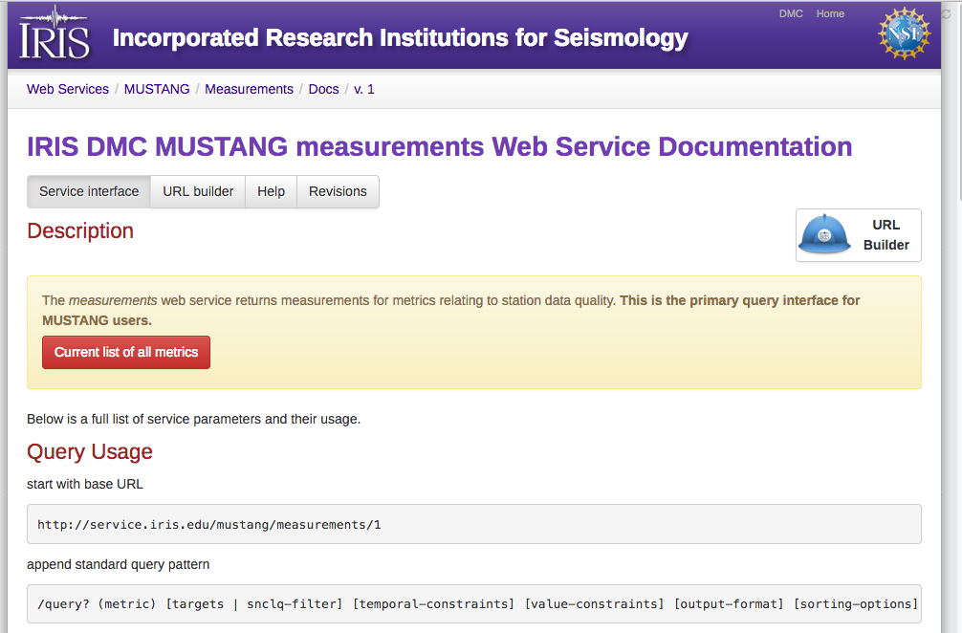
Web Services
MUSTANG Metrics can be reached through IRIS web services:
http://service.iris.edu
http://service.iris.edu/mustang/
Each service provides access to some facet of our metrics catalog

Slide 8
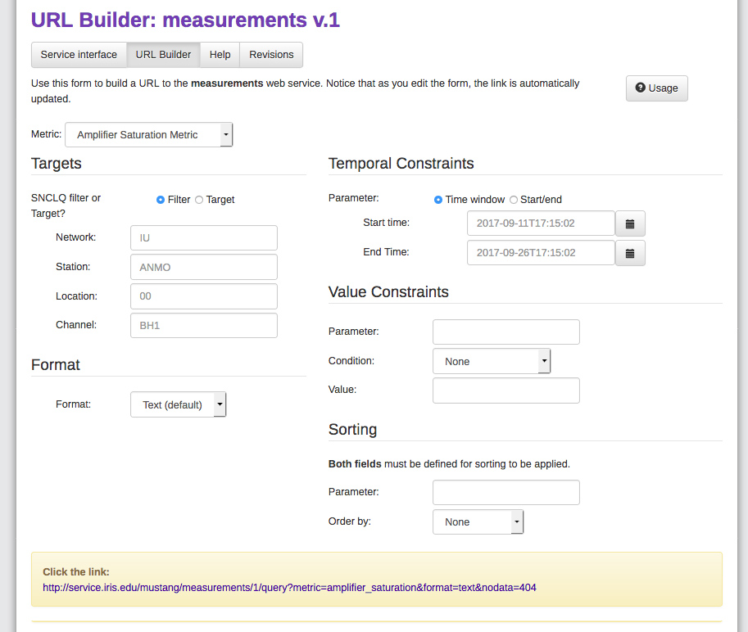
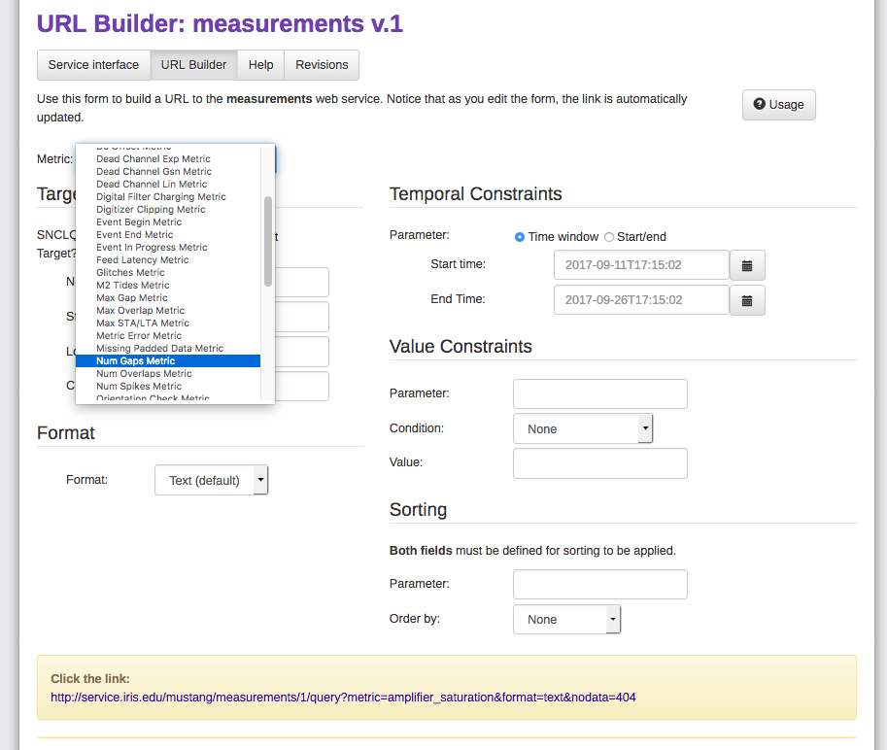
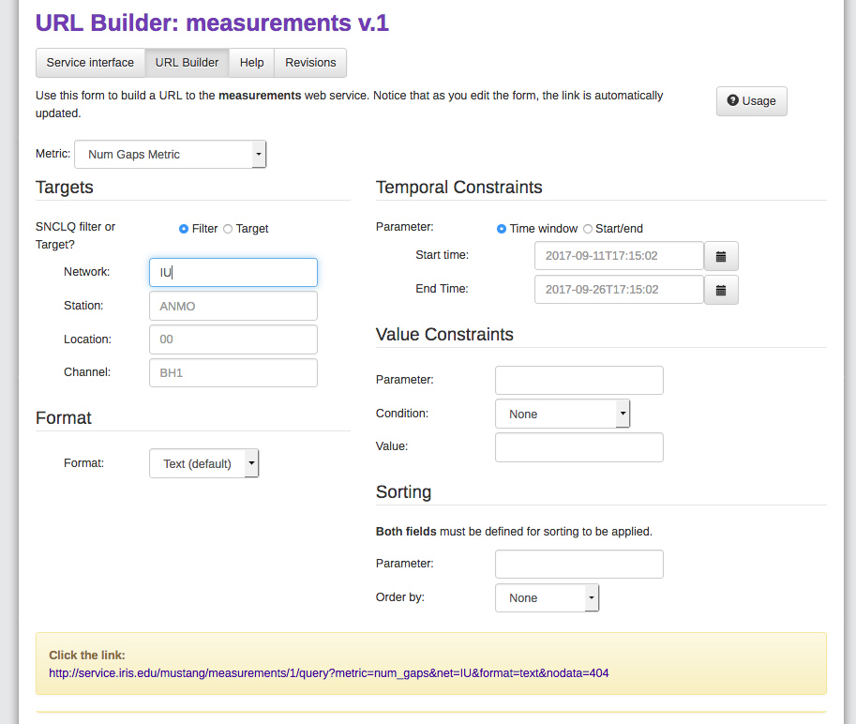
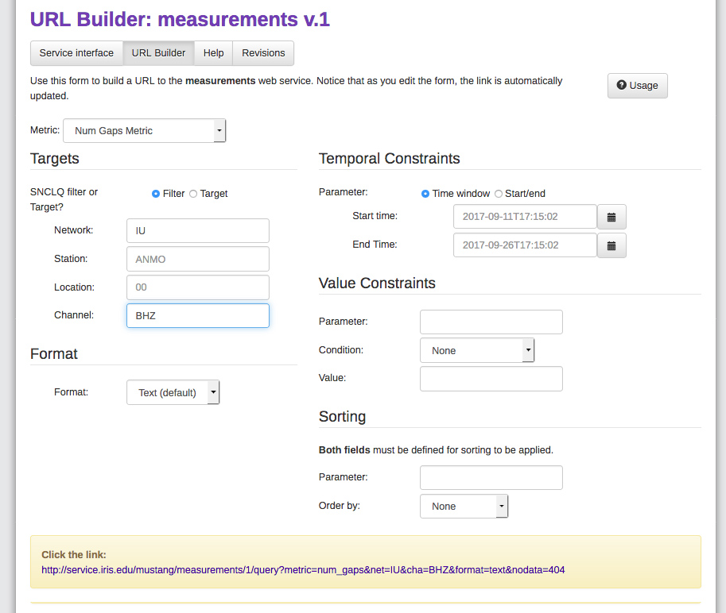
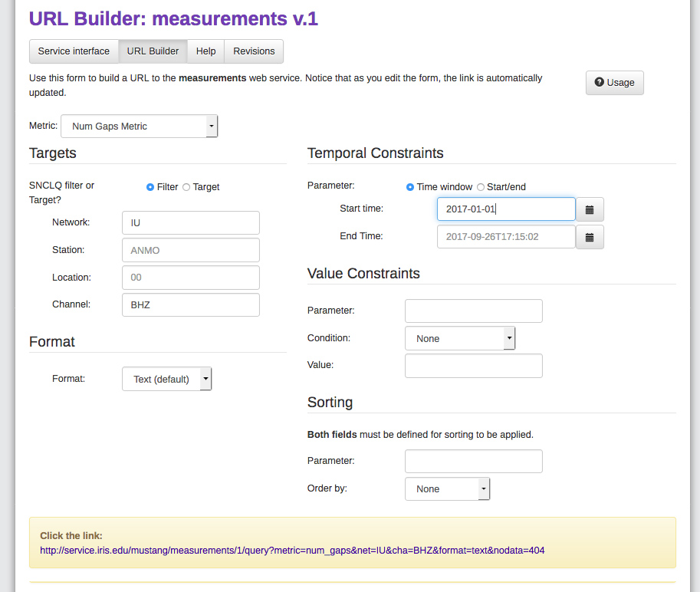
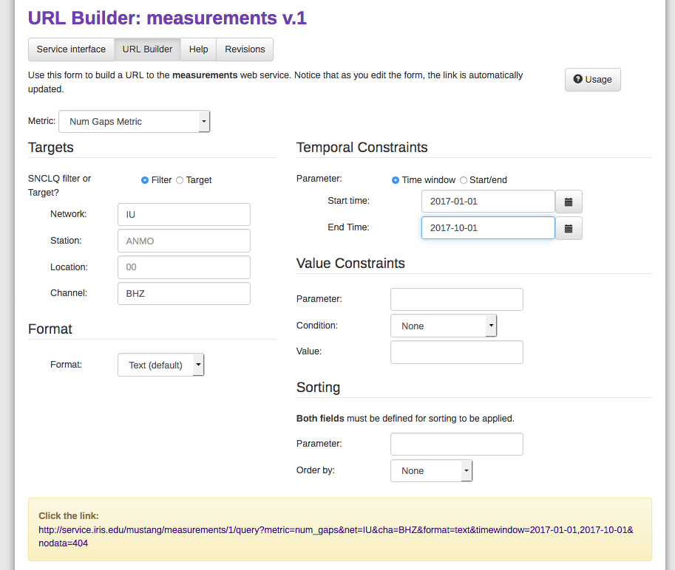
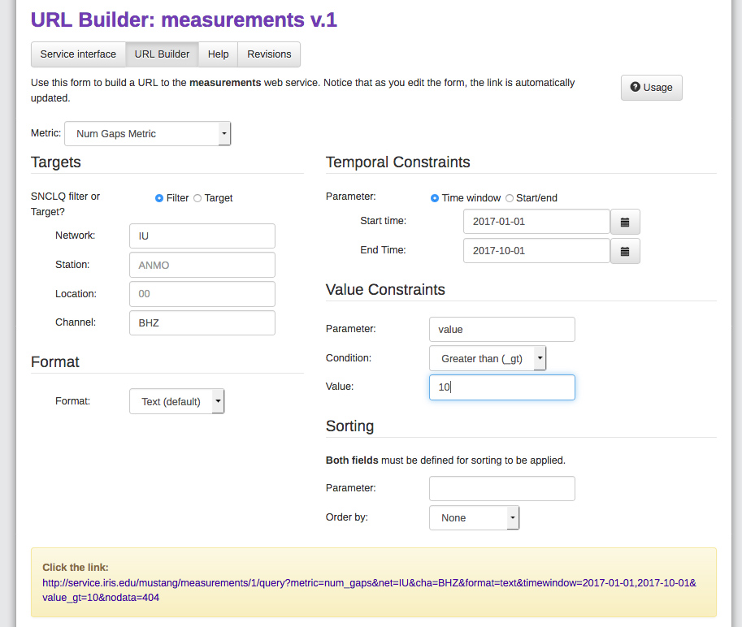
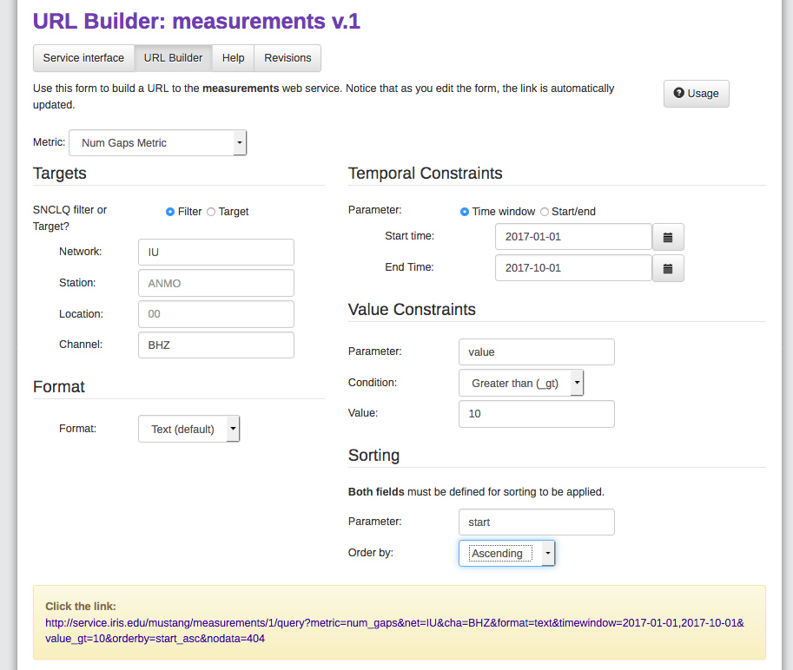
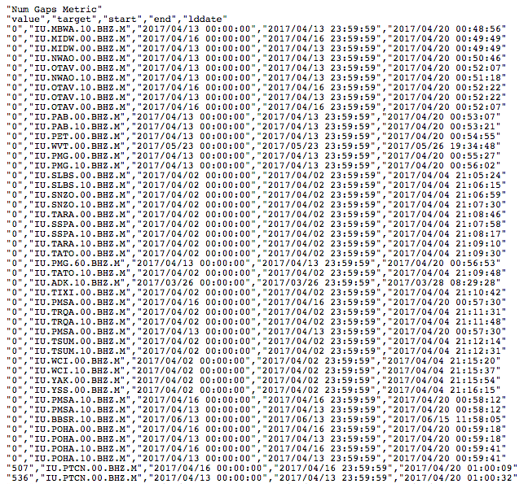
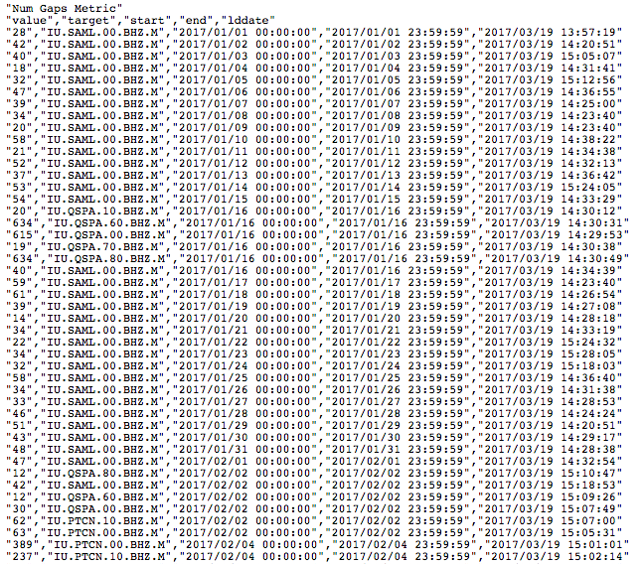
The URL Builder
To wildcard, either leave blank or use */?
Note: the URL updates automatically

Slide 9
Hands-On: measurements service
Pull up the number of gaps (num_gaps) for a month of BHZ data for the IU network
Find the SNCL-days that had greater than 4 gaps
Order by the SNCL
Trickier: Get the percent_availability, num_gaps, and max_gap for a month of II.BORG.00.BH1 data. (hint: use the URL to make the call, not the URL builder)

Slide 10
Web Services - PSDs
MUSTANG Metrics can be reached through IRIS web services:
http://service.iris.edu
http://service.iris.edu/mustang/
Each service provides access to some facet of our metrics catalog

Slide 11
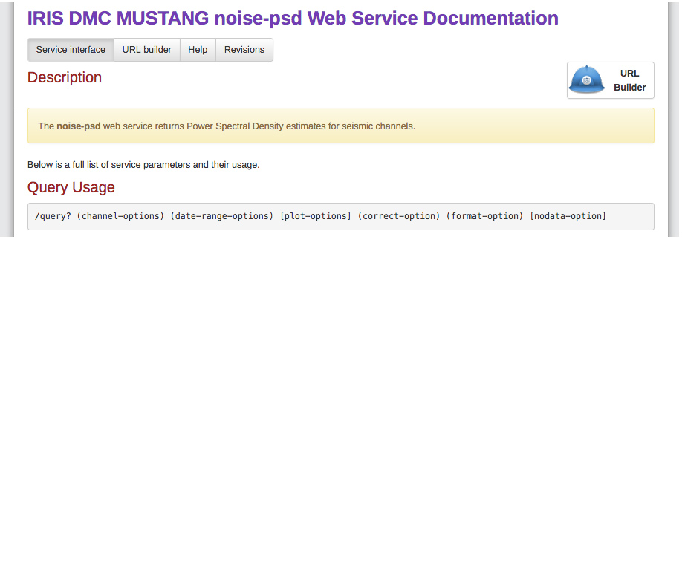
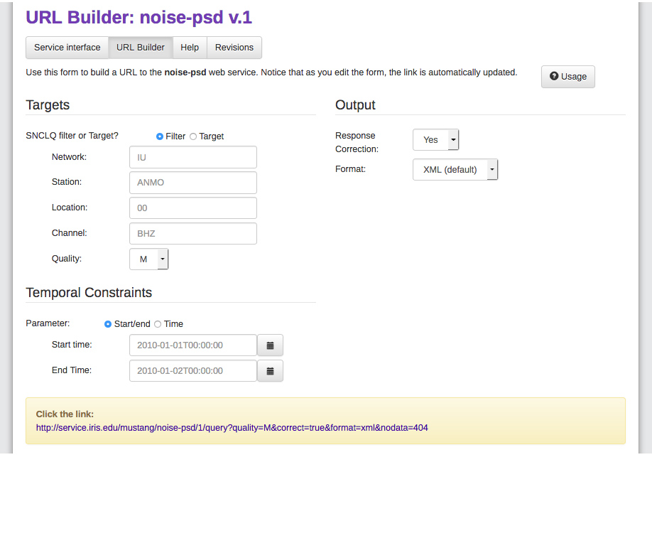
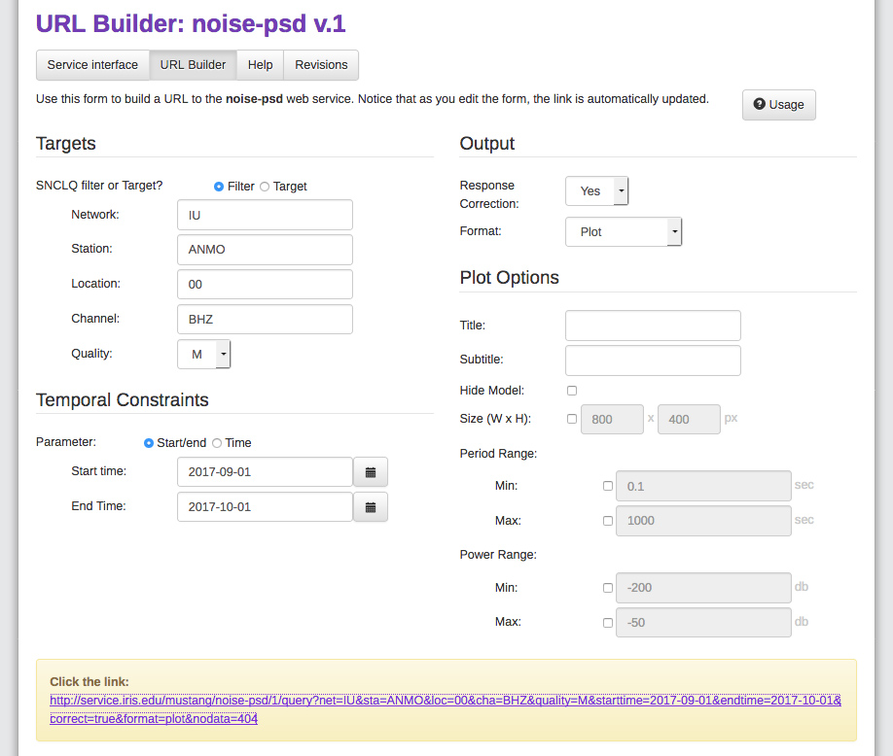
http://service.iris.edu/mustang/noise-psd/1/
Handles wildcards
*Limit 5000 psds

Slide 12
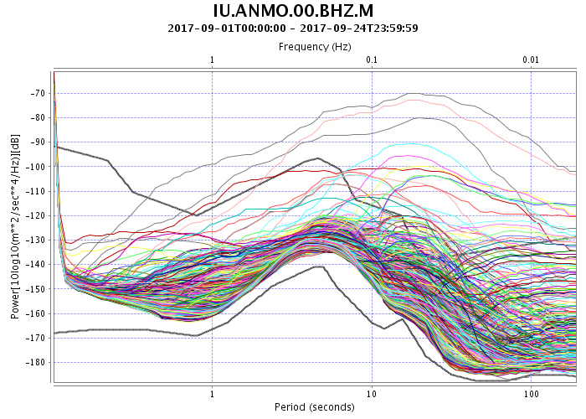
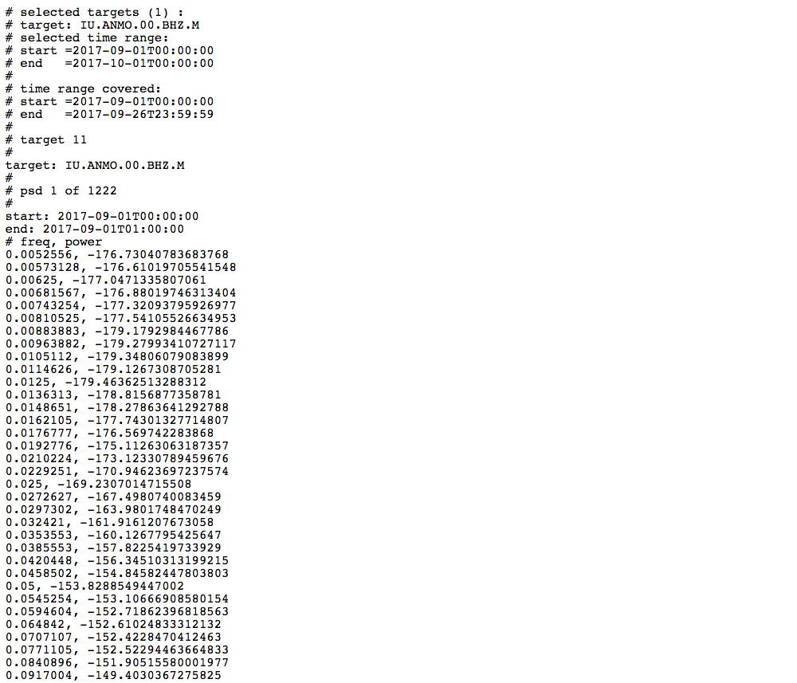
http://service.iris.edu/mustang/noise-psd/1/query?net=IU&sta=ANMO&loc=00&cha=BHZ&quality=M&starttime=2017-09-01&endtime=2017-10-01&correct=true&format=plot&nodata=404
http://service.iris.edu/mustang/noise-psd/1/query?net=IU&sta=ANMO&loc=00&cha=BHZ&quality=M&starttime=2017-09-01&endtime=2017-10-01&correct=true&format=text&nodata=404

Slide 13
Hands-On: PSDs
Pull up a plot of IU.ANMO.00.BHZ data for one day of data
Now do the same, but for an hour
Play with adding a title and the various Plot Options
Instead of a plot, get the results as XML and/or text
Note that PSDs are calculated for hour-long time periods, every half hour.

Slide 14
Web Services – PSD modes
MUSTANG Metrics can be reached through IRIS web services:
http://service.iris.edu
http://service.iris.edu/mustang/
Each service provides access to some facet of our metrics catalog

Slide 15
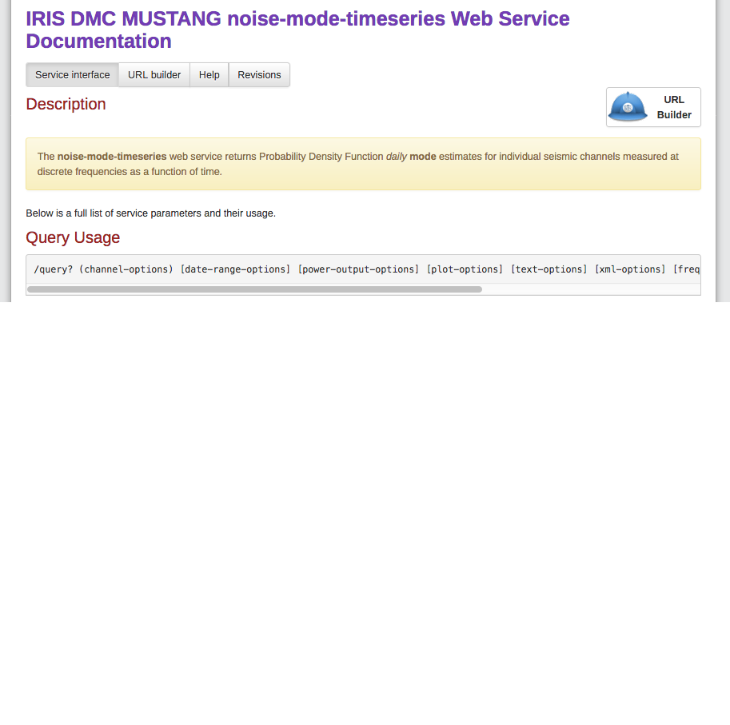
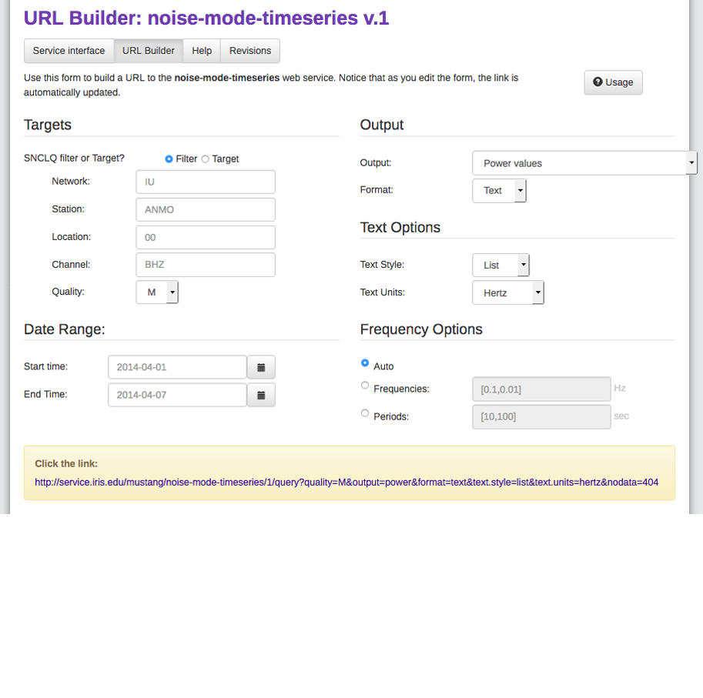
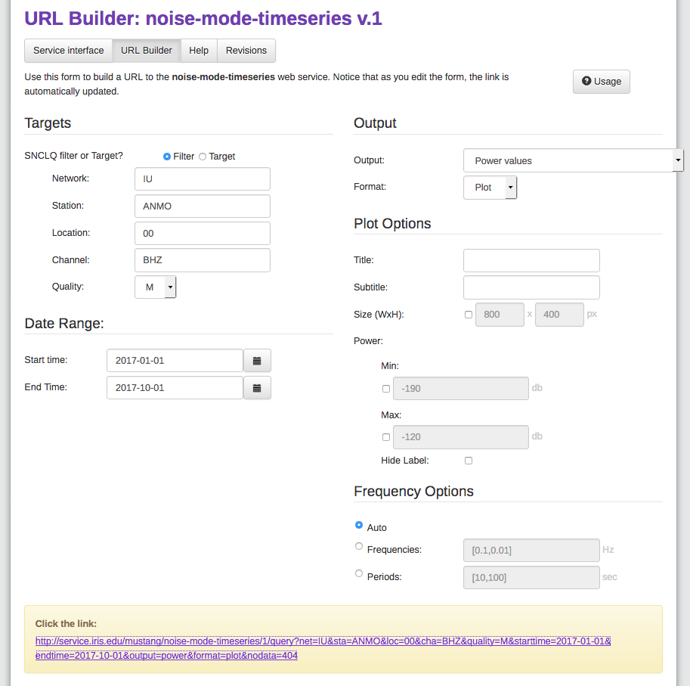
http://service.iris.edu/mustang/noise-mode-timeseries/1/
Single target only – no wildcarding

Slide 16
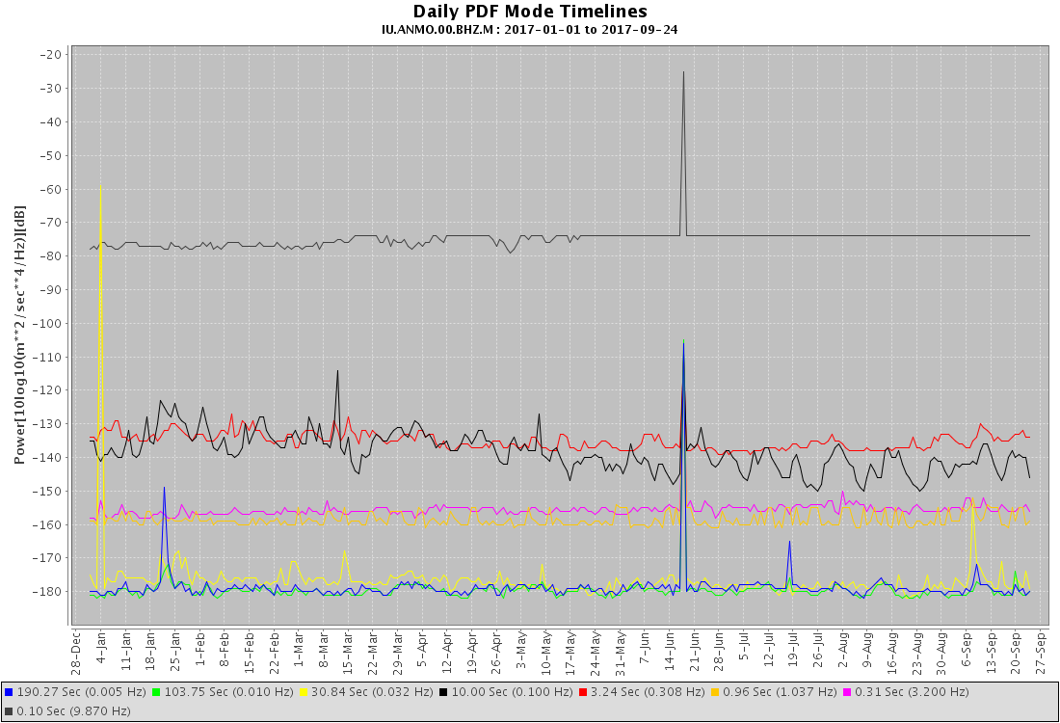
http://service.iris.edu/mustang/noise-mode-timeseries/1/query?net=IU&sta=ANMO&loc=00&cha=BHZ&quality=M&starttime=2017-01-01&endtime=2017-10-01&output=power&format=plot&nodata=404

Slide 17
Hands-On: PSD modes
Pull up a plot of IU.BILL.00.BHZ for 2017-03-01 to 2017-06-01
Compare that to the other Output options:
Power values vs high-noise model
Power values vs low-noise model
Power values vs high- and low-noise models
Choose your own frequencies to plot
Note that you can base it off of your own noise model – which could be the noise model for that station or network, or any other model you would like.

Slide 18
Web Services - PDFs
MUSTANG Metrics can be reached through IRIS web services:
http://service.iris.edu
http://service.iris.edu/mustang/
Each service provides access to some facet of our metrics catalog

Slide 19
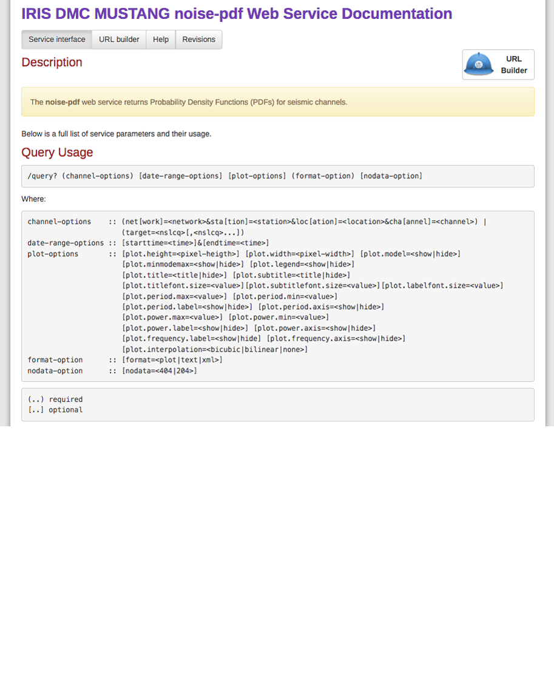
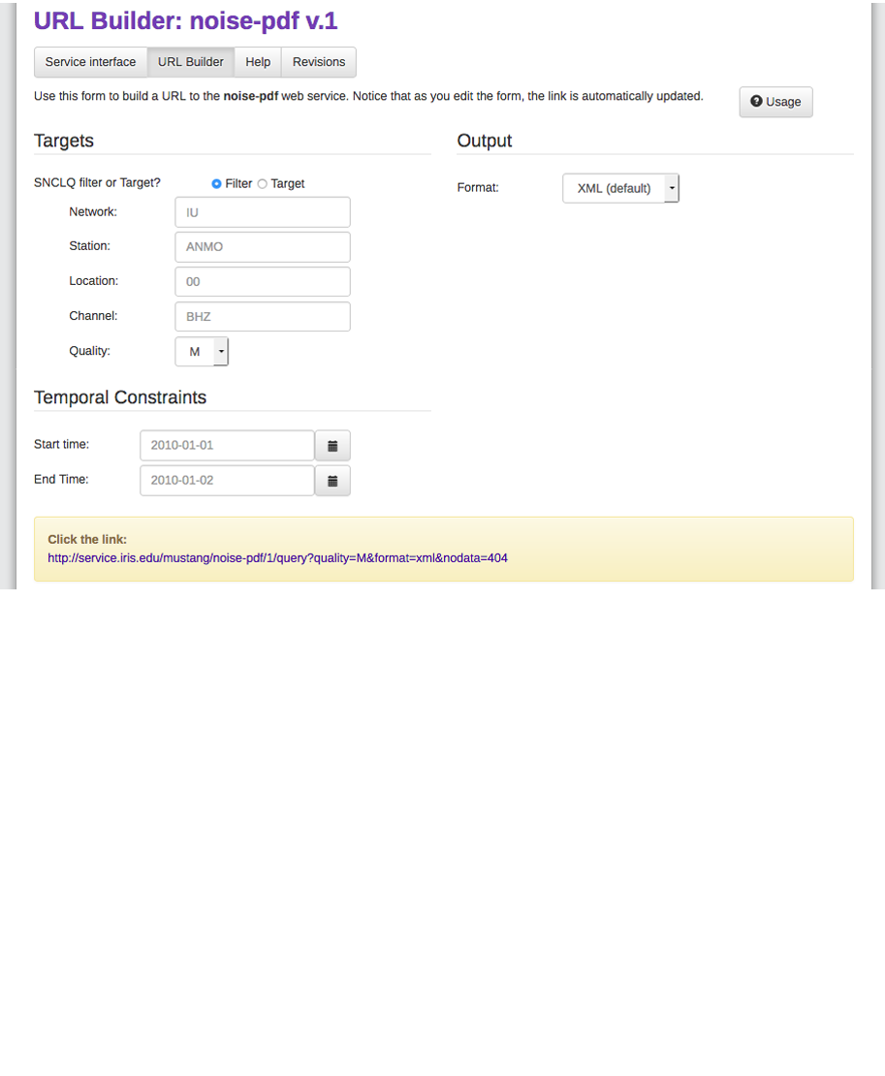
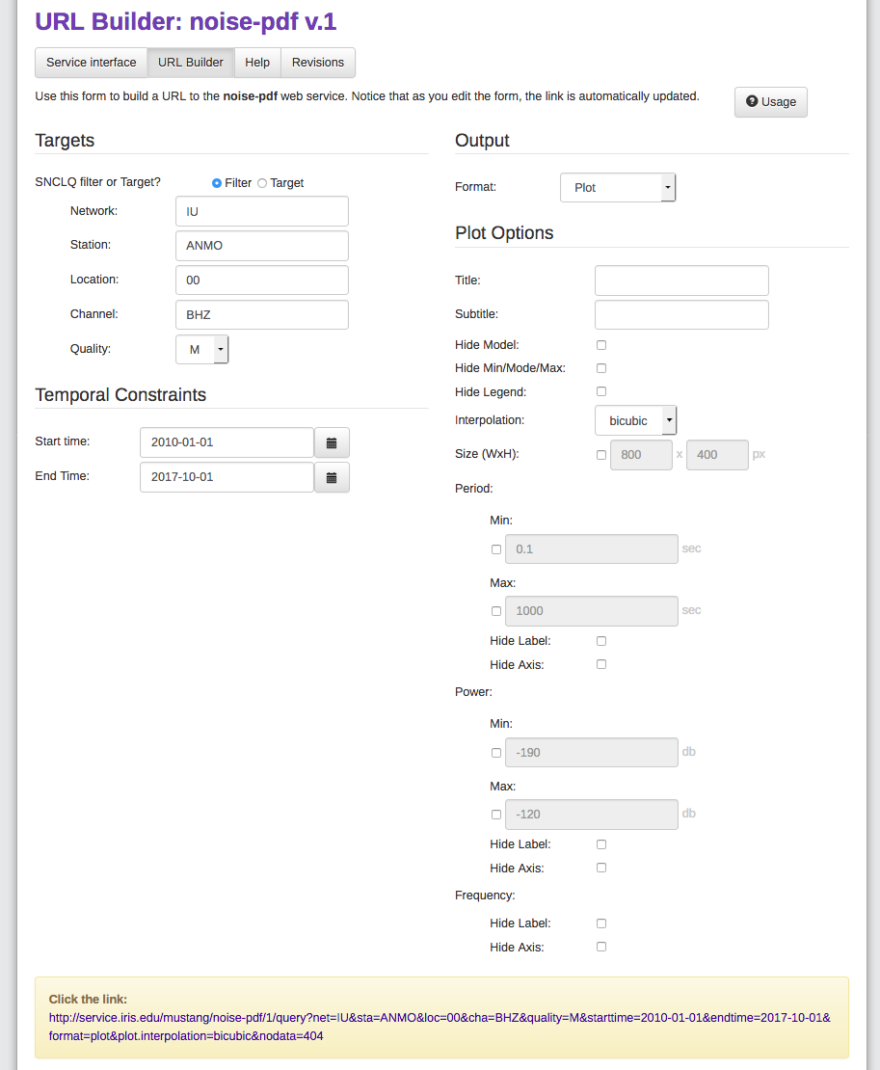
http://service.iris.edu/mustang/noise-pdf/1/
Allows wildcards
Handles long time ranges well

Slide 20
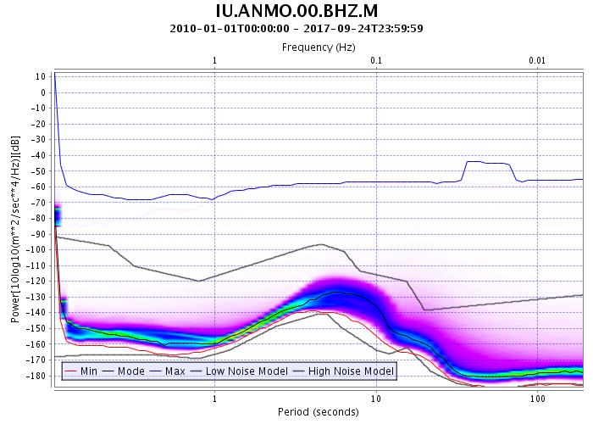
http://service.iris.edu/mustang/noise-pdf/1/query?net=IU&sta=ANMO&loc=00&cha=BHZ&quality=M&starttime=2010-01-01&endtime=2017-10-01&format=plot&plot.interpolation=bicubic&nodata=404

Slide 21
Hands-On: PDFs
Generate a plot of the PDF for IU.BILL.00.BHZ for 2017-03-01 to 2017-06-01
Narrow down to determine when the change occurred
Pull up the text version of the PDF – what is each column?
Get the BHZ channels entire IU network for 2017
Get the entire history of IU.ANMO.00.BH1

Slide 22
Web Services – PDF Browser
MUSTANG Metrics can be reached through IRIS web services:
http://service.iris.edu
http://service.iris.edu/mustang/
Each service provides access to some facet of our metrics catalog

Slide 23
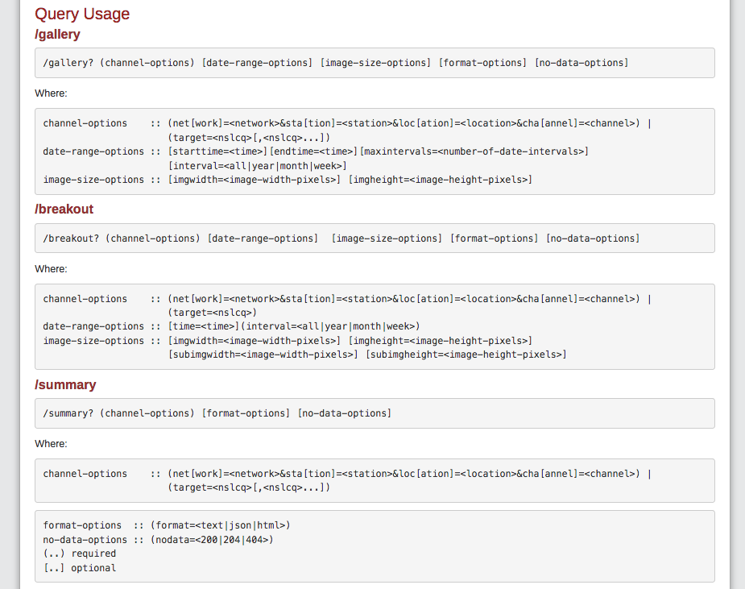
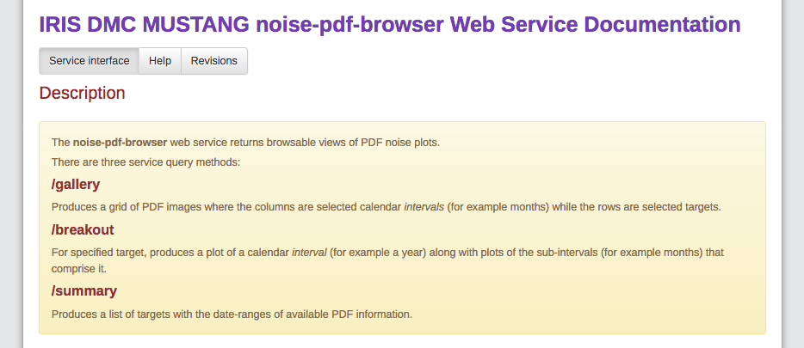
http://service.iris.edu/mustang/noise-pdf-browser/1/
http://service.iris.edu/mustang/noise-pdf-browser/1/gallery?
http://service.iris.edu/mustang/noise-pdf-browser/1/breakout?
http://service.iris.edu/mustang/noise-pdf-browser/1/summary?

Slide 24
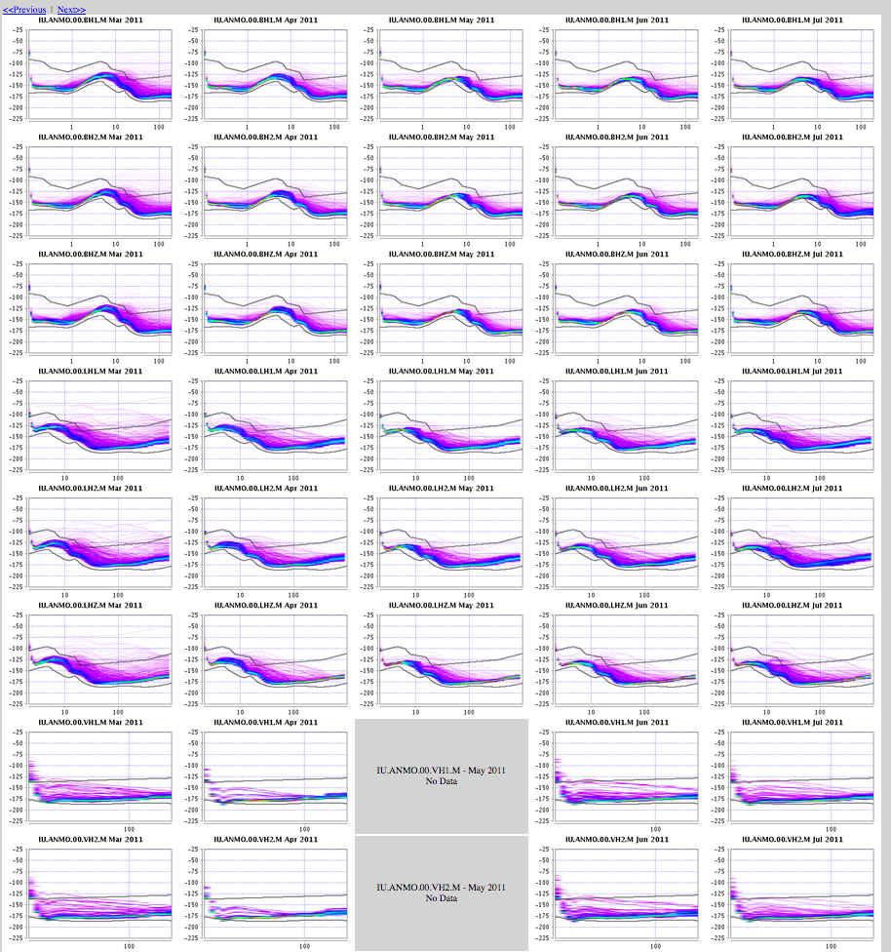
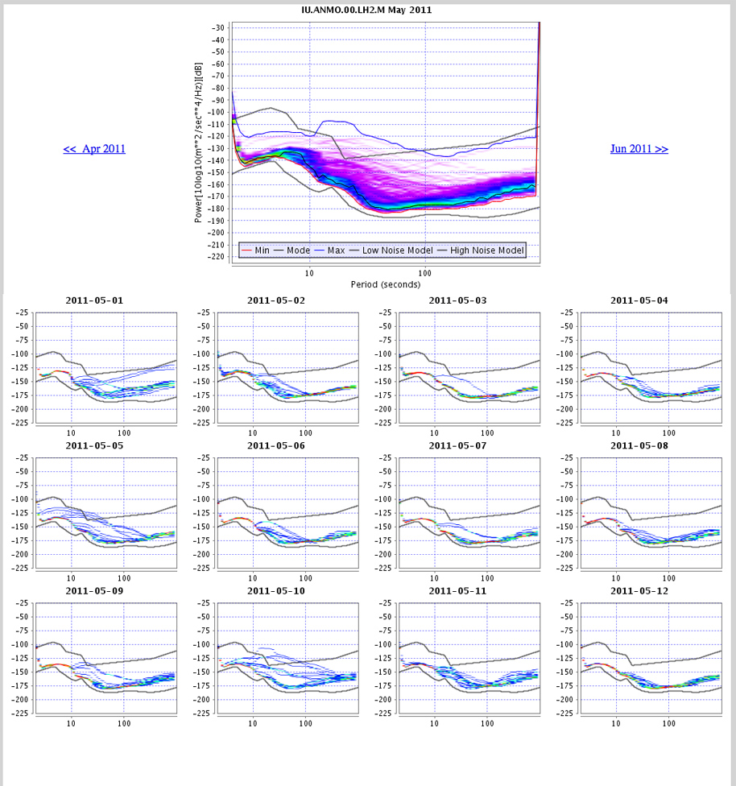
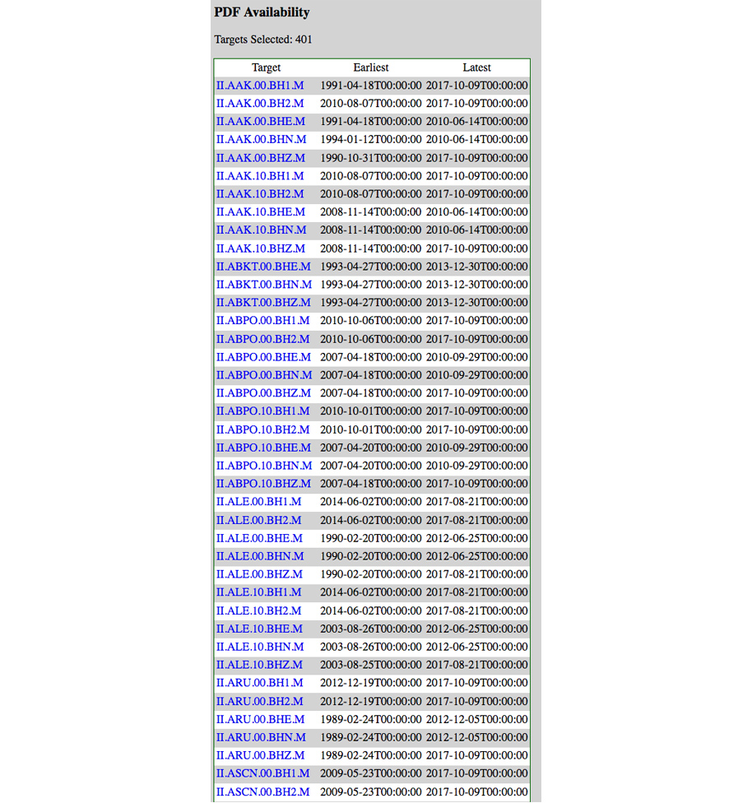
Gallery view – monthly or yearly views
Breakout view – total at top with components below
Year or month on top
Month or day below
Summary view – listing of start and end of PDF availability for each sncl

Slide 25
Hands-On: PDF Browser
Look through the Service interface page at the various usages
/gallery: Get the BHZ channels entire IU network for 2017, by month
/breakout: From the previous page, click on IU.BILL.00.BHZ Apr 2017
Explore looking at the previous/next month
Find the day that the channel went bad in April 2017
/summary: from the Service interface page, click on a summary view example.
What is each column?
Click on a target – takes you to the breakout page for that SNCL

Slide 26
More resources
http://ds.iris.edu/ds/nodes/dmc/tutorials/getting-started-with-mustang/
http://ds.iris.edu/ds/nodes/dmc/tutorials/seismic-data-quality-assurance-using-iris-mustang-metrics/
Playing around the with URL builder, Service Interface, and Help pages
Upcoming: Research Ready Data Sets (RRDS)
Allows users to filter requests for data based upon quality assurance metrics

