Slide 1
DMC Data Provider Agreements and Usage Reports

Slide 2
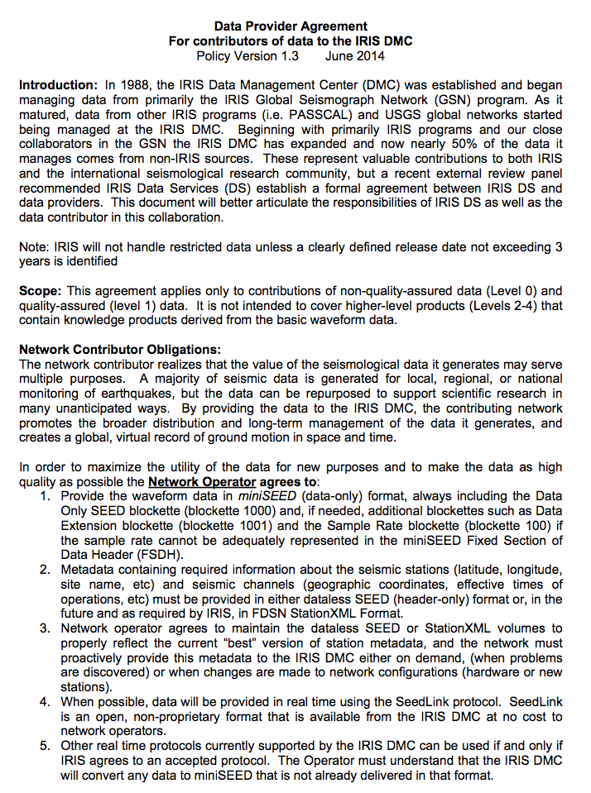
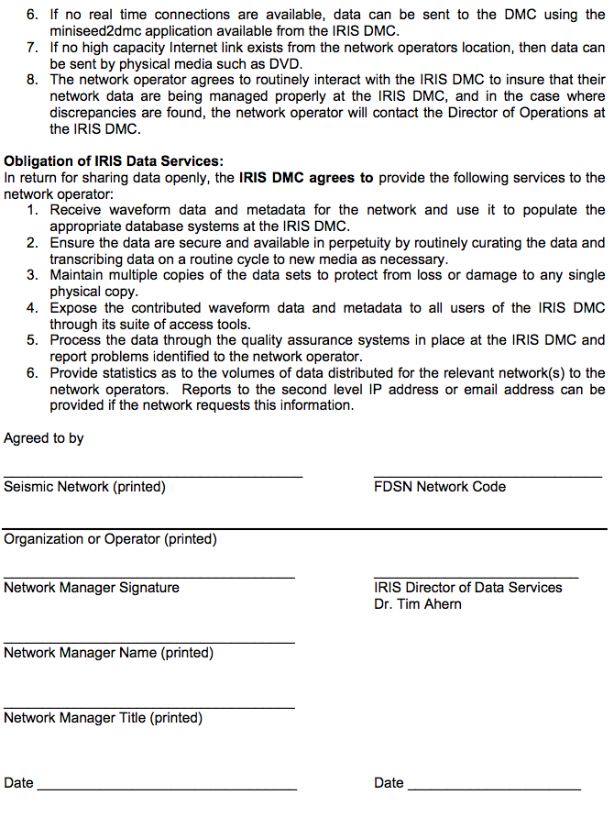
Data Provider Agreements

Slide 3
Data Provider Agreements
Every Country Attending this Workshop submitted a completed Data Provider Agreement
xx-Bhutan CB-China IA - Indonesia
KC -CAIAG KR - Kyrgyzstan KZ - Kazahkstan
MY – Malaysia NG – New Guinea RM - Thailand
RM-Myanmar xx – Timor Leste TW – Taiwan
UZ Uzbekistan
THANK YOU!!!

Slide 4
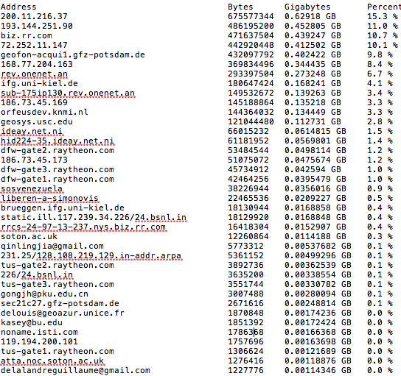
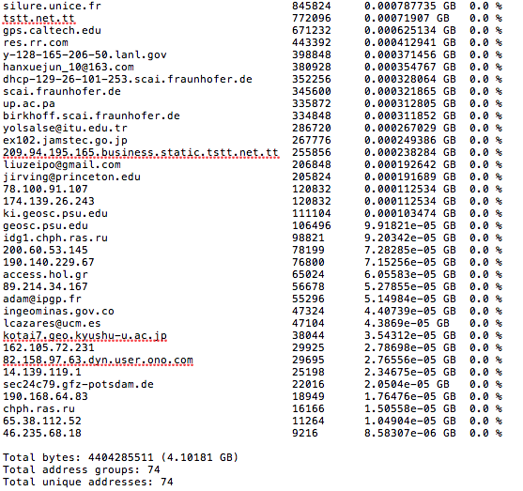
Usage Reports
IP or Email Bytes gbytes % of data
Total bytes sent that month
Total address groups
Total Unique addresses

