Slide 1
An Overview of IRIS Incorporated Research Institutions for Seismology
By
Tim Ahern, Director of Data Services, IRIS

Slide 2
Overview: What is IRIS?
Consortium of 120 US Universities
National Science Foundation Funded
US$30 million annual funding under the SAGE award
Five Programs
GSN
~160 permanent stations
PASSCAL
5000 portable channels
EPO
Workshops, posters, museum displays
Data Services
>27,000 stations over 45 years
350 terabyte archive of waveform data
Archives 60 terabytes per year
Distributes almost 1 petabyte per year
USArray
Transportable Array, Flexible Array, MT, Reference Net
Now moving to Alaska

Slide 3
IRIS
facilitates seismological research
Installs and operates the infrastructure needed by earth scientists to understand the complex Earth.
Supports facilities in permanent networks, portable networks and data management services.

Slide 4
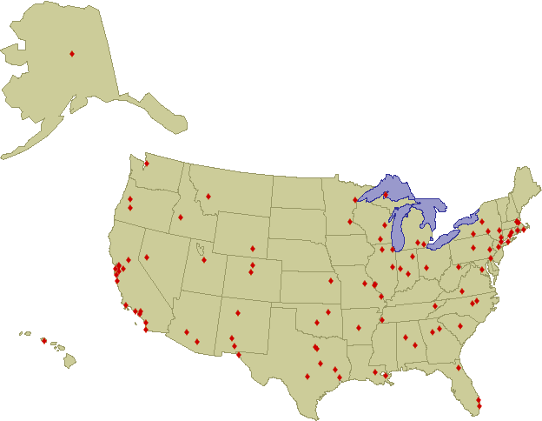
The IRIS Membership 120 Full Member Institutions

Slide 5
Types of IRIS Membership
Full IRIS Members
120 US-Based Research Universities
Educational Affiliates
22 US-Based Colleges
US Affiliates
2 US-Based, non degree granting
Foreign Affiliate Members
113 non-US based institutions
http://www.iris.edu/hq/files/publications/brochures_onepagers/doc/iris_fa_1.15.pdf

Slide 6
IRIS Incorporated Research Institutions for Seismology
IRIS HQ
Washington DC
Data
Generating
Info
Distribution
Seattle
Albuquerque
San Diego
GSN
DS
Research
Community
San Diego
Albuquerque
PASSCAL
EPO
K-12
Public
Socorro

Slide 7
EarthScope
San Andreas Fault Observatory at Depth (SAFOD)
Seismic
Strain
Cores, etc.
Plate Boundary Observatory (PBO)
GPS
Strain
Borehole Seismic
US Seismic Array (USArray)
Reference Network
Flexible Array
Transportable Array
Magnetotelluric Arrays

Slide 8
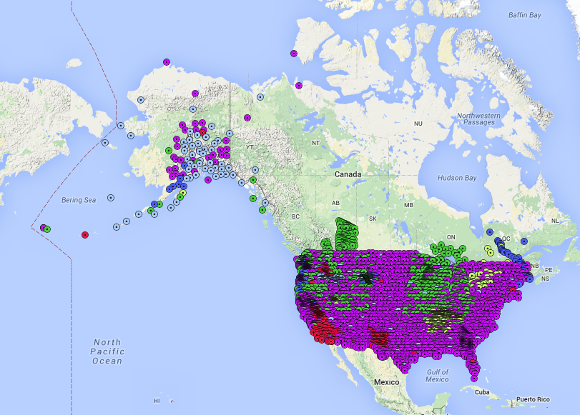
USArray (TA, FA, MT, Ref)
6,644stations have contributed data during the life of USArray

Slide 9
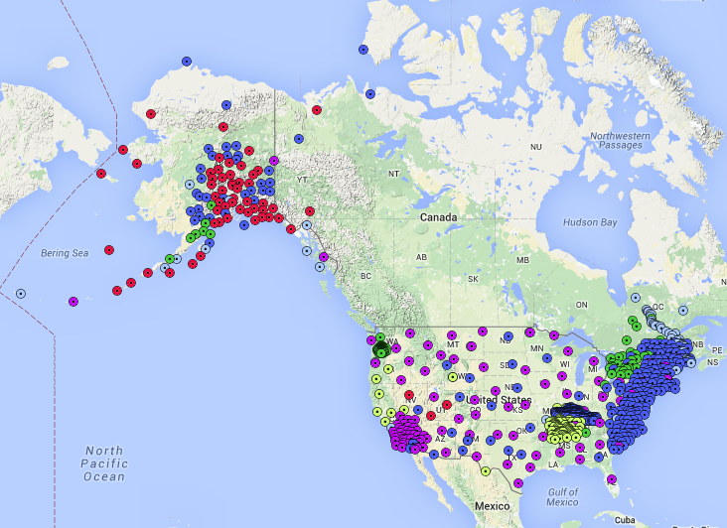
Currently Operating USArray Stations 807 stations

Slide 10
IRIS
Facilities are open to seismologists worldwide
Free of charge
Open Data Policy
Talk to IRIS Staff if you have specific questions

Slide 11
IRIS Data Services
Ingestion
Real time methods
Bulk file transfer methods
Archiving and Curation
Distribution

Slide 12
IRIS Data Services - ingestion
Ingestion
Real time methods rely on BUD
SeedLink is our preferred method
Antelope Orb2Orb
RRP
CD1.0 and CD1.1
And a variety of others (Rick will present more later)
Bulk file transfer methods
mseed2dmc

Slide 13
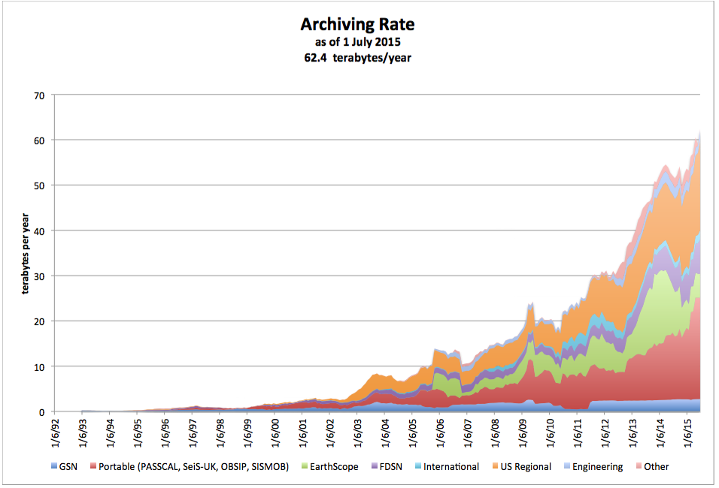
IRIS Data Services - ingestion

Slide 14
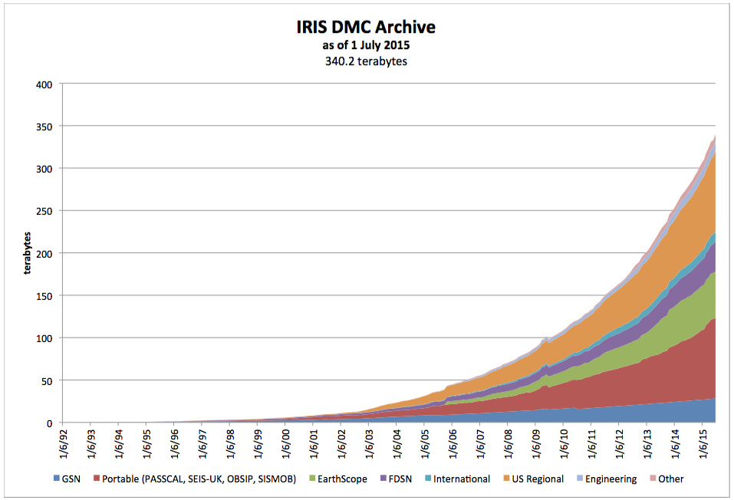
Archiving and curation

Slide 15
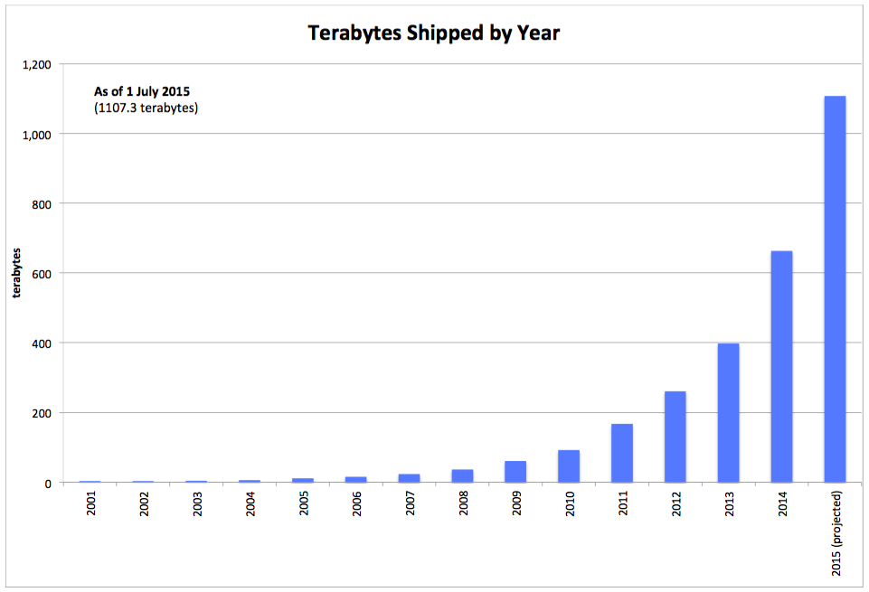
IRIS Data Services - distribution

Slide 16
IRIS DS
International Activities
Data Workshops
Regional Exchange of Earthquake Data (REED)
Support for SeisComp3
Included FDSN web services support

