Slide 1
Seismic Network in Nepal
By
Bharat Prasad KOIRALA
Mukunda BHATTARAI
National Seismological Center
Department of Mines and Geology
NEPAL
International workshop organized by IRIS in Hanoi, Vietnam
9-17 September, 2015

Slide 2
Outline
Introduction
Seismic Network
Instrumentation
Seismicity
Recent Earthquakes
Future Plans

Slide 3
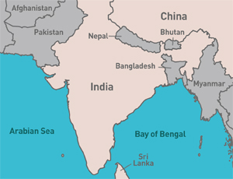
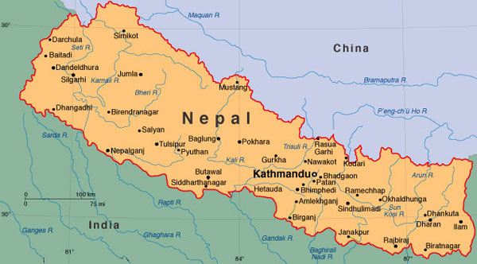
INTRODUCTION

Slide 4
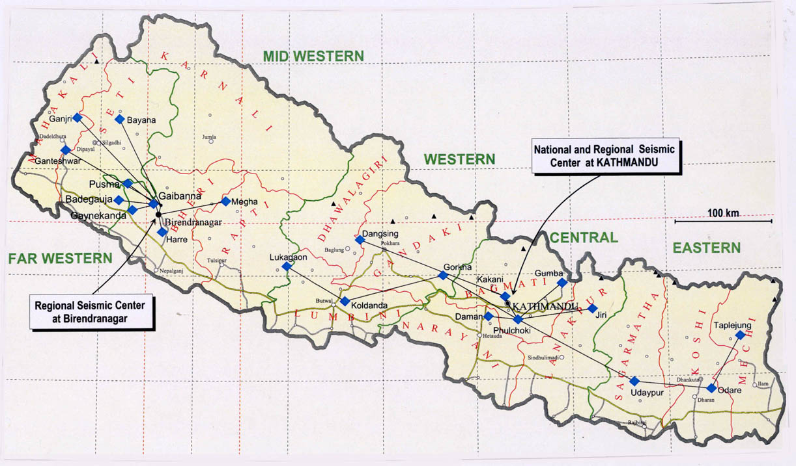
Seismic Network

Slide 5
Table of current seismic stations
EASTERN NETWORK
85.40 27.57 PKI
85.10 27.60 DMN
85.27 27.80 KKN
85.88 27.91 GUN
84.63 28.00 GKN
82.98 28.10 PYUN
83.60 27.76 KOLN
83.76 28.34 DANN
86.59 26.95 RAMN
87.39 26.86 ODAN
87.71 27.35 TAPN
86.19 27.65 JIRN
WESTERN NETWORK
82.34 28.71 MEGN
81.16 28.77 BADN
81.33 28.63 GNKN
81.61 28.68 GBAN
81.27 28.87 PUSN
81.20 29.47 BAYN
80.62 29.17 GHAN
80.74 29.48 GJRN
81.67 28.41 HARN

Slide 6
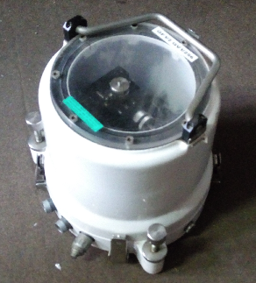
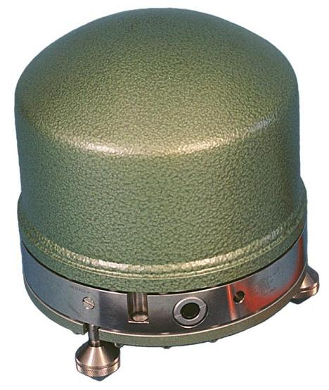
Instruments

Slide 7
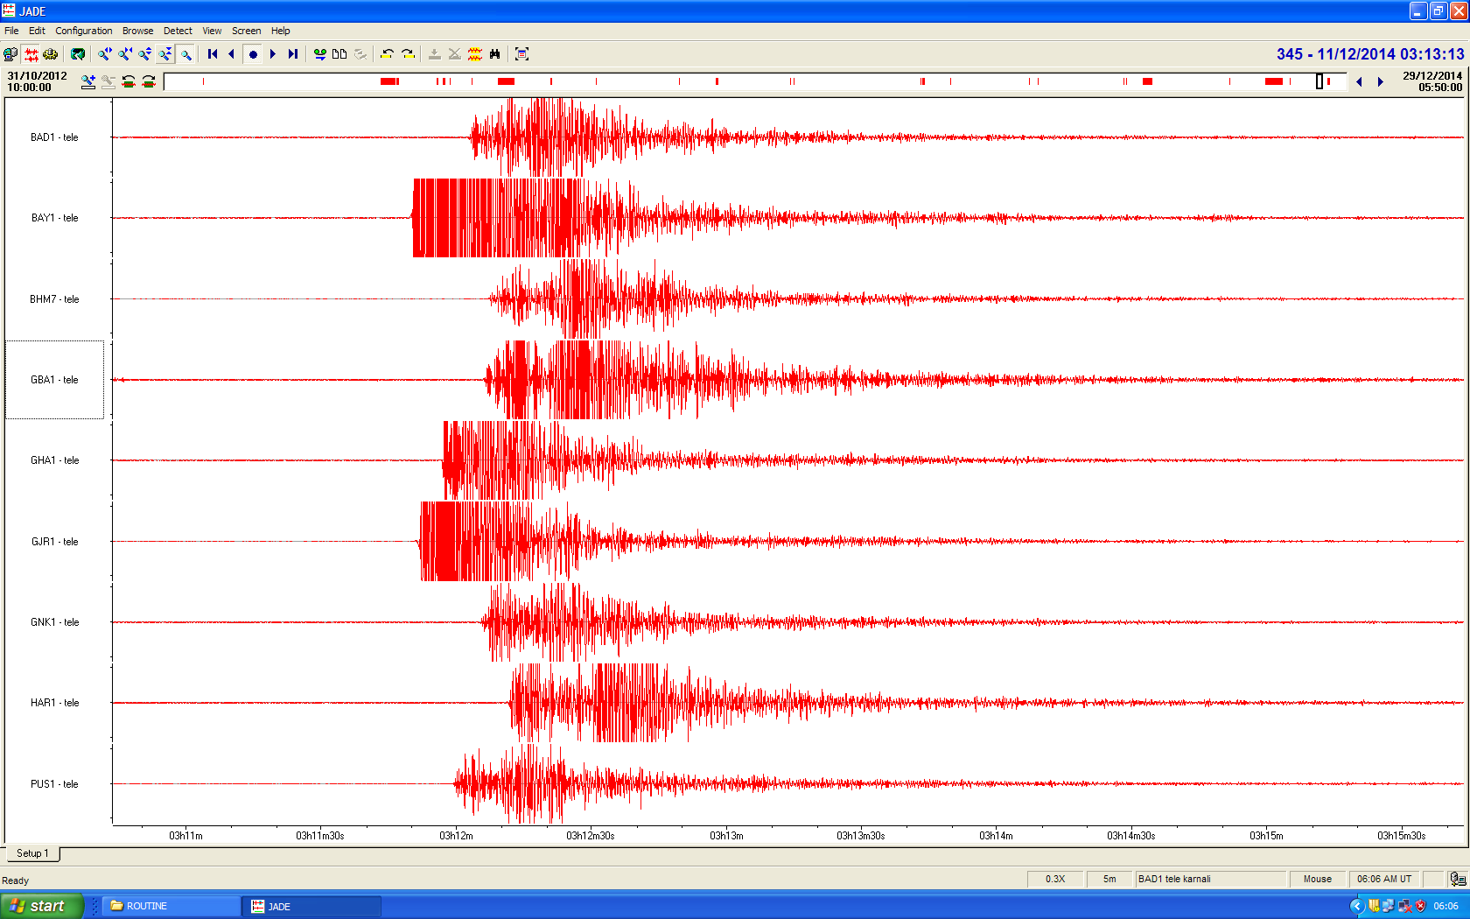
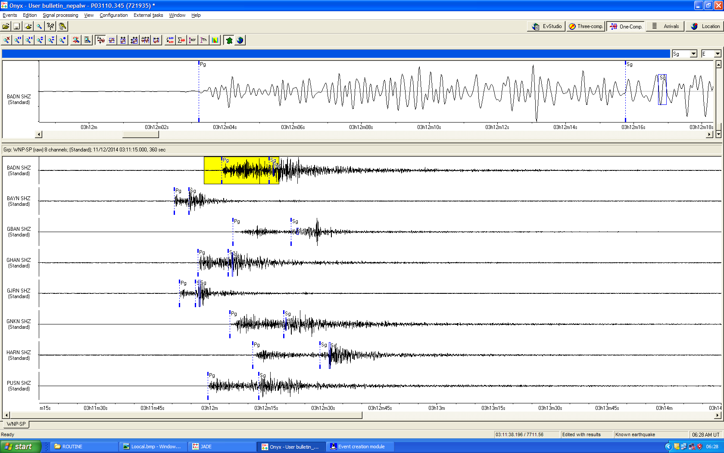
Analysis system
Digitizer → ADAS – PC
Seismometer → 21 – ZM 500 – 1 Hz
2 – Broadband STS 2.0
3 – Long Period ZM 500, HM 500
Analysis System
JADE – Data acquisition
ONYX --Processing/Interpretation
ONYX

Slide 8
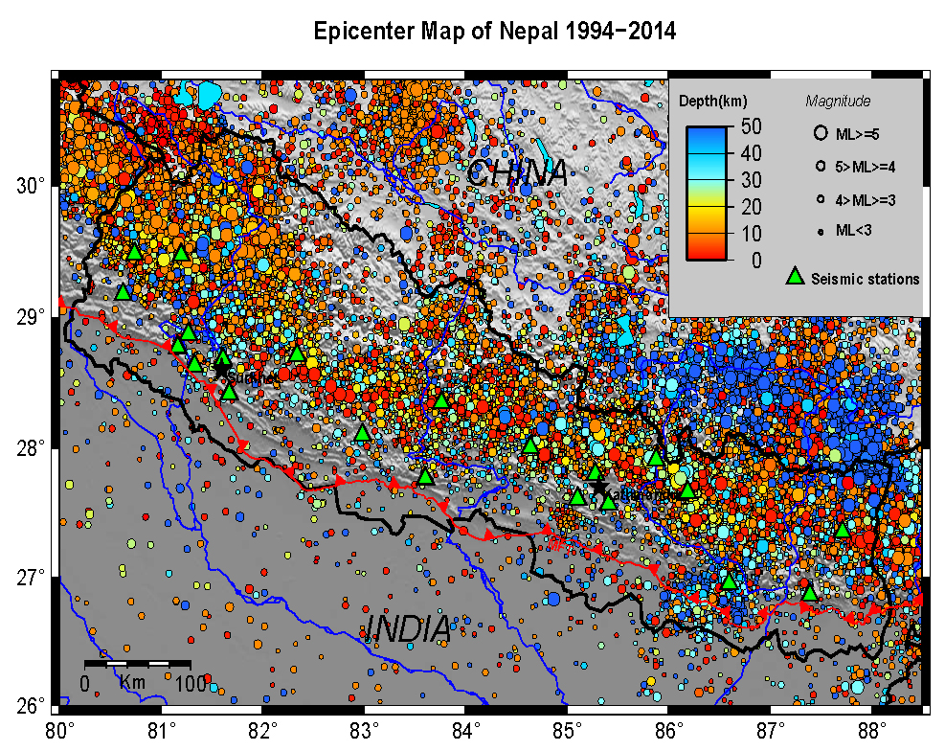

Slide 9
Seismic signal of Gorkha Earthquake (25 Apr 2015)

Slide 10
Aftershock Distribution of Gorkha Earthquake 2015

Slide 11
Future Plans
The MoU between RIMES and DMG is under process to strengthen the Network capacity.
We are going to upgrade our analogue acquision system to digital system.

Slide 12
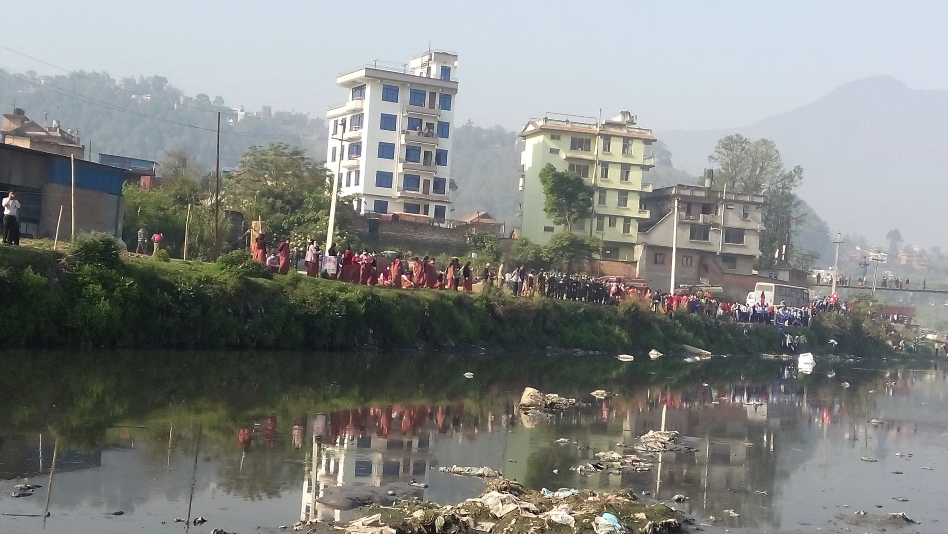
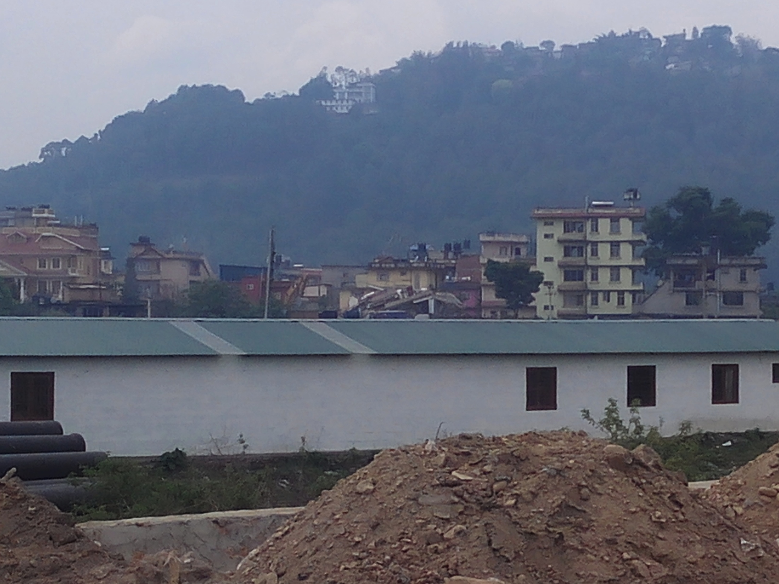
THANK YOU

