Slide 1
Seismic Network
Moosa Saeed
Maldives Meteorological Service

Slide 2
Seismic Network in Maldives
Two Broadband Seismometer is installed in Maldives.
One in HA.Hanimadhoo (North of Maldives).
Other one in GD.Kaadhehdhoo (South of Maldives).
Seismic data is transferred to the HUB in Jakarta, Indonesia by VSAT satellite
communication.
SeisComp3 system is installed to monitor Earthquakes.

Slide 3
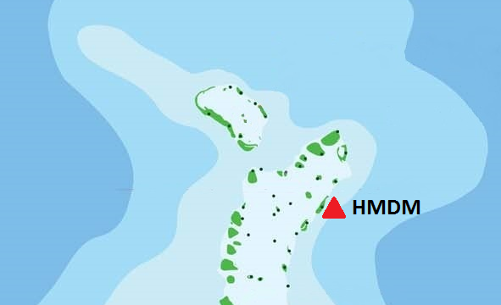
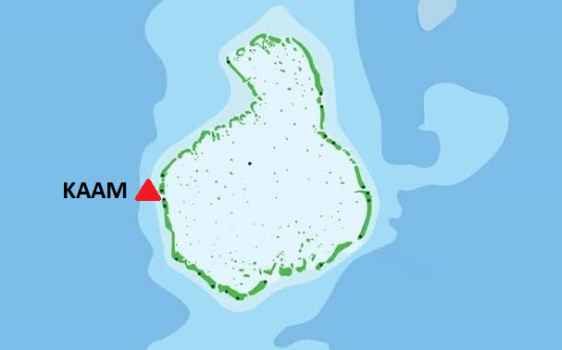
Map of Seismic Network in Maldives

Slide 4
Station Details
Station Name | Hanimadhoo , Maldives
Station ID | HMDM
Network | GE (GEOFON Global Seismic Network)
Coordinates | 6⁰77’31”N , 73⁰18’22” E
Station Name | Kaadehdhoo , Maldives
Station ID | KAAM
Network | GE (GEOFON Global Seismic Network)
Coordinates | 0⁰49’26”N , 72⁰99’49”E

Slide 5
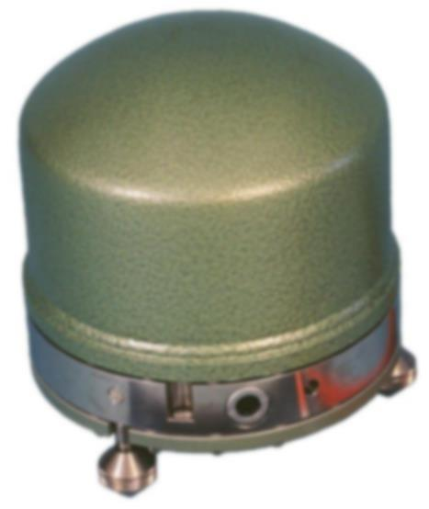
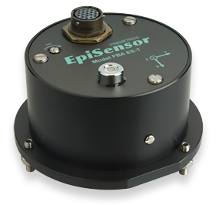
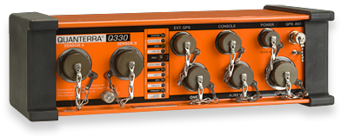
Instruments used in Seismic Network
Primary Sensor
Streckeisen STS2
Secondary Sensor
Kinemetrics Force Balance Accelerometer
Digitizer
Kinemetrics Q330
Communication
VSAT Satellite

Slide 6
SOP of MMS
No action is taken on earthquakes that is less than 5.9 in magnitude
How ever, if there is an earthquake in the Andaman Islands or the Carlsberg region, SMS will be sent to the ‘task force’ group.
If there is an earthquake above 7.0 in another area of the world, it will be notified to the task force via SMS
If there is an earthquake of 7.0 in the Indian Ocean, we fall in to the alert system.

Slide 7
THANK YOU

