Slide 1


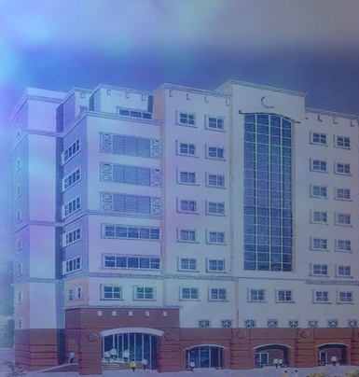

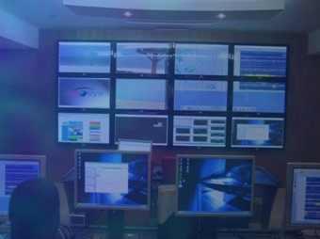

MALAYSIAN
NATIONAL TSUNAMI EARLY WARNING SYSTEM
MNTEWS
AHMAD RIFAIE AHMAD RIDZUAN
METEOROLOGICAL OFFICER
Malaysian Meteorological Department (MMD)
Ministry of Science, Technology and Innovation (MOSTI)
Jalan Sultan, 46667 Petaling Jaya, Selangor, Malaysia
Email: rifaie@met.gov.my

Slide 2
Malaysian National Tsunami Early Warning System (MNTEWS)
Malaysian Government had established MNTEWS after the December 2004 Acheh Tsunami.
To enable the provision of timely and effective early warning to the public in the event of the occurrence of a tsunami generated over the Indian Ocean, South China Sea, Sulu Sea or the Pacific Ocean that will affect Malaysia.

Slide 3
Malaysian National Tsunami Early Warning System
(MNTEWS)
As national monitoring centre for all earthquake activities and tsunami in Malaysia and its adjacent areas on a 24-hour basis throughout the year.
Issuance of information, advisory, notice, early warning and warning on the occurrence of earthquake and tsunami that threaten the security and safety of Malaysia.
It is an integral part of the Indian Ocean Tsunami Warning System and the Northwest Pacific Advisory System coordinated by the Intergovernmental Oceanographic Commission, UNESCO.

Slide 4
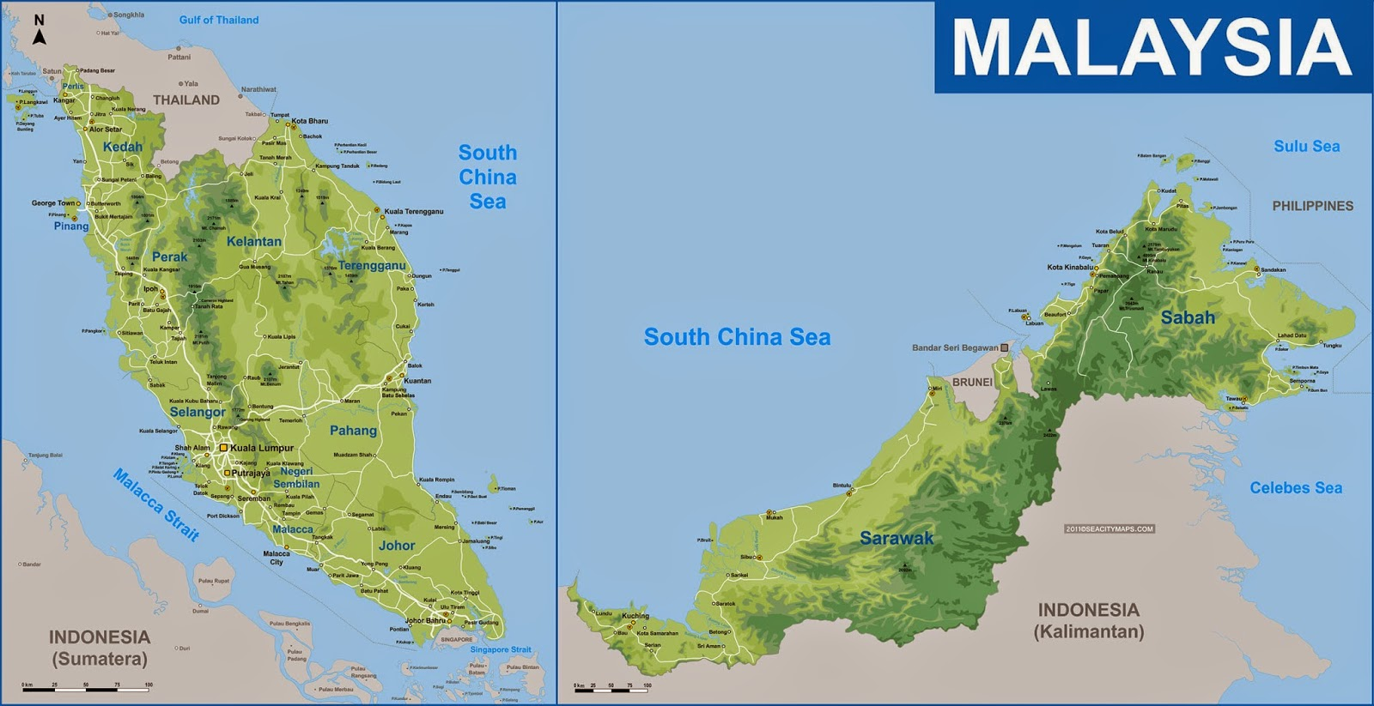
MALAYSIA NATIONAL SEISMIC NETWORK MAP –
WEAK MOTION
K.Trengganu
Kuala Krai
Kudat
Kulim
Temenggor
K.Kinabalu
Ranau
Sandakan
Ipoh
Lahad Datu
Jerantut
Sapulut
Danum
Tawau
Semporna
Kuala Lumpur
Kuala Pilah
Bintulu
Bakun
Murum
Kluang
Sibu
Kota Tinggi
Broad-band sensor
Kuching
Batang Ai
Short-period sensor

Slide 5
MALAYSIA NATIONAL SEISMIC NETWORK MAP – STRONG MOTION
Chuping
Gurun
Ranau
Teluk Kumbar
Taiping
Tanah Rata
Setiawan
Danum Valley
Behrang
Jempol
Kuala Pilah
Bukit Katil
Batu Pahat
Johor Bahru
Gelang Patah

Slide 6
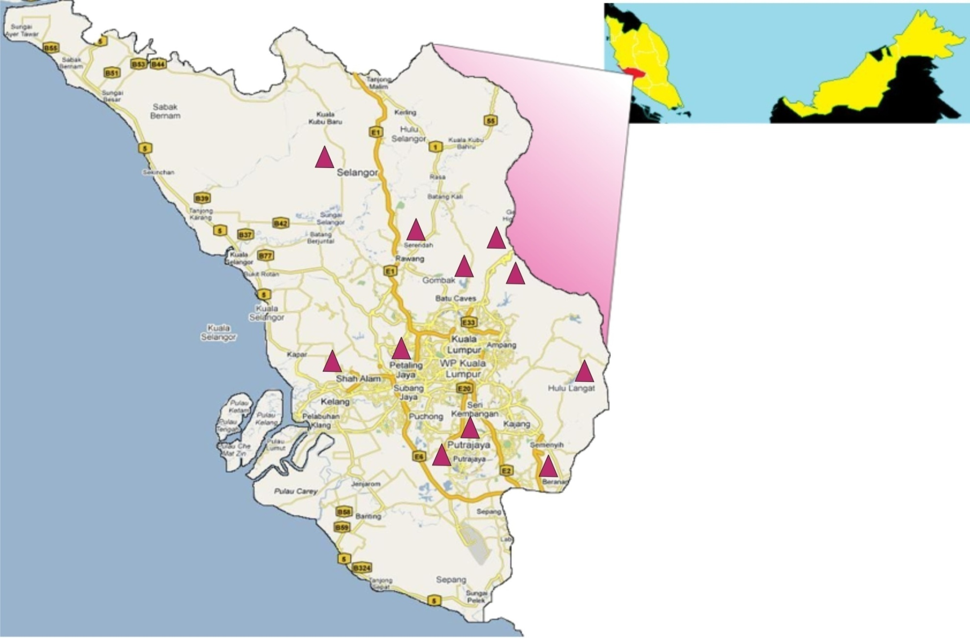
MALAYSIA NATIONAL SEISMIC NETWORK MAP – STRONG MOTION
Malaysia
Mardi Kundang
Pusat Serenti,Serendah
Aminuddin Baki,Gohtong Jaya
Bukit Tinggi
Empangan Batu, Ulu Yam
Pondok Polis, Janda Baik
Pusat Sains, Bukit Kiara
Bukit Cerakah, Shah Alam
IKBN,Dusun Tua
Wetland Putra Jaya
Perbadanan Putra Jaya
Kolej Mara-Beranang
State of Selangor & Federal Territory

Slide 7
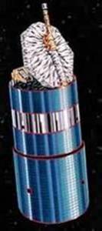
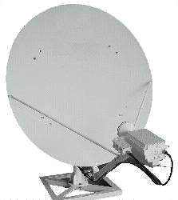
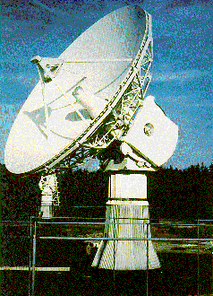
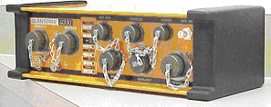
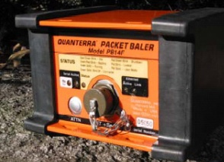
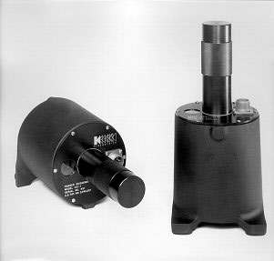
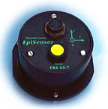
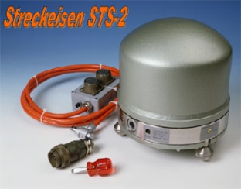
SEISMIC MONITORING SYSTEM USING
SATELLITE COMMUNICATION SYSTEM
VSAT
64kbps
64kbps
MEASAT
Data Transmitter
Data Digitizer and Recorder
Earth Station at
Kuala Lumpur
Sensors
Router
National Operations Centre Data Archiving and Processing

Slide 8
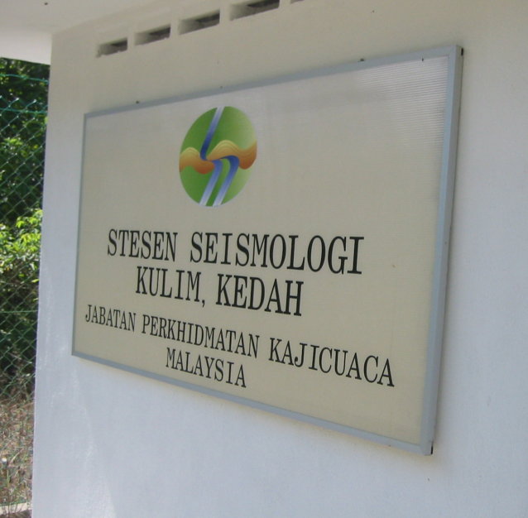
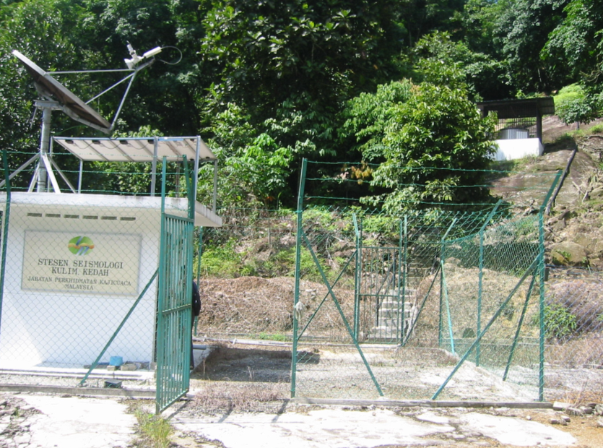
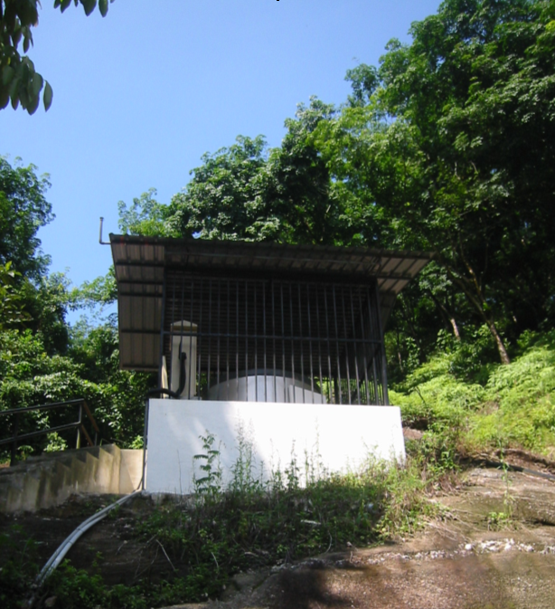
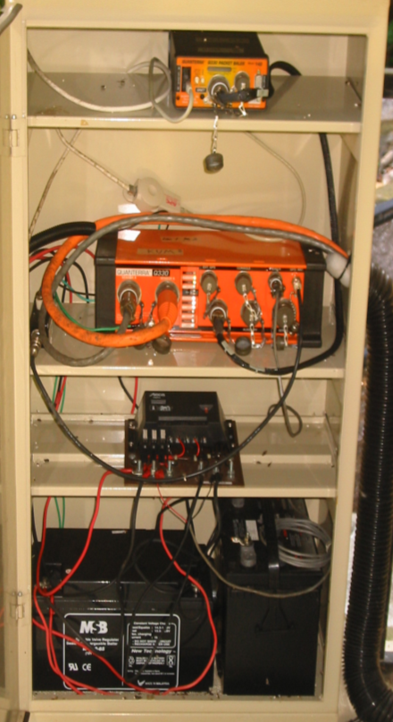
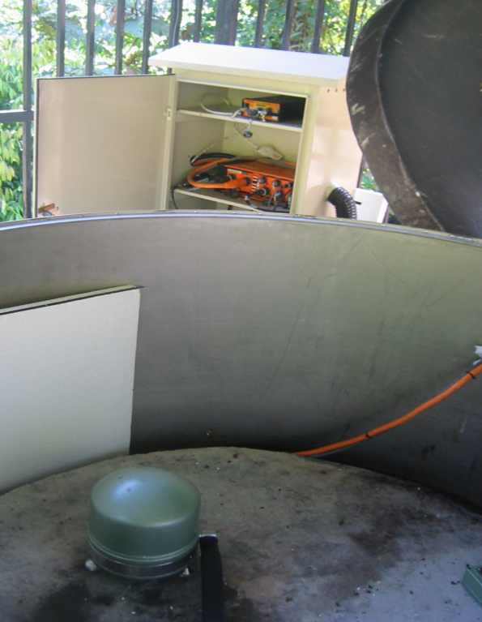
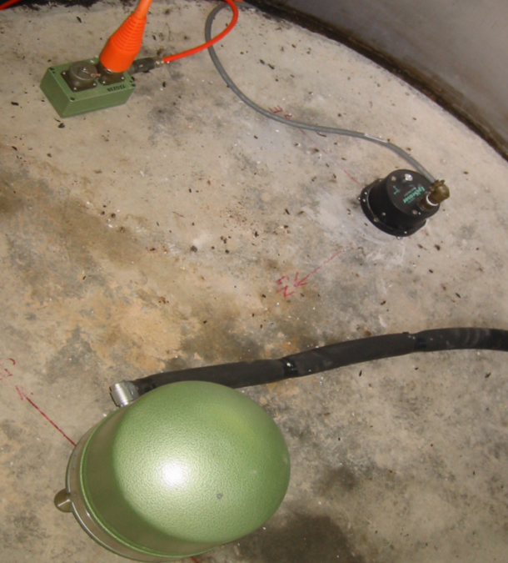
INSTRUMENTATION AT REMOTE
SEISMIC STATION
VSAT
Data Logger PB14
Digitiser Q330
ES-T EpiSensor
Charge Controller
Power Supply
Broadband Strekeisen STS-2

Slide 9
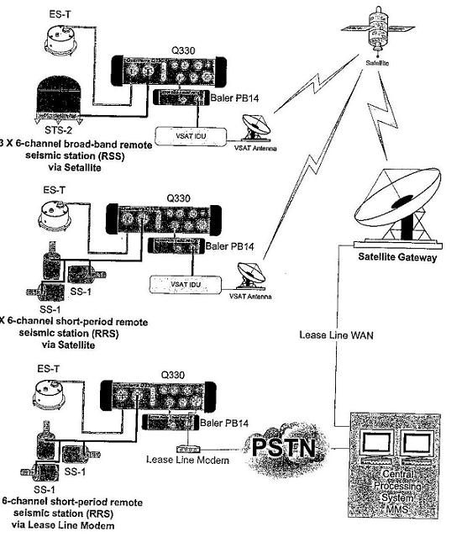
10 Stations
KUM
IPM
KOM
KSM
SBM
KKM
LDM
BNM
SPM
JRM
6 Stations
KGM
KTM
BTM
SDM
TDM
KDM
1 Station
FRIM

Slide 10
METADATA MALAYSIA NATIONAL SEISMIC NETWORK
 | Station Name | Code | Latitude | Longitude | Data Logger | Digitizer | Seismometer | Accelerometer | Telemetry
1 | Kulim | KUM | 5.2902 | 100.6492 | Baler 14D | Q330 | STS2 | ES-T | VSAT
2 | Ipoh | IPM | 4.4795 | 101.0255 | Baler 14D | Q330 | STS2 | ES-T | VSAT
3 | Jerantut | JRM | 3.8867 | 102.4767 | Marmot | Q330 | STS2.5 | ES-T | VSAT
4 | Kota Tinggi | KOM | 1.7922 | 103.8467 | Baler 14F | Q330 | STS2 | ES-T | VSAT
5 | Kuching | KSM | 1.4733 | 110.3083 | Baler 14D | Q330 | STS2 | ES-T | VSAT
6 | Sibu | SBM | 2.4529 | 112.214 | Baler 14D | Q330 | STS2 | ES-T | VSAT
7 | Bakun | BNM | 2.7767 | 114.035 | Baler 14D | Q330 | STS2 | ES-T | VSAT
8 | Sapulut | SPM | 4.7083 | 116.465 | Baler 14D | Q330 | STS2 | ES-T | VSAT
9 | Lahad Datu | LDM | 5.1777 | 118.498 | Baler 14F | Q330 | STS2 | ES-T | VSAT
10 | Kota Kinabalu | KKM | 6.0443 | 116.2147 | Baler 14D | Q330 | STS2 | ES-T | VSAT
11 | K.Terengganu | KTM | 5.328 | 103.1356 | Baler 14D | Q330 | SS1 | ES-T | VSAT
12 | Kluang | KGM | 2.0157 | 103.319 | Baler 14D | Q330 | SS1 | ES-T | VSAT
13 | FRIM | FRIM | 3.237 | 101.625 | Baler 14D | Q330 | SS1 | ES-T | Lease Line
14 | Sandakan | SDM | 5.6409 | 117.195 | Baler 14D | Q330 | SS1 | ES-T | VSAT
15 | Kudat | KDM | 6.936 | 116.806 | Baler 14D | Q330 | SS1 | ES-T | VSAT
16 | Tawau | TSM | 4.2936 | 117.8725 | Baler 14D | Q330 | SS1 | ES-T | VSAT
17 | Bintulu | BTM | 3.206 | 113.099 | Baler 14D | Q330 | SS1 | ES-T | VSAT
Current Station: 10 BroadBand & 7 Short Period

Slide 11
METADATA MALAYSIA NATIONAL SEISMIC NETWORK
 | Station Name | Code | Latitude | Longitude | Data Logger | Digitizer | Seismometer | Accelerometer | Telemetry
1 | Temenggor | TPM | 5.41117 | 101.2929 | Baler 14D | Q330s | STS2.5 | ES-T | VSAT
2 | Kuala Krai | KRM | 5.5151 | 102.1931 | Baler 14D | Q330s | STS2.5 | ES-T | VSAT
3 | Batu Kikir, Kuala Pilah | BKM | 2.8579 | 102.2710 | Baler 14D | Q330s | STS2.5 | ES-T | VSAT
4 | Batang Ai,Betong | BIM | 1.17 | 111.8 | Baler 14F | Q330s | STS2.5 | ES-T | VSAT
5 | Murum | MUM | 2.6456 | 114.37 | Baler 14D | Q330s | STS2.5 | ES-T | VSAT
6 | Semporna | SMM | 4.4398 | 118.6220 | Baler 14D | Q330s | STS2.5 | ES-T | VSAT
7 | Ranau | RNM | 5.95481 | 116.68159 | Baler 14D | Q330s | STS2.5 | ES-T | VSAT
8 | Danum Valley | DVM | 4.98038 | 117.84421 | Baler 14D | Q330s | STS2.5 | ES-T | VSAT
Future Station: 8 BroadBand Sensor (Operational End of 2015)

Slide 12
MNTEWS System Overview
Data & Information Collection Component
Processing Component
Dissemination Component
SEISMIC
Tsunami Operations Centre
Information And Warning Dissemination
DEEP OCEAN BUOY
TIDE GAUGE
COASTAL CAMERA NETWORK
Data Communications
Integration
Analysis
Modelling
Decision Making
SMS
Telefax
Webcast
Linkage PTWC / JMA / Others
Siren / PA
Media Broadcast
Mini Studio

Slide 13
RELATED PRODUCT BY MMD
DATABASE OF EARTHQUAKES – Felt and Local
INTENSITY MAP FROM MICROSEISMIC
STUDY
PLOTTING EARTHQUAKE
PHASE DATA – INCLUDING PRIMARY,
SECONDARY AND ARRIVAL TIME

Slide 14
THANK YOU

