Slide 1
NATIONAL CENTER FOR SEISMOLOGICAL RESEARCH CUBA NETWORK REPORT
Eng. Manuel Cutie Mustelier
MSc. Griselda Despaigne L.
PhD. Olearys Gonzalez Matos
2014

Slide 2
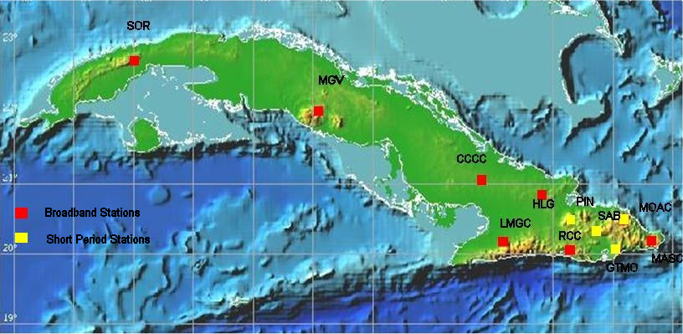
NATIONAL CENTER FOR SEISMOLOGICAL RESEARCH CUBA Distribution of Seismic Stations

Slide 3
NATIONAL CENTER FOR SEISMOLOGICAL RESEARCH CUBA
Station | Channel | Network | Location Code | Longitude | Latitude | Local Name | Sensor | Digitizer | Communication
RCC | HHZ HHN HHE | CW | 00 | -75.6965 | 19.9950 | Rio Carpintero | Geodevice BBVS 60 (60 seconds) BBAS-2 | Geodevice EDAS24IP6 | Satellital
MASC | HHZ HHN HHE | CW | 00 | -74.2312 | 20.1755 | Maisi | Geodevice BBVS 60 BBAS-2 | Geodevice EDAS24IP6 | ADSL
LMGC | HHZ HHN HHE | CW | 00 | -77.0045 | 20.0646 | Las Mercedes | Geodevice BBVS 60 BBAS-2 | Geodevice EDAS24IP6 | ADSL
HLG | HHZ HHN HHE | CW | 00 | -76.35867 | 20.9280 | Holguin | Nanometrics Trillium 120P | Nanometrics Taurus | Satellital
CCCC | HHZ HHN HHE | CW | 00 | -77.4173 | 21.1934 | Cascorro | Geodevice BBVS 120 (120 seconds) | Geodevice EDAS24IP3 | Satellital
MGV | HHZ HHN HHE | CW | 00 | -79.9796 | 22.1194 | Manicaragua | Geodevice BBVS 60 | Geodevice EDAS24IP3 | ADSL
SOR | HHZ HHN HHE | CW | 00 | -83.0086 | 22.7932 | Soroa | Geodevice BBVS 60 | Geodevice EDAS24IP3 | ADSL
MOAC | EHZ EHN EHE | CW | 00 |  |  | Moa | Geodevice FSS-3M BBAS-2 | Geodevice EDAS24IP6 | ADSL
SAB | EHZ EHN EHE | CW | 00 |  |  | Sabaneta | Geodevice FSS-3M | Geodevice EDAS24IP3 | Radio
PIN | EHZ EHN EHE | CW | 00 |  |  | Pinares Mayari | Geodevice FSS-3M | Geodevice EDAS24IP3 | Radio
GTMO | EHZ EHN EHE | CW | 00 |  |  | Malone | Geodevice FSS-3M | Geodevice EDAS24IP3 | Radio

Slide 4
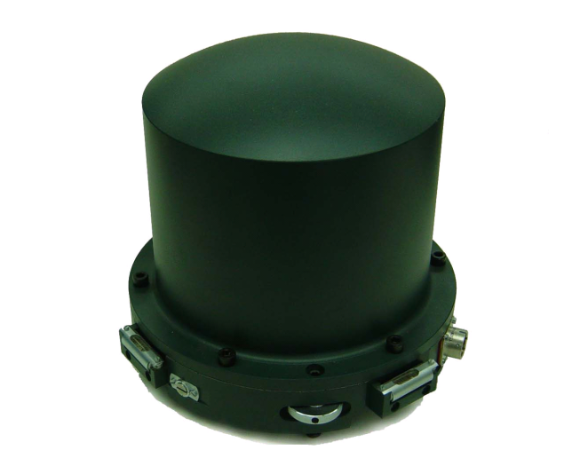
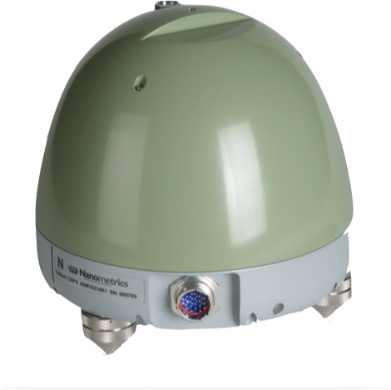
NATIONAL CENTER FOR SEISMOLOGICAL RESEARCH CUBA
Broadband Seismometers
BBVS-60 (120) Geodevice China
Main period 60 s. (120s)
Frequency Range 0.0167 (0.0083) Hz – 40 Hz
Sensitivity 2000 V/m/s
Dynamic Range140 db.
Trillium 120 PA Nanometrics
Main period 120 s
Frequency Range 0.0083 – 145 Hz
Sensitivity 1200 V/m/s
Clip Level >15 mm/s up to 1.5 Hz

Slide 5
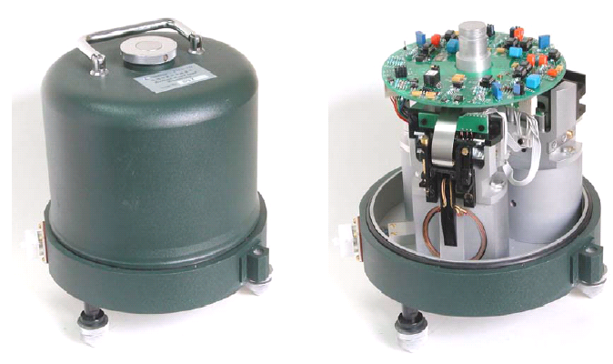
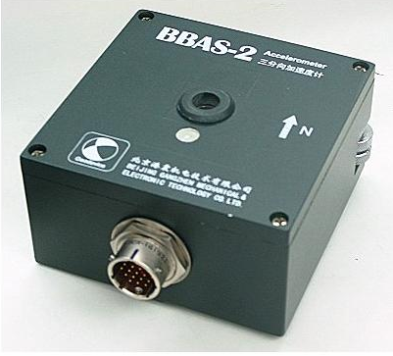
NATIONAL CENTER FOR SEISMOLOGICAL RESEARCH CUBA
Short Period Seismometers
FSS-3M Geodevice China
Triaxial
Main period 2s.
Frequency Range 0.5– 60 Hz
Sensitivity 2000 V/m/s
Dynamic Range > 120 db.
Accelerometers
BBAS-2 Geodevice China
Range ±4g (2g) optional
Frequency Range 0 – 100 Hz
Sensitivity 5V/g (differential)
Dynamic Range >135 db.

Slide 6
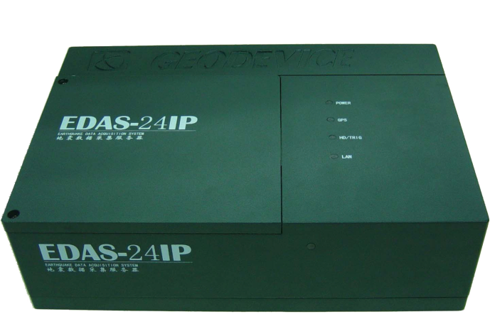
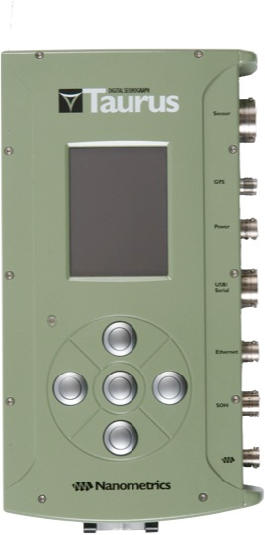
NATIONAL CENTER FOR SEISMOLOGICAL RESEARCH CUBA
Digitizers
EDAS/24IP3 (6) Geodevice China
Channels : 3 (6)
24 bits A/D Converter
Dynamic Range 135 db.
8 Gb Memory Flash.
Communications Ethernet port. Serial Port
FTP, Telnet
GPS
Taurus Nanometrics
Channel: 3
Sensitivity 1 count/microvolts (gain 1)
Input voltage range 40V pp. differential (gain 0.4)
Dynamic Range > 140 db.

Slide 7
NATIONAL CENTER FOR SEISMOLOGICAL RESEARCH CUBA
CENTRAL STATION DATA FLOW
Apollo Server
Nanometrics Taurus Digitizer HLG CW
Automatic Location
Rest of National Stations CW
Earthworm System
Manual Location
SEISAN
International Stations IRIS
Winston Wave Server
SWARM

Slide 8
NATIONAL CENTER FOR SEISMOLOGICAL RESEARCH CUBA
The primary products of our seismic network:
1. Recorded Seismic Events Daily report (the last 24 hours.) 2. Network´s Status Daily report (the last 24 hours.) 3. Recorded Seismic Events Weekly report. 4. Recorded Seismic Events Monthly report. 5. Felts seismic events report. 6. Anomalous seismicity report. 7. Annual Report and the Earthquake Catalog. An analysis and assessment of annual seismicity is made.

Slide 9
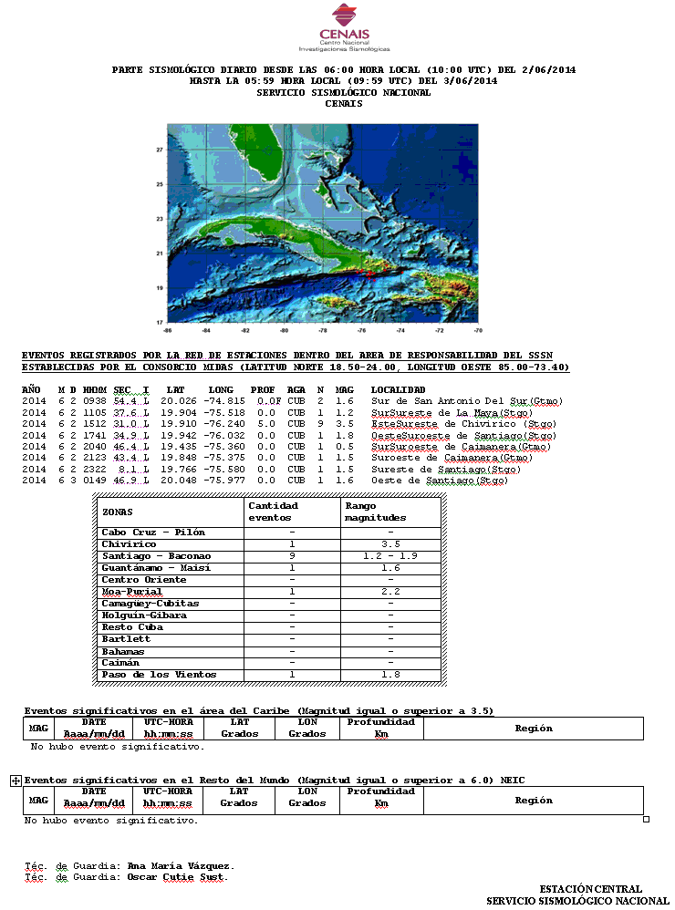
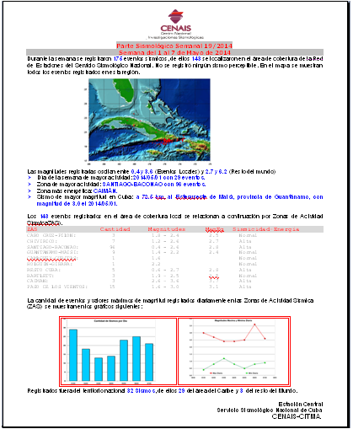
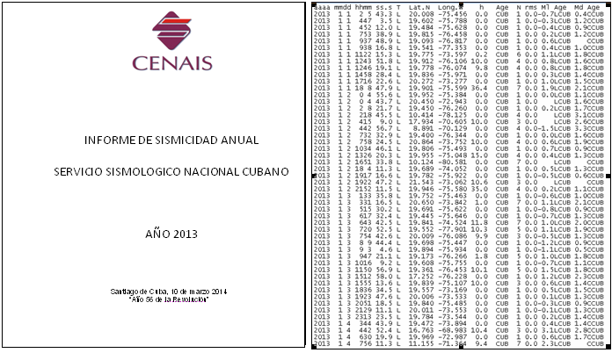
NATIONAL CENTER FOR SEISMOLOGICAL RESEARCH CUBA
Daily report
Weekly report
Seismological Annual Report

Slide 10
NATIONAL CENTER FOR SEISMOLOGICAL RESEARCH CUBA
Projects for next years
Introduce the SEISCOMP System in our Central Station
Installation of an Accelerograph Network in Santiago de Cuba as part of a Rapid Respond System for this city.
Increase the number of stations in the network and in this way improve the covering area as well as the monitoring capacity of our system for local and regional seismicity
Share the data of our stations with the international community through IRIS DMC

