Slide 1
Rick Benson
Tuesday, January 10, 11:05am

Slide 2
Metadata & RESP files
SEED Notes and Shortcuts

Slide 3
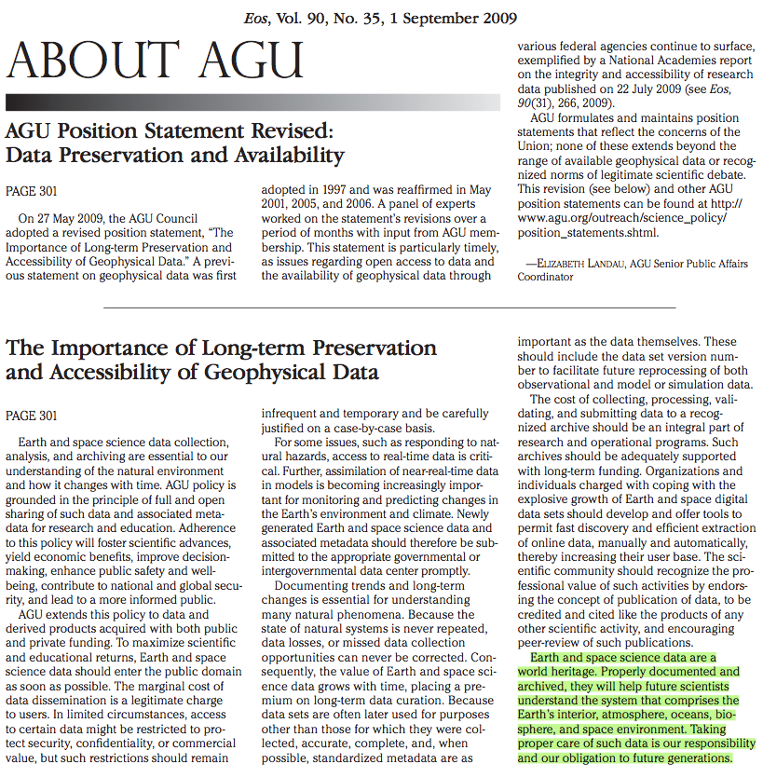
Data Preservation is Important
“Because the state of natural systems is never repeated,
data losses, or missed data collection opportunities
can never be corrected. Consequently, the value of
Earth and space science data grows with time, placing
a premium on long-term data curation.”
EOS
Policy
Statement
“Earth and space science data is a world heritage.
properly documented and archived, they will help future
scientists understand the system that comprises the Earth’s
interior…………..and space environment.”
Closes by stating:
“Taking proper care of such data is our responsibility
and our obligation to future generations”.

Slide 4
Why is metadata important?
They are the Rosetta Stone- making it possible to decode
information well into the future
Increases accessibility: “tell me where sites are in a
region”, or “what are station names in an area”, or “what
instruments operate in a region”, etc.
Carefully created, they create both short and long-term
benefits by capturing “tribal knowledge” when it’s
still available, like equipment (serial numbers), sample rates,
gains, documenting an accurate history of ground motion
Retention of context- who operates instruments, etc
Remember: People forget!

Slide 5
Metadata In(di)gestion
Functionally, we use “technical” metadata, in that it is used to
describe how the seismic system behaves, and limited
software description (like compression, etc)
metadata can be shared in dataless SEED,
which makes metadata “portable” amongst heterogeneous
systems
Whenever anything changes at a site,
new metadata should be exchanged with
archives or other networks using it

Slide 6
First: Registering Network and Stations
To request a FDSN network code, start here for either a permanent or temporary network code:
http://www.iris.edu/scripts/getcode.html
To register your stations with the World Data Centers ISC and NEIC, start here:
http://www.isc.ac.uk/IR/reg.html
This should be done before sharing data or parametric data with other agencies.

Slide 7
SEED Comments:
SEED format designed for data exchange and archiving. Only now becoming more common in processing, so format conversion likely required.
Coordinates in decimal degrees
+121.135 and NOT 121⁰ 8’6’’
Elevation in Meters
Velocity and displacement in Meters
Acceleration in meters/sec²

Slide 8
SEED v2.4 Manual
http://www.iris.edu/manuals/seed/SEEDManual_V2.4_Appendix-A.pdf

Slide 9
Introduction to SEED
Recommended reading for an overview of SEED is this Chapter from the SEED manual, which is also located on your USB stick.
http://www.iris.edu/manuals/SEED_chpt1.htm
Includes notes about Design Goals and Strategies,
Recommended Uses, and conventions.

Slide 10
Channel naming convention for common sensors:
A gain of 250 V/m/s was
somewhat arbitrarily chosen
as the division between
'High gain' and 'Low gain'
for velocity sensors.
Those 250 V/m/s and higher
would use “H” as the
instrument code, those less
than 250 V/m/s would use “L”.

Slide 11
High Gain vs. Low Gain
Notes:
This division places the STS-2, Guralps, Trilliums, S-13, and HS-10 in the high gain regime (for SEED channel naming) and the Mark Products sensors in the low-gain regime. [a search of the DMC's database shows the HS-10 (gain = 300 V/m/s @ 10 Hz) has been archived as a high gain sensor. The choice of 250 V/m/s therefore is consistent with the only instrument code used for previous submissions of HS-10 data.]

Slide 12
Notes about SEED “channels”
For consistency with the SEED manual, “L” is recommended as the instrument code for the 4.5 Hz geophone sensor, though in practice it is considered a geophone. Example: LLE, LLN, LLZ
The SEED manual recommends “P”, the geophone code, for sensors with a natural frequency of 5 - 10 Hz and higher. Example: LPE, LPN, LPZ
For accelerometers, the use of the broad-band band codes "H" and "B" for the band code of the channel name are recommended. While the term "broad-band" is typical with respect to the flat portion of the response curve of velocity sensors, its use is logical for accelerometers, considering their responses are flat with respect to acceleration. Example: HNE,HNN, HNZ

Slide 13
RESP format files and info
Files are named like this:
RESP.IU.CHTO.00.BHZ or
RESP.IU.CHTO..BHZ without location code.
The program RDSEED creates and supports the format
http://www.iris.washington.edu/manuals/rdseed.htm
For Windows Users: Jrdseed
http://www.iris.washington.edu/manuals/jrdseed.htm
Created on command line with syntax like this
Rdseed –fR ‘SEED_volume’ OR
rdseed -f IU.CHTO.dataless –R gives the same output but using
the dataless SEED volume on your USB drive.

Slide 14
What’s in a RESP file?
The Response is carefully derived from first principles:
ground motion (meters) -> sensor -> Volts -> electronics -> volts -> Analog-to-digital converter -> counts -> digital filters -> counts
Therefore, RESP files contain all the digital filter information,
Something that SAC Pole/Zero (PZ) files do not

Slide 15
Example RESP file, cascade
Stage 1=
Sensor
In this case,
KS-54000
Borehole in
Chiang Mai, Thailand
Goes from M/S ground
Motion to Volts

Slide 16
Stage 2 = Datalogger
Volts are converted
To counts

Slide 17
Stage 3-n = Digital Filtering & Downsampling
Transfer function type

Slide 18
Reporting Filter Delays & Decimation

Slide 19
Overall Gain (also called Sensivitity)
The very last stage in the response cascade is the overall
gain of the whole system, which is the Multiple of all stage
gains at the same frequency, and called Stage 0

Slide 20
Where can I get RESP files?
These are produced using ‘rdseed’:
Rdseed –fR SEED.volume (either dataless or full)
Viewed using “metadata aggregator” or http://www.iris.edu/mda at the channel level.
IRIS also has a Web Service located at http://www.iris.edu/ws/ where one service is RESP file returns at http://www.iris.edu/ws/resp/

Slide 21
The End

