Slide 1
Federation of Digital Broad-Band Seismograph Networks
The FDSN and Sustainable Seismic Networks
Gerardo Suárez
Instituto de Geofísica, UNAM
México

Slide 2
Federation of Digital Broad-Band Seismograph Networks
The FDSN: Origins
Founded in 1985 to bring together digital broad-
band seismic networks
Support national institutions and seismic networks
moving into the broad-band seismic technology
Coordinate the location of new seismic stations to
avoid duplications and promote global distribution
FDSN has commission status within IASPEI
(International Association of Seismology and
Physics of the Earth Interior)

Slide 3
Federation of Digital Broad-Band Seismograph Networks
The FDSN: Goals
Coordinates site selection, data exchange and
instrument standardization
Promotes the installation of seismic stations. There
are about 2000 broad band sites now; 200 in real
time (backbone stations)
Promote a variable network geometry approach:
local, regional, national, worldwide scales
Promotes de the deployment of ocean bottom
seimometers

Slide 4
Federation of Digital Broad-Band Seismograph Networks
The FDSN: A Unique Organization
FDSN does not have inter-governmental status
Has no budget
No permanent staff
Operated by support offered by member institutions

Slide 5
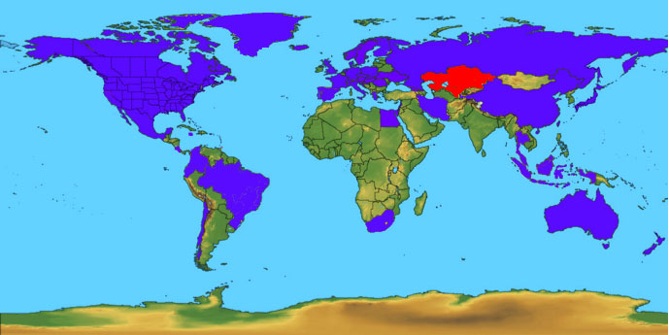
FDSN Membership in 2007 66 institutions in 53 countries
Australia
Austria
Brazil
Bulgaria
Canada
Chile
China (CSB & CAS)
Columbia (Ingeominas & Osso)
Costa Rica
Croatia
Czech Republic
Denmark
Ecuador
Egypt
European Union (ORFEUS)
Finland (Helsinki & Sodankyla)
France (Geoscope & ReNaSS)
Georgia
Germany (GEOFON & GRSN)
Greece (NOA, Thessaloniki)
Hungary
Iceland
Indonesia
Iran
Israel
Italy (ING-V & OGS)
Jamaica
Japan (ERI & NEID)
Kazakhstan
Macedonia
Malaysia
Mexico
Netherlands
New Zealand
Nicaragua
Norway
Poland
Portugal (CGUL & IST)
Romania
Russia
Slovakia
Slovenia
South Africa
Spain
Sweden
Switzerland
Taiwan
Tajikistan
Thailand
United Arab Emirates
United Kingdom
USA (IRIS, NCSN, PRSN, SCSN & USGS)
Uzbekistan
Red indicates countries that have contributed to the FDSN Archive
Yellow indicates countries pending FDSN membership approval

Slide 6
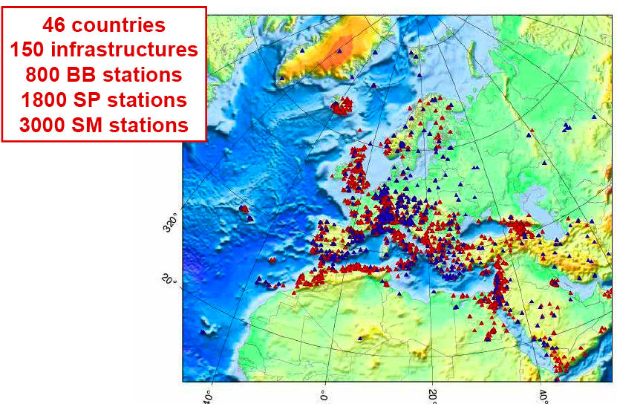

Slide 7
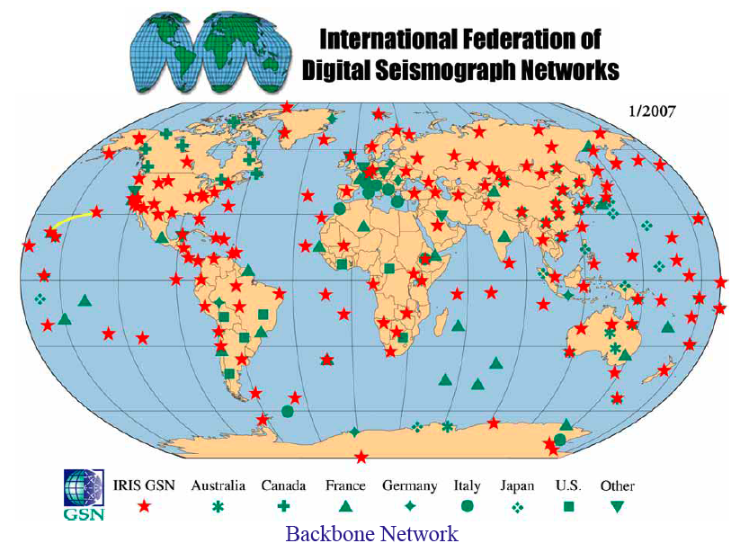

Slide 8
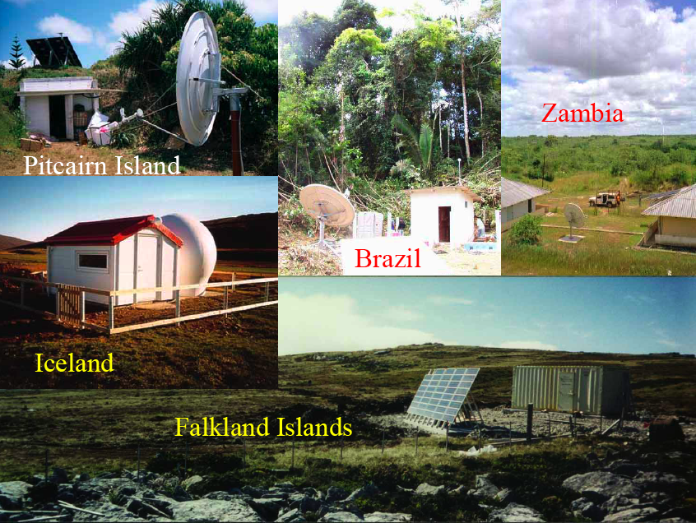
Federation of Digital Broad-Band Seismograph Networks

Slide 12
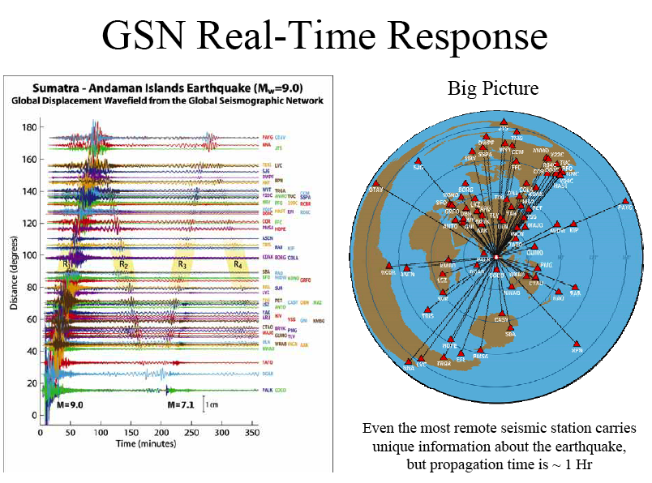

Slide 13
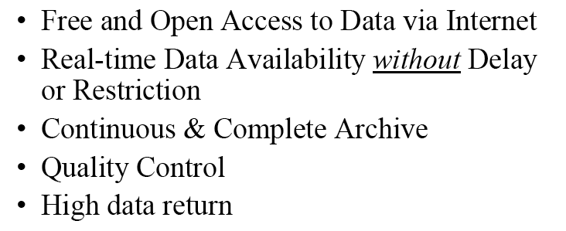
Federation of Digital Broad-Band Seismograph Networks
Data Distribution Performance Goals

Slide 14
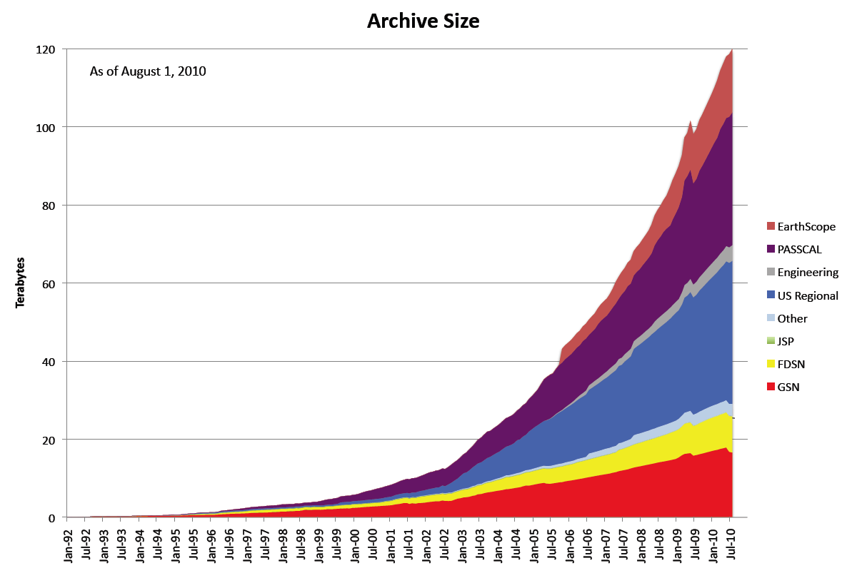
The IRIS Archive Growth

Slide 15
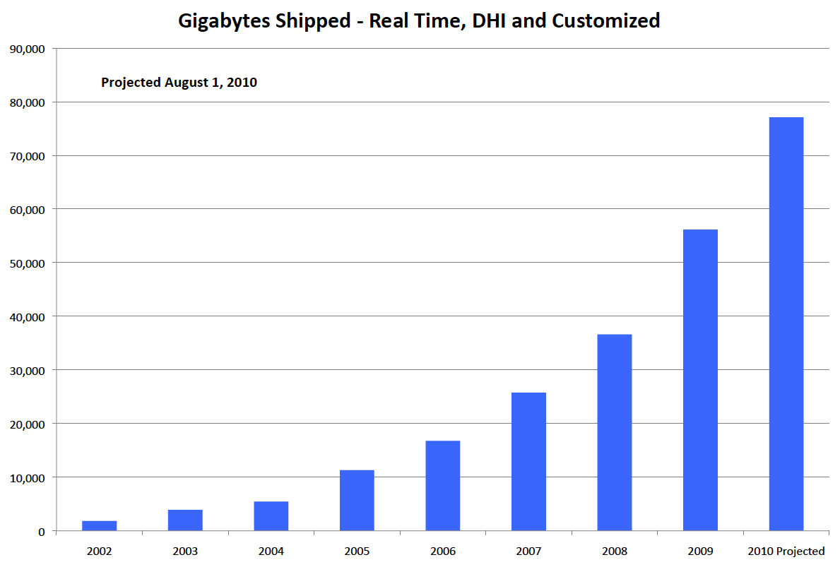
FDSN Archive (non-US)

Slide 16
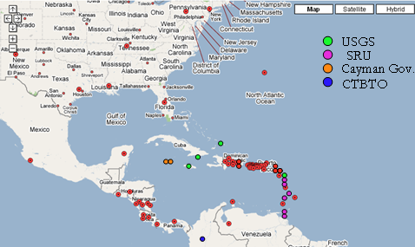
Near Future RT seismic stations for the CTWS
http://temblor.uprm.edu/GMap/GoogleEB.html

Slide 17
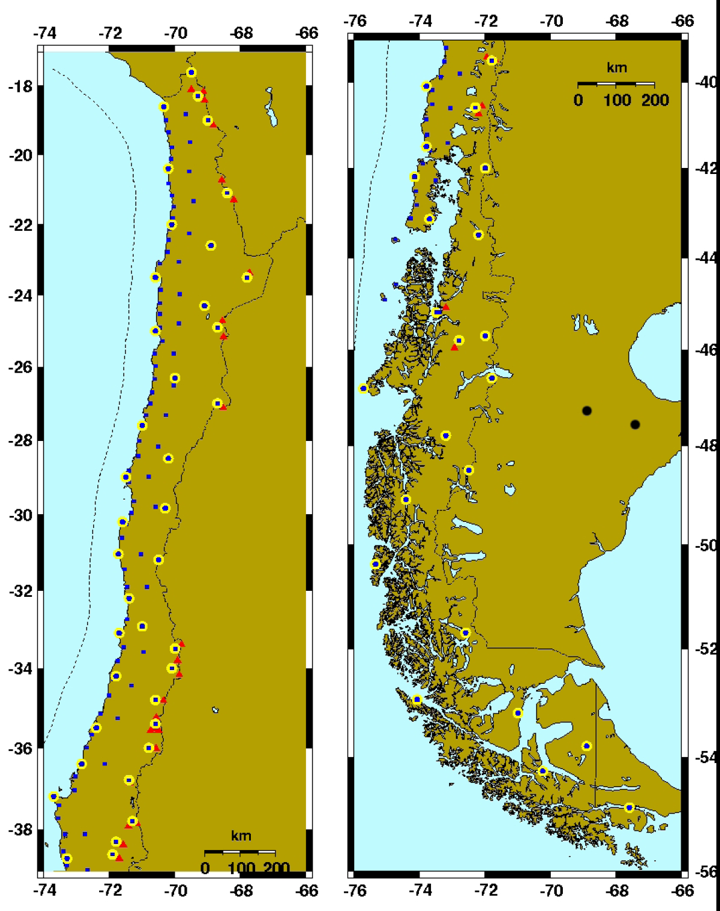
Planned
Seismic and Geodetic
Network in Chile

Slide 18
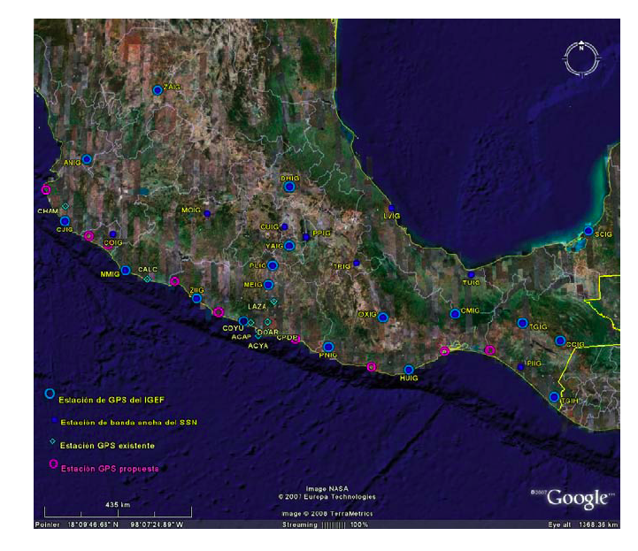
Proposed
Expansion of
The Mexican
Seismic Network

Slide 19
Federation of Digital Broad-Band Seismograph Networks
The FDSN Challenges:
Encourage and support the development and
Implementation of tools for societal benefit:
Early damage assessment
Tsunami and earthquake warning efforts
Shake maps
Long-term scientific research
Source Characterization

Slide 20
Federation of Digital Broad-Band Seismograph Networks
Future Challenges for the FDSN Community:
Maintain the current infrastructure
Diversify the offer of products and services
Improve the coverage of broad band stations
Enlarge the number of FDSN members
and broad band stations transmitting real time
Improve coverage by offering societal advantages
Increase the number of broad band stations

Slide 21
Federation of Digital Broad-Band Seismograph Networks
THANK YOU!

