Slide 1
NRL: Nominal Response Library & The NRL Tool

Slide 2
SEED Metadata
SEED headers are comprehensive with many required fields. Creating proper SEED metadata requires many details, particularly the channel response information.
The Nominal Response Library (NRL) provides a catalog of response information for many common sensors and data recorders.

Slide 3
The IRIS Nominal Response Library
http://www.iris.edu/NRL
Verified with the manufacturer
Integrated into PDCC using NRL Tool
Flexible design for updates and merging

Slide 4
NRL Components
Each instrument and digitizer in the NRL is represented by a SEED RESP file.
Categorized by equipment type and manufacturer
HTML web pages for detailed information not readily available elsewhere

Slide 5
NRL Tool
Features:
Integrated into PDCC
Selection of complete instrument (sensor and data logger) from NRL
Merging NRLs (e.g. IRIS and local)

Slide 6
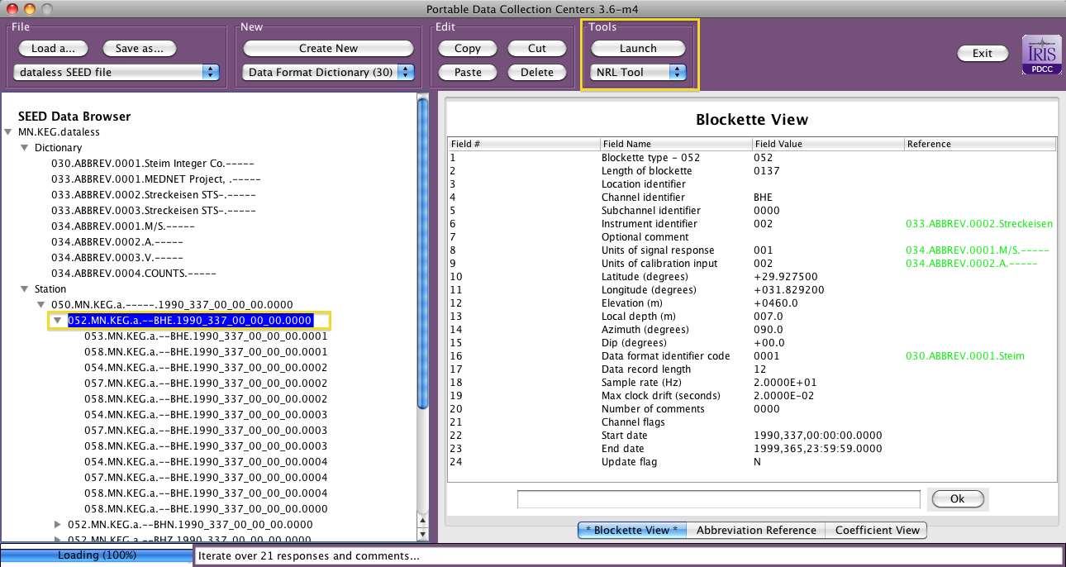
How to launch NRL Tool in PDCC

Slide 7
NRL Tool Demo
Reminders:
A channel (Blockette 052) must be selected before launching NRL Tool
NRL Tool will replace the response information for the selected channel

